Slide 1

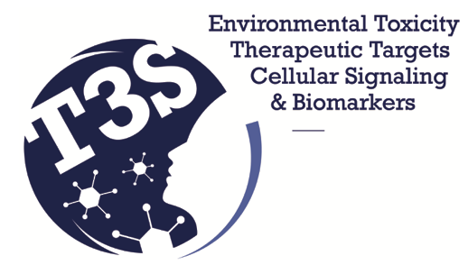
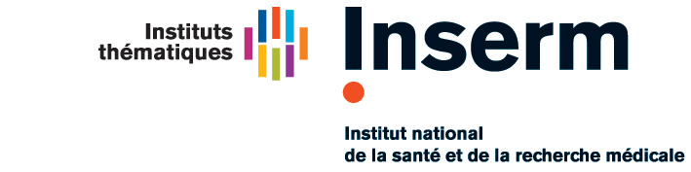
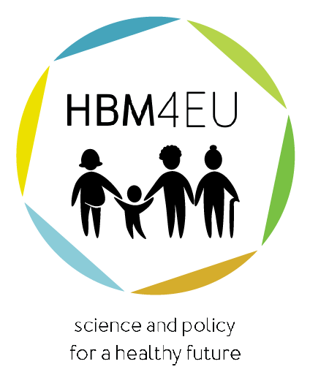



Air pollution and the liver
including liver cancer
Paris Hepatology Conference 2023
Paris
27 March 2023
Robert Barouki
INSERM UMR-S 1124, T3S
Service de Biochimie métabolomique et Protéomique
Hôpital Necker enfants maladies
Université de Paris

Slide 2
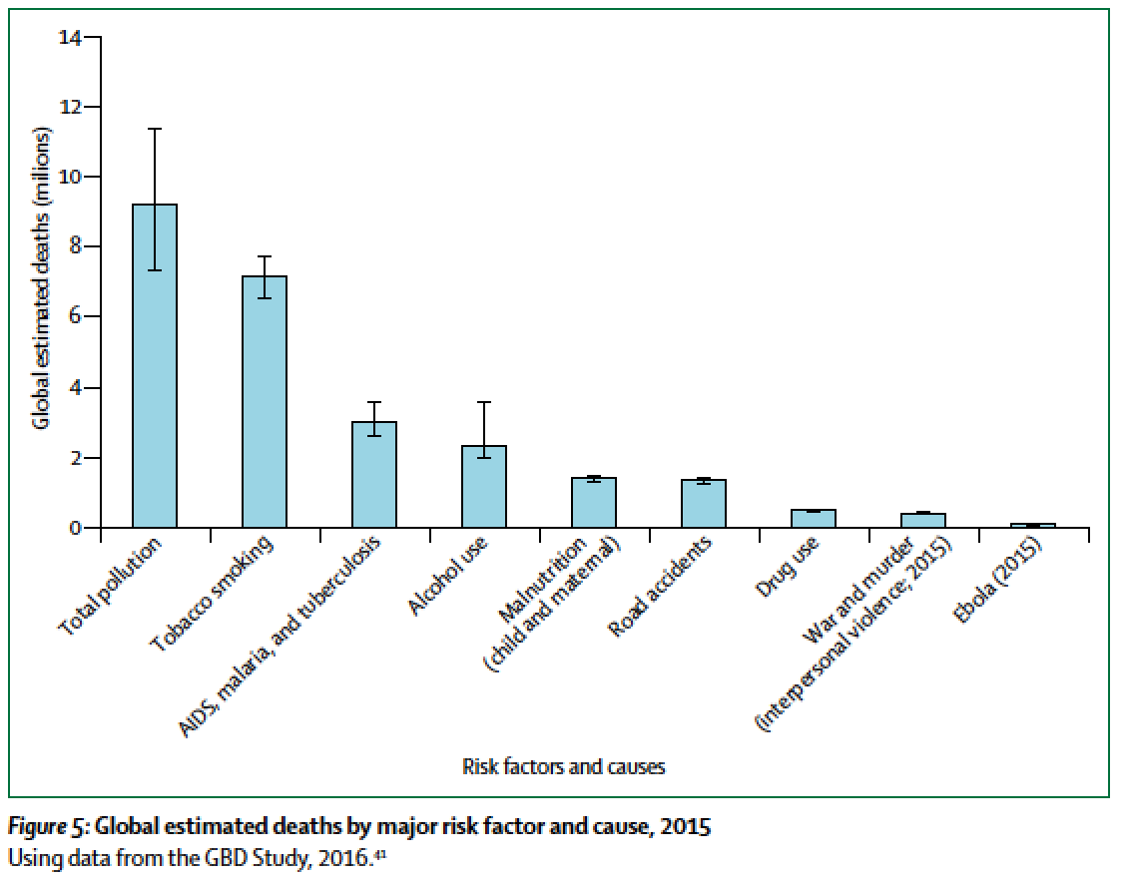
Pollution and Health
Air pollution is the major contributor to total pollution death toll
7 million deaths per year from air pollution
Landrigan et al, Lancet, 2018

Slide 3
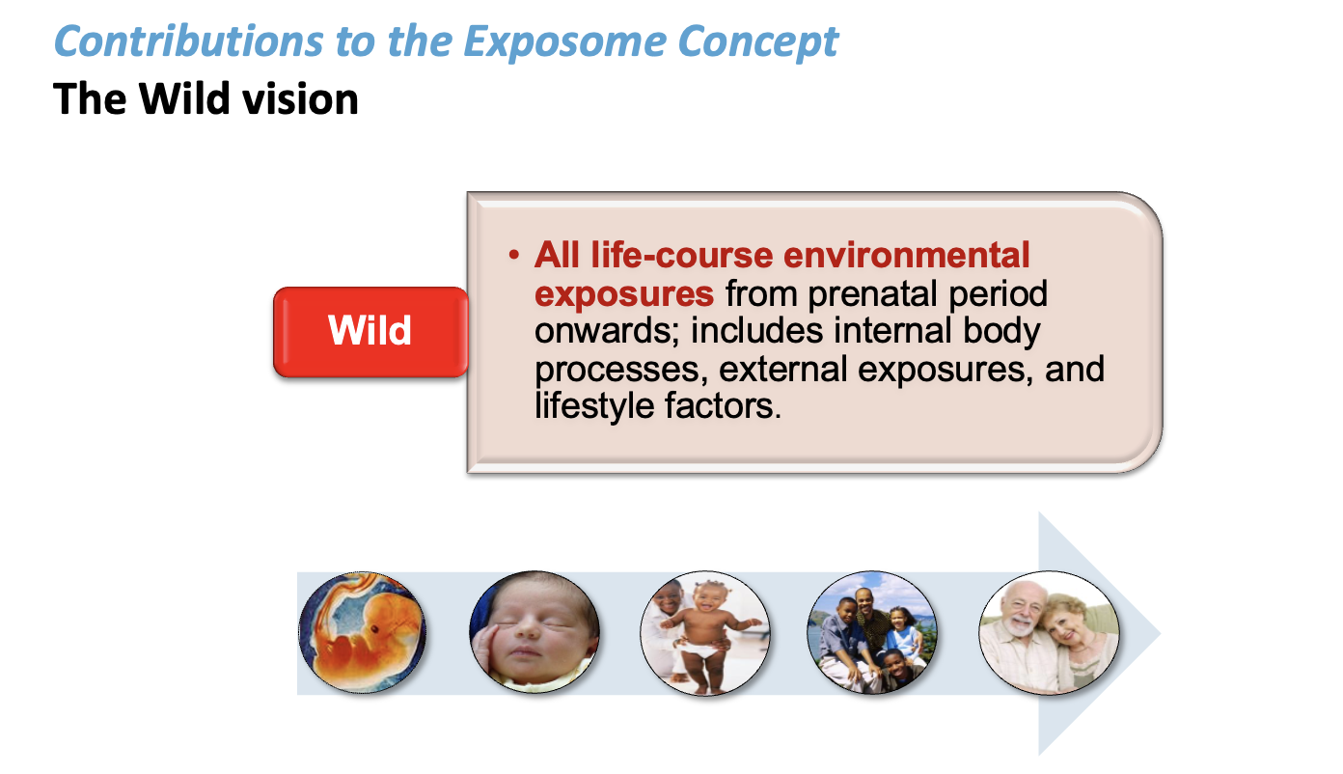

Slide 4
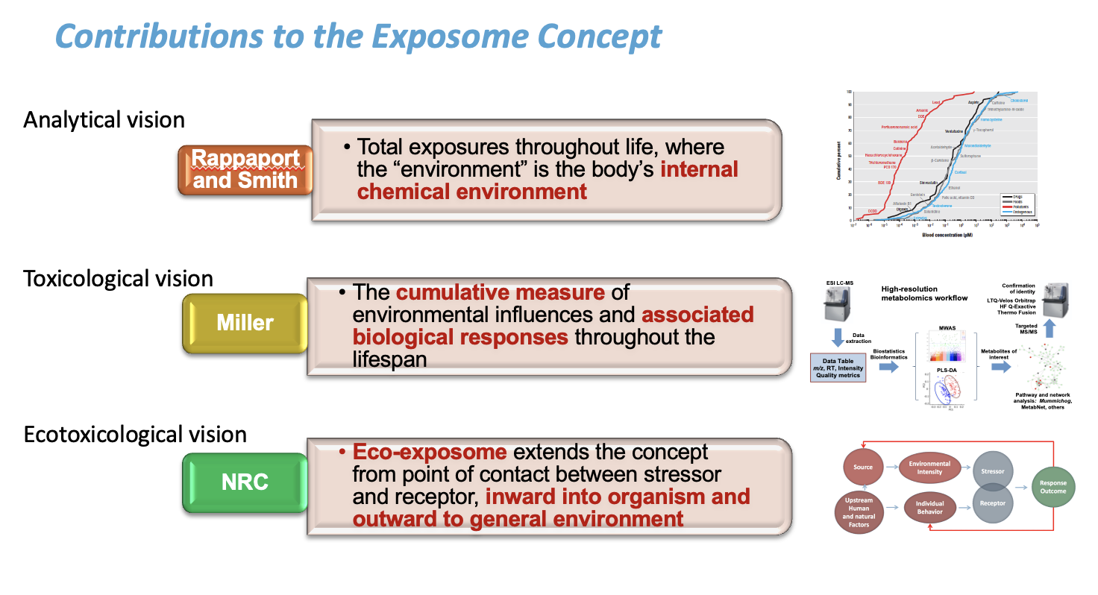

Slide 5
Major chronic diseases or conditions linked to the environment
Cancers (different types)
Hormonal and reproductive diseases and conditions;
developmental neurotoxicity and neurodegeneration
Obesity, metabolic diseases,
Cardiovascular and respiratory diseases
Liver and GI diseases
immune diseases, allergies
developmental diseases and malformation

Slide 6
Traditional exposure determinants of liver diseases
Liver diseases
Medical drugs; drugs/narcotics; alcohol
Chemical contaminants: toxins; occupational, some environmental, tobacco smoke
Infectious agents: viruses, parasites, bacteria
Nutritional imbalance

Slide 7
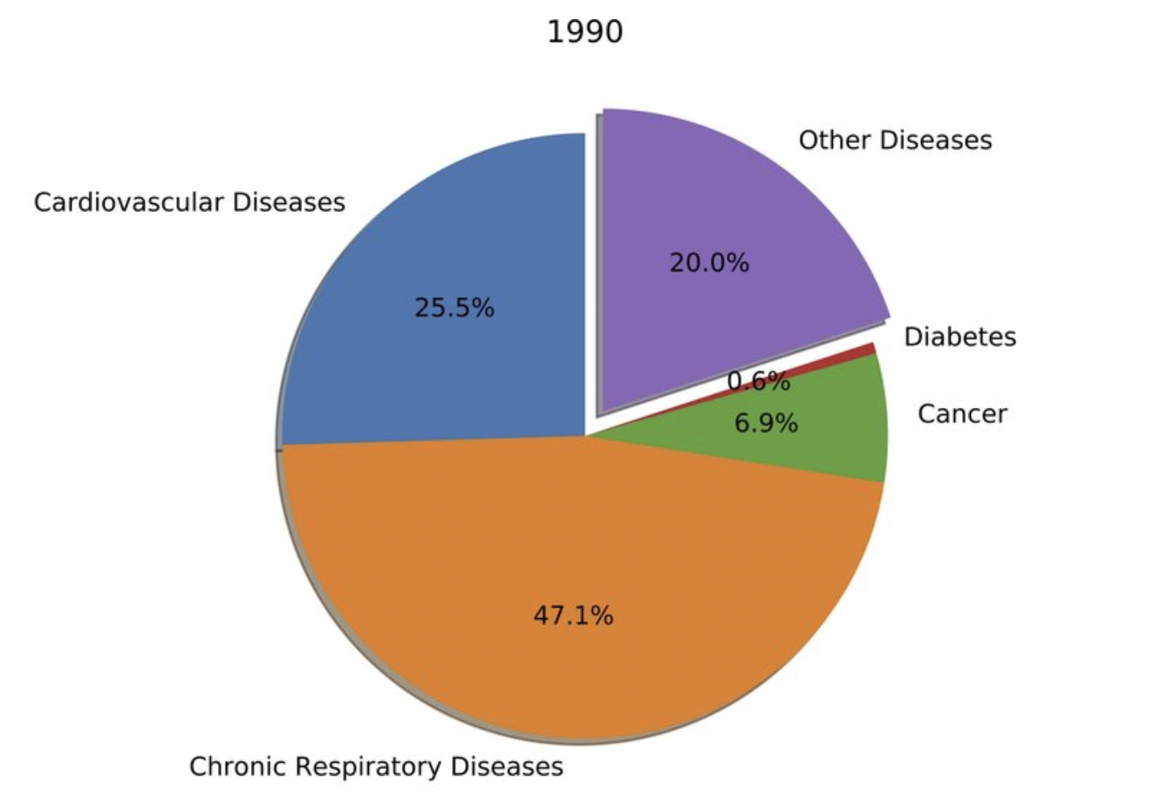
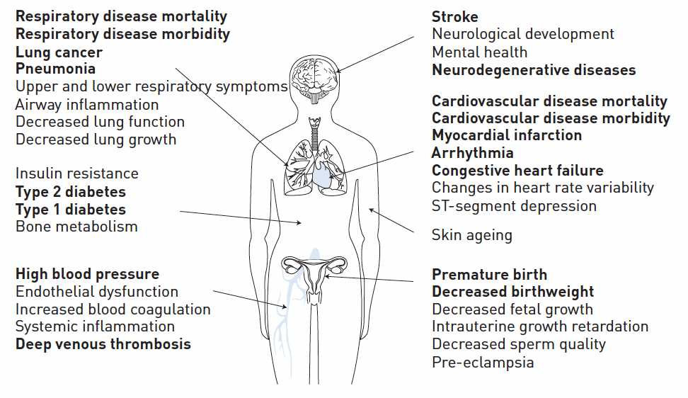
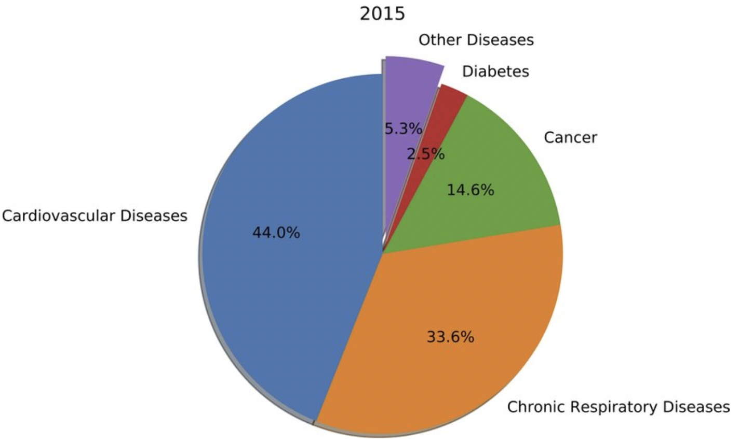
Health effects of air pollution
Thurston et al, Eur Resp J, 2017
Chen and Bloom, Plos one, 2019

Slide 8
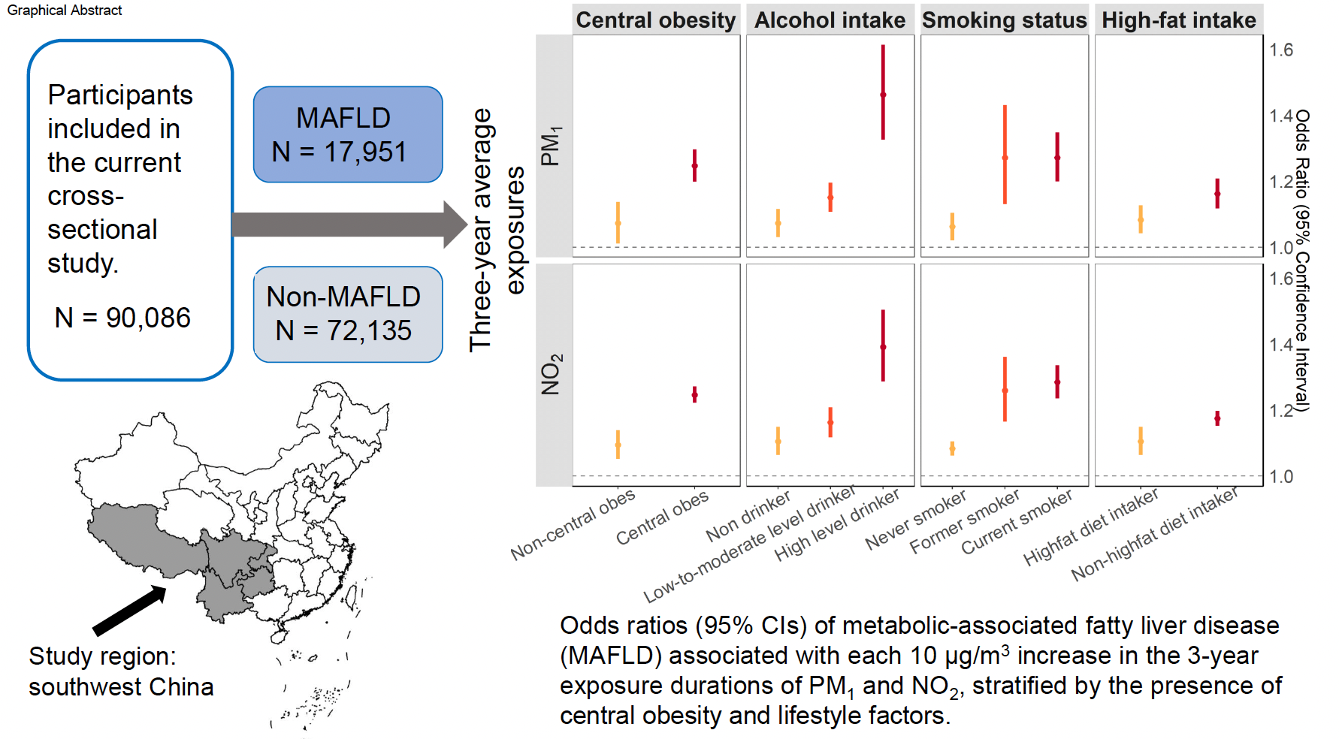
Air pollution and MAFLD: epidemiological study

Slide 9
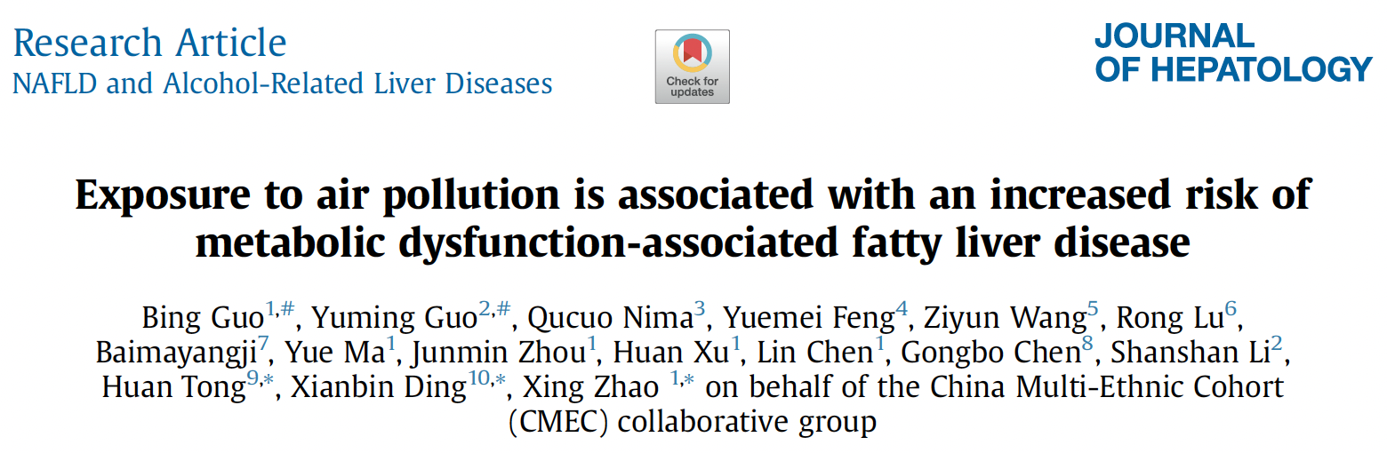
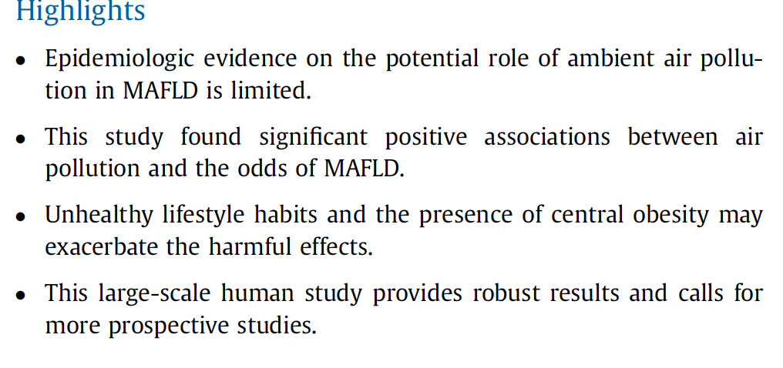
Air pollution and MAFLD: epidemiological study

Slide 10
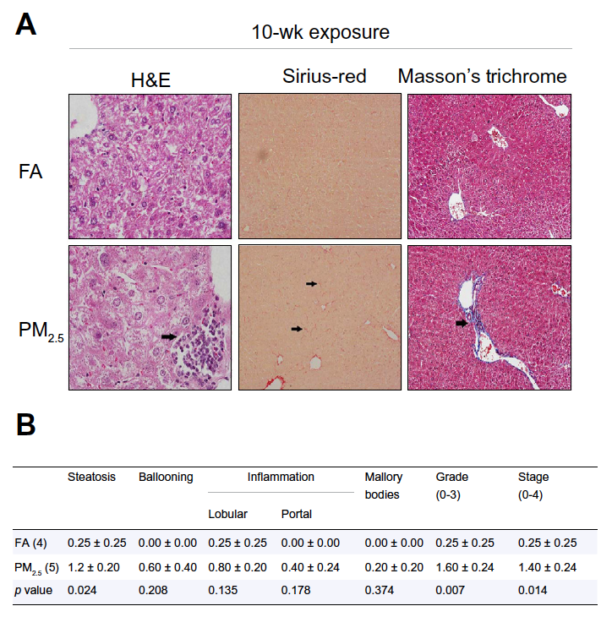
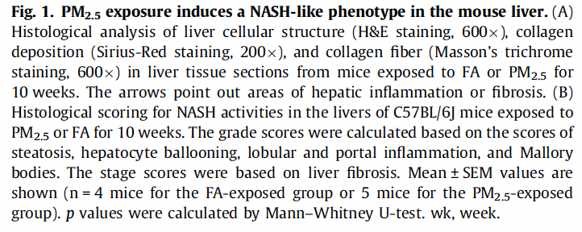
Particulate matters and MAFLD: experimental study
Zheng et al, J hepatol, 2013

Slide 11
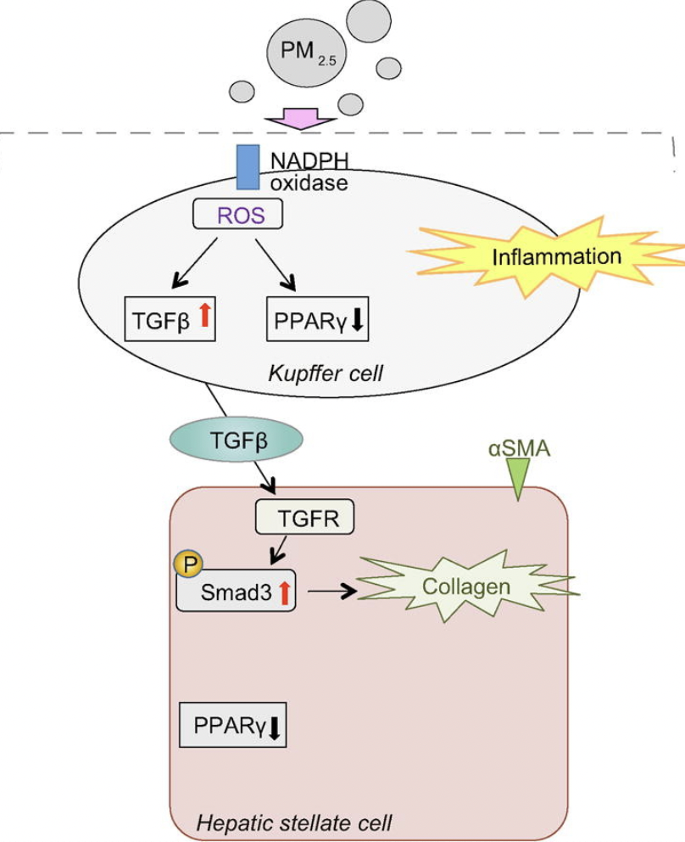
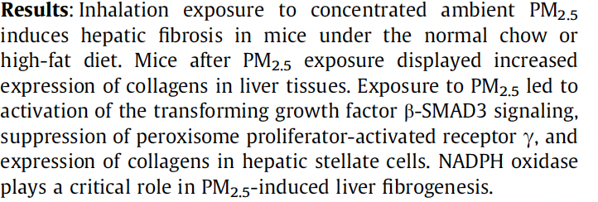
Particulate matters and fibrosis: mechanisms
Zheng et al, J hepatol, 2015

Slide 12
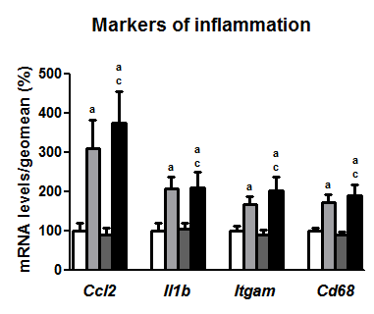
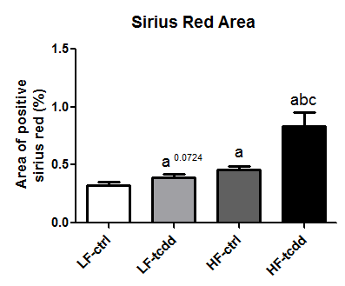
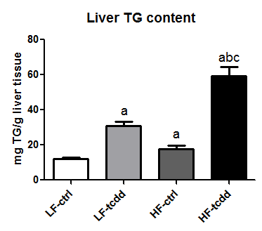
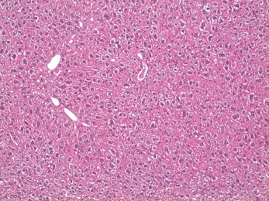
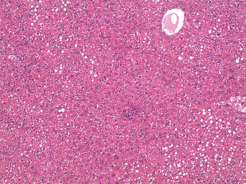
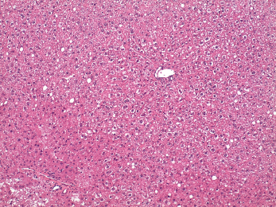
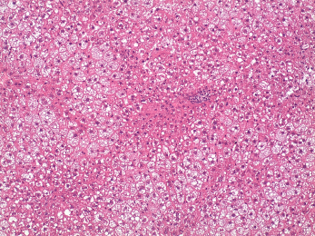
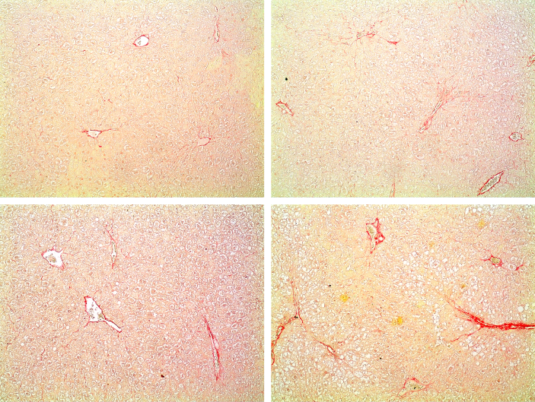
Dioxin and High fat diet: steatosis
Dioxin is the prototypical activator of the AhR, a receptor for a large number of air pollutants
Sirius Red Staining
LF-ctrl
LF-tcdd
HF-ctrl
HF-tcdd
LF-ctrl
LF-tcdd
HF-ctrl
HF-tcdd
H&E staining
Duval et al, Env Health Perspect, 2017

Slide 13
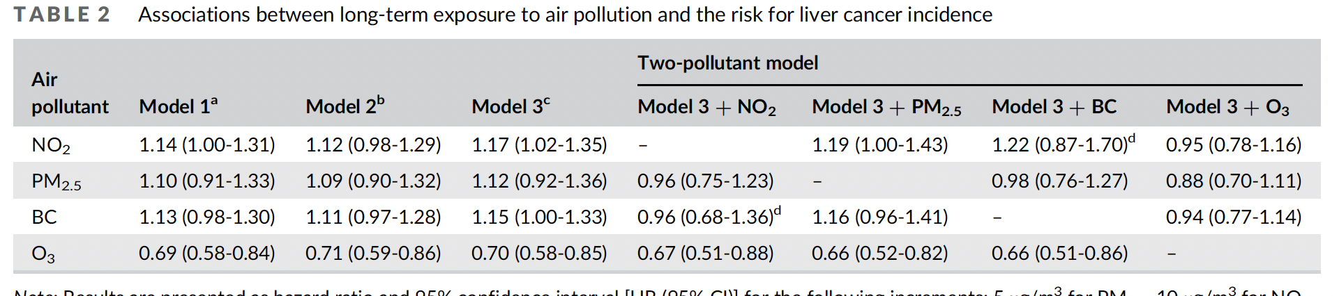
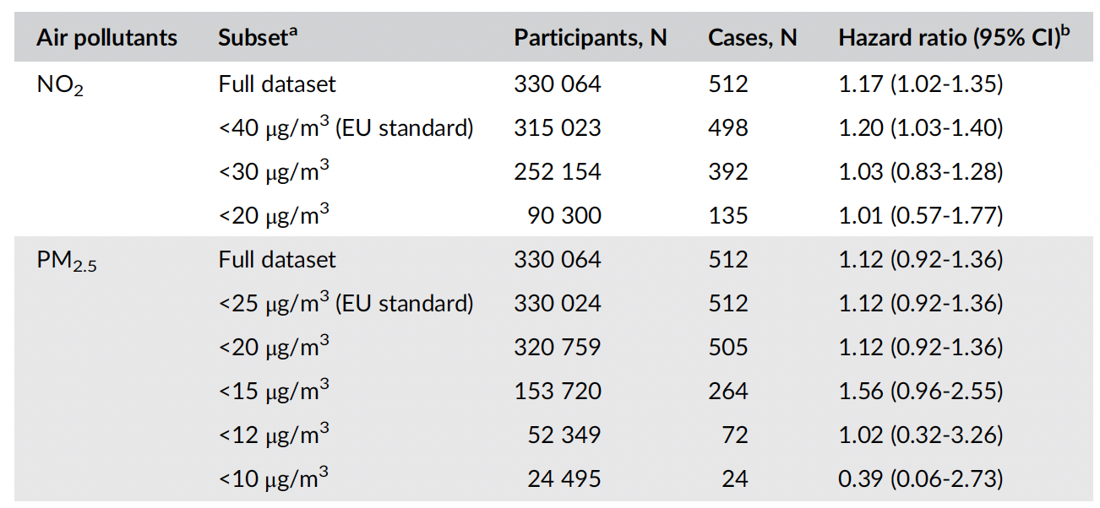
Air pollution components and liver cancer incidence in 6 EU cohorts (ELAPSE)
So et al, Cancer
epidemiology 2021

Slide 14
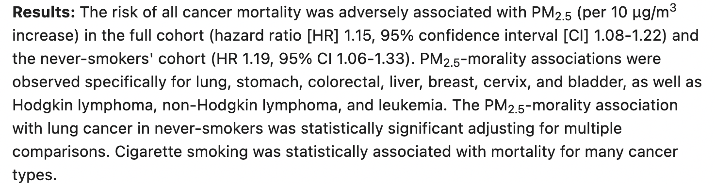
PM2.5 and liver cancer mortality in a US cohort
Coleman et al, Cancer
Causes control 2020

Slide 15
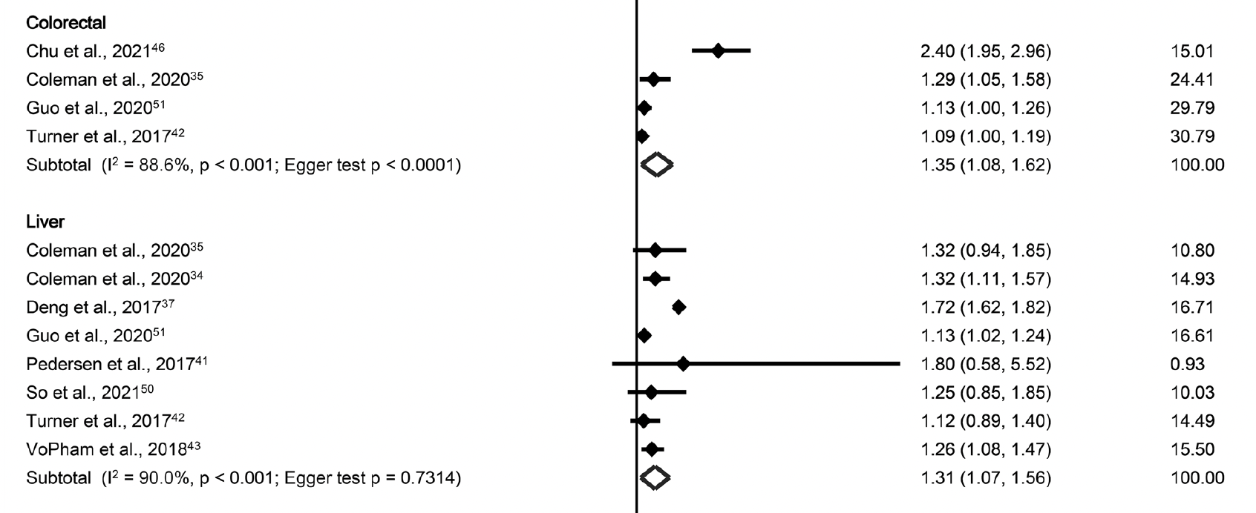
PM2.5 and risk of GI cancer
a systematic review showing increased risk of liver and colorectal cancers
Pritchett et al, EHP 2022

Slide 16
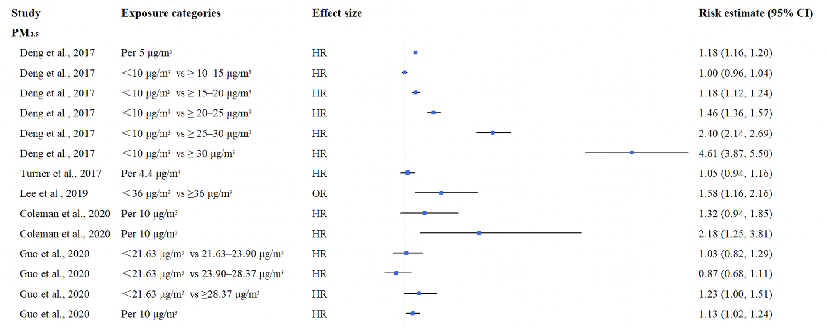
PM2.5 and risk of liver cancer mortality
a systematic review showing increased risk of liver cancer mortality but not incidence
Gan et al, J environ sci. 2023

Slide 17
Conclusions on air pollution and liver diseases
Strong evidence for the effect of air pollution on liver metabolic diseases:
epidemiologic and experimental evidence
Some evidence for the effect of PM2.5 on liver cancer mortality
Possible effects of PM2.5 on liver cancer (but some contradictory data)
Genotoxic and non genotoxic carcinogens in air pollution components
Evidence for an effect of air pollutant components on metastasis for some cancer locations.

Slide 18
Expanding the liver exposome
Medical drugs; drugs/narcotics; alcohol
Chemical contaminants: toxins; occupational, some environmental, tobacco smoke
Infectious agents: viruses, parasites, bacteria
Nutritional imbalance
Liver diseases
Pollution; particles;
Stressor combination
internal pollutants
Chemical mixtures
Microbiota metabolites

