Slide 1
Caring for patients in war-torn Ukraine
Elina Manzhalii, PhD, MD
Bogomolets National Medical University
Kiyv, Ukraine

Slide 2
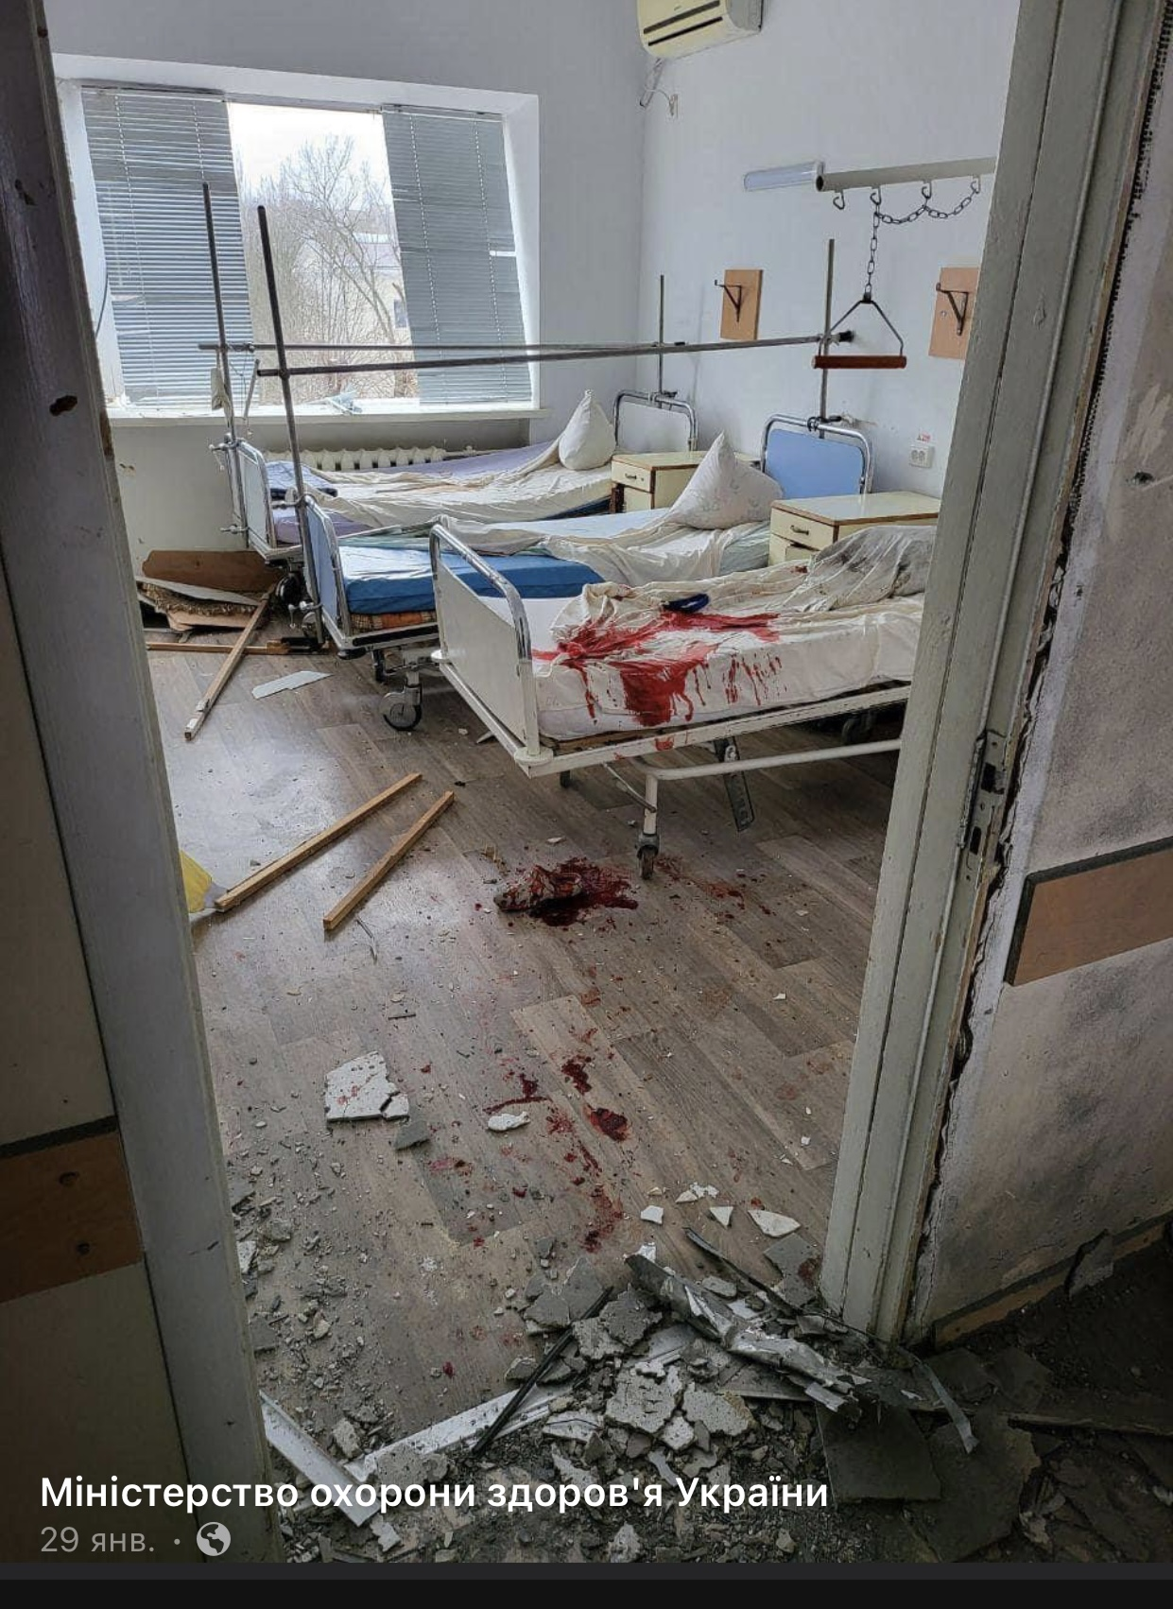
On 24 February 2022, Russia launched a large-scale military invasion of Ukraine
Some hospitals in Ukraine stopped providing routine medical care services. During the war in Ukraine, 906 healthcare facilities have been damaged, of which 123 have been completely destroyed.
Notes:
За даними на кінець серпня 2022 року з початку

Slide 3
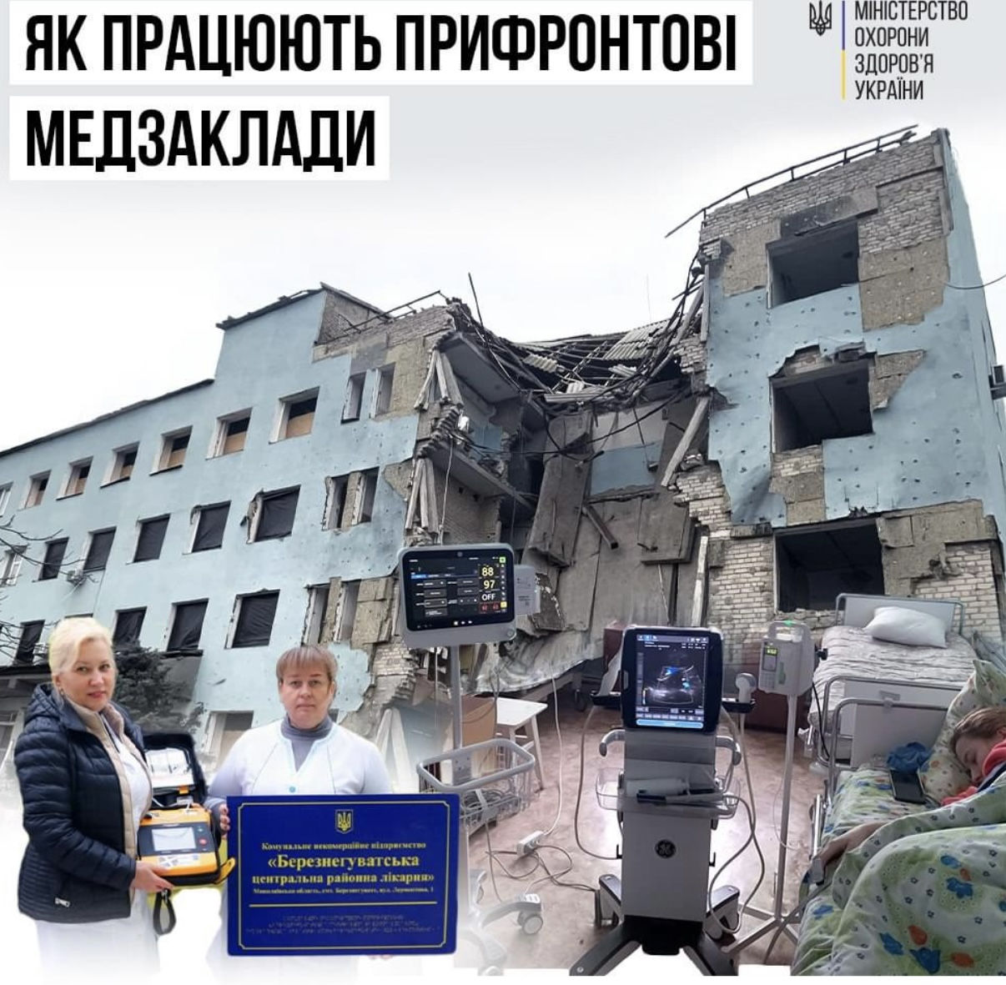
396 pharmacies and many drugstores were damaged. More than 200 emergency medical vehicles were shot at or taken away by the occupiers.
Notes:
In addition,

Slide 4
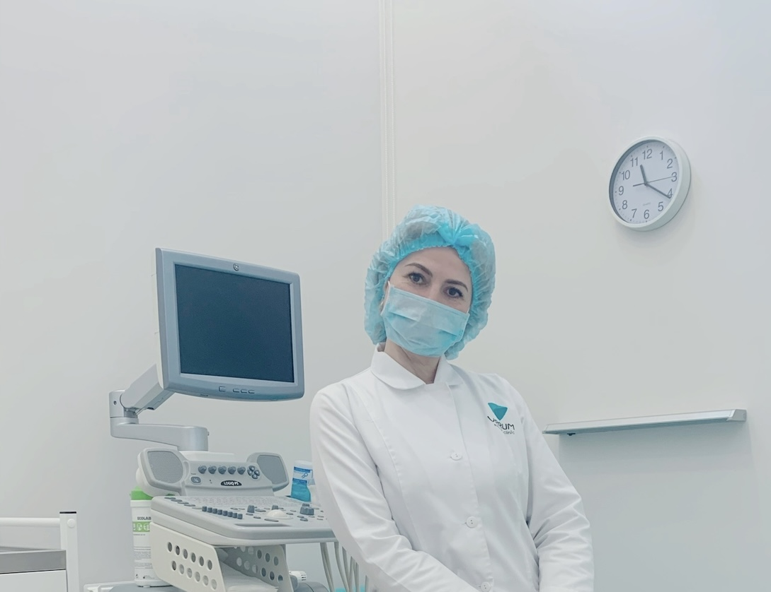
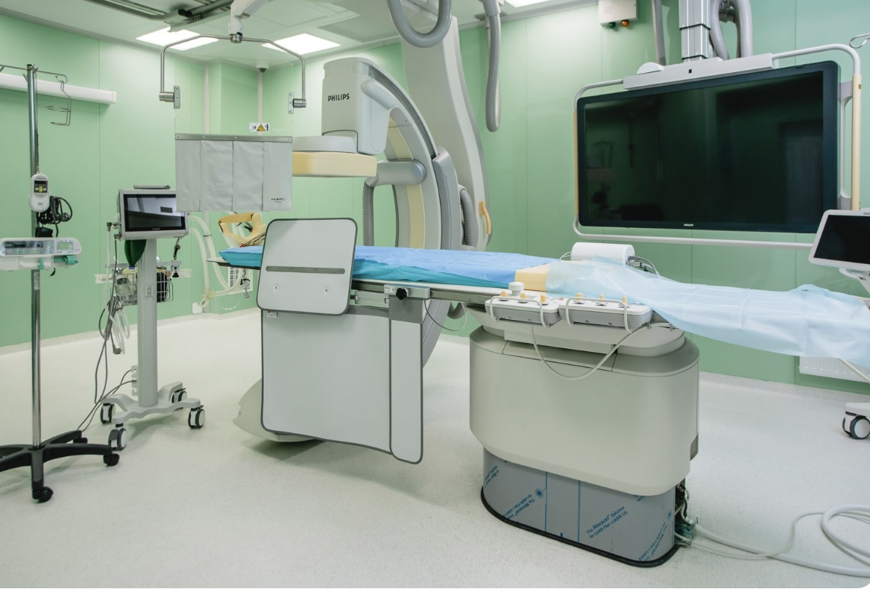
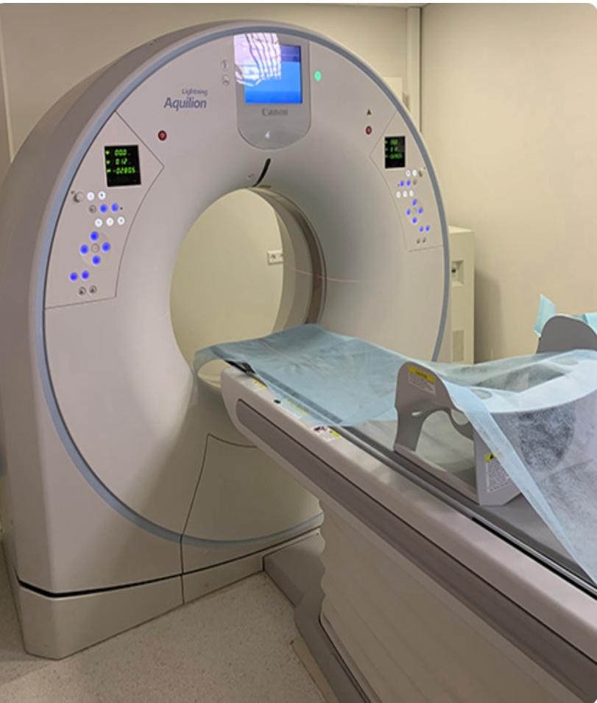
The situation is slightly better in Kyiv and western Ukraine
Hospitals and primary care operate and provide services.
The medicine in Ukraine developed very rapidly before the war
Our clinics had modern equipment, innovative methods, participated in scientific research, and much has been done in the field of transplantation

Slide 5
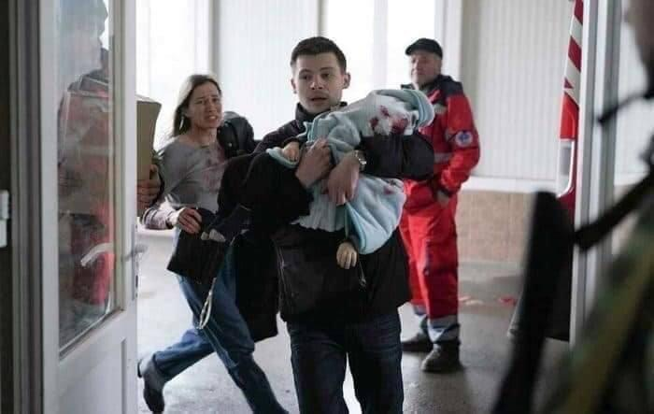
Since the beginning of the war in Ukraine, many citizens have been forced to change their place of residence. At the same time, the Ministry of Health reminds everyone that inpatient care is provided free of charge - regardless of where patients live and which institution they decide to choose for hospitalization.
All medical and related services provided by the package of medical services are guaranteed, and patients do not have to pay extra for anything. In particular, it covers all areas necessary for patients: cardiology, neurology, infectious diseases, pulmonology, gastroenterology, pediatrics and more.
Patients can receive free services in the following cases:
if there is a referral from a family / attending physician
if the patient is taken to hospital by an emergency team
by referral from another clinical unit or institution if the person is already being treated in a hospital
on self-appeal in case of emergency
Free of charge for patients are: blood, urine, cerebrospinal fluid tests, bacteriological and other laboratory tests
electrocardiography, ultrasound (including doppler), endoscopic examination, X-ray, CT, MRI
anesthesia at all stages
provision of medicines from the National List, as well as those purchased at the expense of other programs of the central and local budgets
intensive care

Slide 6
People with chronic diseases are especially affected now, including patients with liver diseases.
The number of decompensated cases of advanced cirrhosis and liver cancer, autoimmune hepatitis has increased.
Due to the large number of toxic emissions of combustion products from explosions and bombs, the number of toxic hepatitis has increased.
Also, due to stress, the number of patients with rapid weight gain or anorexia and functional diseases is increasing.

Slide 7
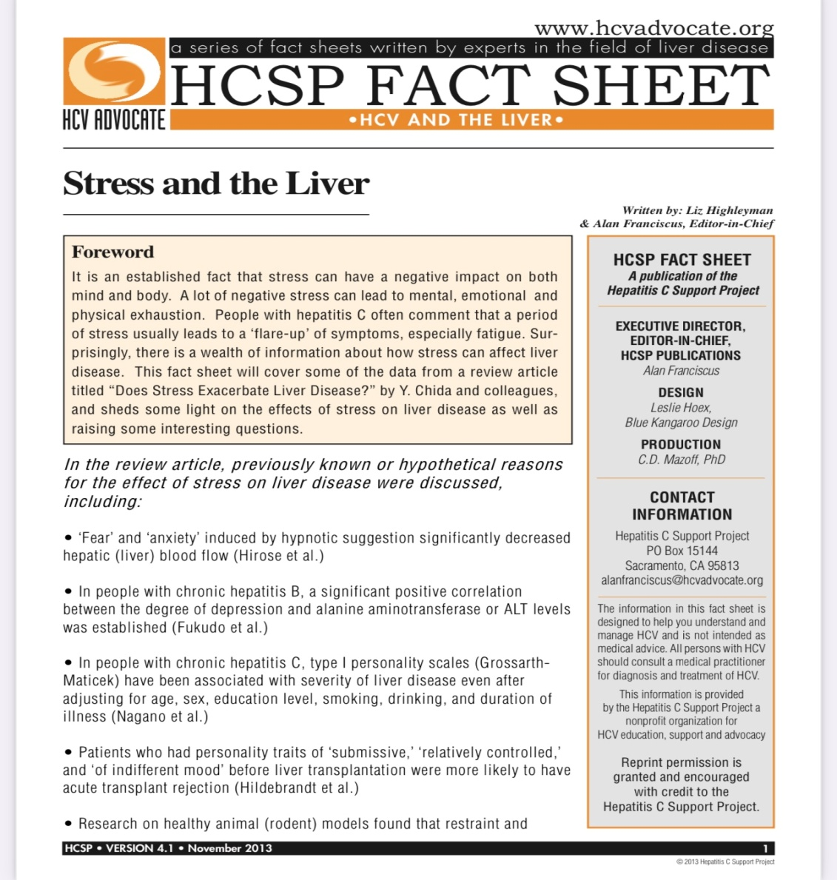
Experimental studies and clinical observations have shown that stress can damage the liver tissue both directly and indirectly
The liver is an organ that filters the mass of foreign material and then maintains immune tolerance in physiological conditions. However, in conditions of stress, the immune tolerance is impaired, which leads to the induction of inflammation in the liver.
The reasons for this process can be classified as follows: hypoxia-recovery, excessive activation of Kupfer cells and oxidative stress, influx of intestinal lipopolysaccharide and norepinephrine, as well as excess production of stress hormones and activation of the sympathetic nerve
Notes:
The search for literature using PubMed was conducted (http: //www.ncbi.nlm. Nih.gov/pubMed) in full by March 2018 and analyzed the study, mainly on animals for liver damage caused by stress.Багато досліджень частково виявили причину стрес-спричиненого ураження печінки; проте весь процес ще не розкритий.

Slide 8
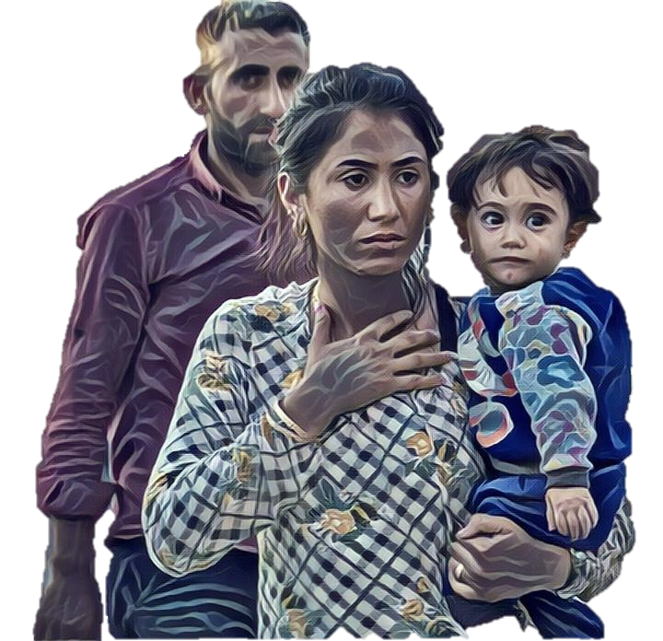
Trauma & Family in War
Centrifugal Effects of Social Trauma
Families…
…Neighbors
VILLAGE
Fear
Farm
Withdrawal
Hyper
Arousal
Vigilance
Family
Alienation
Drug/Alcohol
Avoidance
Government
Office
Suspicion
Affects
Domestic Violence
Absence of government presence
Shame
Infrastructure
Denigration of others
Self Denigration
Despair
Business
Fear of
Abandonment
Effects
Helplessness
Family
Shops
DESTROYS BONDS
Between families, friends, neighbors
Rage
Family
Depression
Public Works
Hopelessness
Notes:
Trauma and disorders may also affect specific neurotransmitter systems. Phs trauma involved in either an increase, decrease, or imbalance of certain neurotransmitters

Slide 9
Journal of Hepatology 2022 vol. - j 1–6. The negative bidirectional interaction between climate change and the prevalence and care of liver disease: A joint BSG, BASL, EASL, and AASLD commentary Mhairi C. Donnelly, William Stableforth, Aleksander Krag, Adrian Reuben
The prevalence of fatty liver disease is the same as in Europe, but now I think the prevalence of metabolically associated fatty liver disease will increase due to alcohol consumption, fructose and environmental ecotoxin and lack of activity.

Slide 10
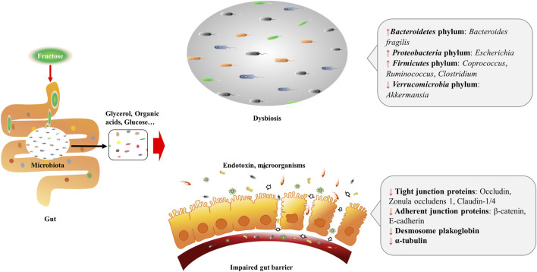
Fructose impact changes the macrophage energy supply mode, which causes oxidative stress and secretion of inflammatory cytokines
Front Pharmacol. 2021, 18 .11 Doi: 10.3389 / fphar.2021.783393
https://www.ncbi.nlm.nih.gov/pmc/articles/PMC8637741/
Notes:
КНК, фруктокиназа; F1P, фруктозо-1-фосфат; ChREBP-β, белок, связывающий углевод-чувствительный элемент β; JNK, N-концевая киназа c-Jun; IRS, субстраты рецепторов инсулина; PGC-1β, гамма-соактиватор-1β рецептора, активируемого пролифератором пероксисом; SREBP-1, белок-1, связывающий регуляторный элемент стерола; АСС1, ацетил-КоА карбоксилаза 1; DNL,липогенез de novo ; UA, мочевая кислота; SCFA, жирная кислота с короткой цепью; AA, аминокислота.
Люминальная фруктоза на физиологическом уровне стимулирует высвобождение глюкагоноподобного пептида 1 (GLP-1) из EEC L-подтипа у людей и животных, однако мыши с диабетом 2 типа устойчивы к GLP-1 из-за дисбактериоза кишечника
было обнаружено, что фруктоза улучшает выживаемость кишечных ворсинок в условиях гипоксии, что приводит к расширенному всасыванию питательных веществ в кишечнике, что способствует увеличению массы тела и накоплению жира
Фруктоза также влияет на кишечный барьер, регулируя метаболизм этанола
Избыточное потребление фруктозы может привести к нарушению всасывания фруктозы, и было обнаружено, что неабсорбированная фруктоза втягивает жидкость в просвет кишечника, что приводит к боли в животе, метеоризму, диарее и другим расстройствам пищеварения ( Beyer et al., 2005 ; Gaby, 2005 ). . Органические кислоты и газ, которые образуются в процессе метаболизма фруктозы, также способствуют возникновению вышеупомянутых желудочно-кишечных симптомов

Slide 11
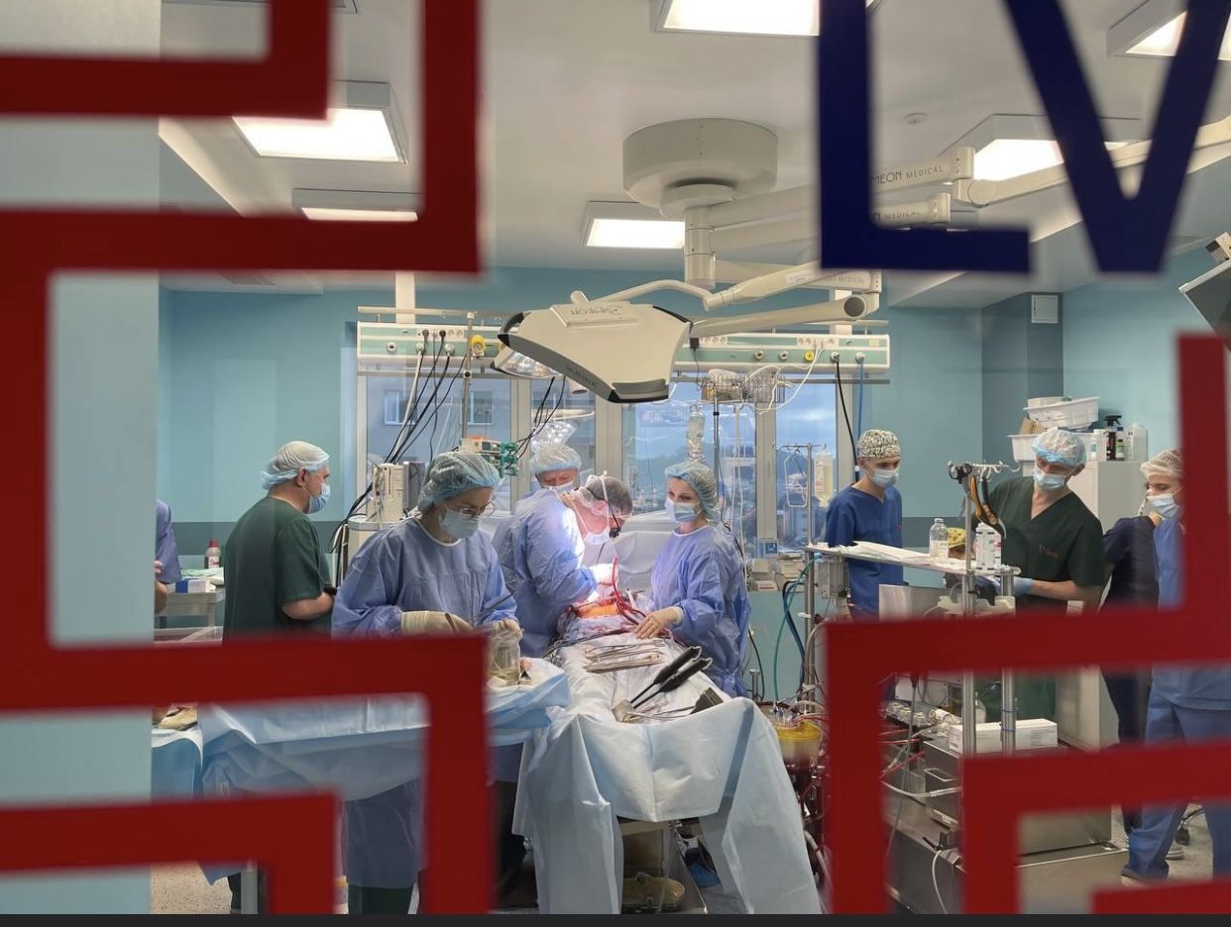
Transplantation in Ukraine during a full -scale invasion

Slide 12
Transplantation in Ukraine during a full -scale invasion
In 2022, Ukrainian doctors conducted 384 transplants. This is 20% more than in 2021 and most of the entire existence of an independent Ukraine. Currently, organ transplantation in Ukraine is carried out by 32 medical centers. 74 liver transplants were conducted during 2022
Most often the kidneys were transplanted - 188 times, the heart - 25.
In 2022, the surgeons of the first medical association of Lviv held a record number of transplants, saving almost a hundred Ukrainians in Ukraine. Medical teams transplanted 7 hearts, 12 liver and 78 kidneys. Of these, three kidneys and one liver received children.
Notes:
The war did not stop Ukrainian doctors.

Slide 13
It is believed that at least two -thirds of cancer in the war period remain undiagnosed or unregistered. Information about them becomes available only after the conflict is over. There is a danger that due to the decline of the economy and health care, the lack of state programs for prevention and oncological screening, the situation in Ukraine may become worse than it was in the pre -war period.
The invasion of the Russian Federation into our country can lead to more diseases and deaths from cancer than was observed in peacetime. There are also fears that we will never learn about the real consequences of the impact of the war on the risk of developing cancer in Ukraine, since the register-registers had practically stopped working during the fighting. The latest official data was published for 2020-2021.
Notes:
The frequency of liver and pancreas cancer in US Army veterans from 2000 to 2018 increased by 96%.

Slide 14
Prevention of viral hepatitis during the war
Critical issues of access to testing, treatment and prevention of viral hepatitis became especially acute.
Injuries, transfusion of unverified blood and sexual abuse, which, unfortunately, occur in Ukraine with the onset of a full -scale invasion of the Russian army,
increase the risk of infection with viral hepatitis B and C.
The number of surgical interventions is increased and they may not always be performed in proper conditions It can lead to an increase in the risk of infection with viral hepatitis.

Slide 15
Case study
The man is 45, military. Complaints of fatigue, weakness, yellowing of the skin and sclera, heaviness in the right hypochondrium. A history of the disease: 16.11.2022 Condition after suffering AK47 gunshot wound to the left lobe of the liver. The patient is in hospital. The doctor prescribed him lactulose 3 g/day, Ursofalk 500mg 2 g/day, alphallipon 2 g/day, atoxil 3 g/day. Intravenously: argitek 250 ml, tivortin 100 ml.
History of life: 16.11.2022 suffered trauma from an anti-personnel mine causing a thoraco-abdominal injury to the right with a through injury of the left lobe of the liver, deerosion of the stomach in the area. Operations: 16.11.2022 thoracocentesis, drainage of the right pleural cavity, laparotomy, surgical hemostasis of the wound of the liver, cholecystomy, suturing of the anterior wall of the stomach. Transfusion of plasma and blood substitutes on 16.11.2022

Slide 16
Physical examination
Weight 93 kg, height 181 cm, BMI 28.38.
Blood pressure 130/70 mm Hg Heart rate 72 beats/min.
Skin and visible mucous membranes - skin clean, yellow; Subicterical sclera, mucous membranes are moderately covered with white coating. The tongue is moderately covered with white coating. The abdomen is soft, sensitive in the right hypochondrium. The liver protrudes 5 cm from the edge of the rib arch.

Slide 17
Laboratory tests
Complete blood count (CBC)
International normalized ratio (INR)
Hepatic function panel (ie, serum albumin, total and direct bilirubin, alanine aminotransferase [ALT], aspartate aminotransferase [AST], and alkaline phosphatase levels)
Estimated glomerular filtration rate (eGFR)
HCV RNA (HCV HIV)
HCV genotype and subtype.
HBsAg, anti-HBc, anti-HBs, HIV
Extended FAST (eFAST) protocol
Ultrasound elastography and esophagogastroduodenoscopy
Upon receipt of the results of the research, a diagnosis was established: Chronical hepatitis C, genotype 1A; fibrosis stage, F0-F1. S3. NASH

Slide 18
The results of analyzes
Назва обстеження | Референтний інтервал | 07.12.2022 | 13.12.2022 | 23.12.2022
ALT | <40,0 U/L | - | 52,1 | 924
АSТ | <35,0 U/L | - | 36,6 | 404
Alkaline phosphatase | <248 U/L | - | 149,3 | 352
GGT | 65,0-85,0 U/L | - | 71,5 | 101
Direct bilirubin | <21 μmol/l | - | 12,0 | -
Creatinine | 44-115 μmol/l | - | 85,9 | 113
Urea | 1,7-8,30 μmol/l | - | 4,56 | 7,9
Glucose | 3,5-5,9 ммоль/л | - | 3,5 | 6,1
Hemoglobin | 130-160 g/l | 116 | - | 123
Erythrocytes | 3,9‑5,3 Г/л | 3,7 | - | 3,95
Leukocytes | 4-9 | 9,7 | - | 7,89
Lymphocytes | 19-37% | 27 | - | 25
Monocytes | 3-10% | 8 | - | 10
ESR | 1-10 мм/год | 3 | - | 13

Slide 19
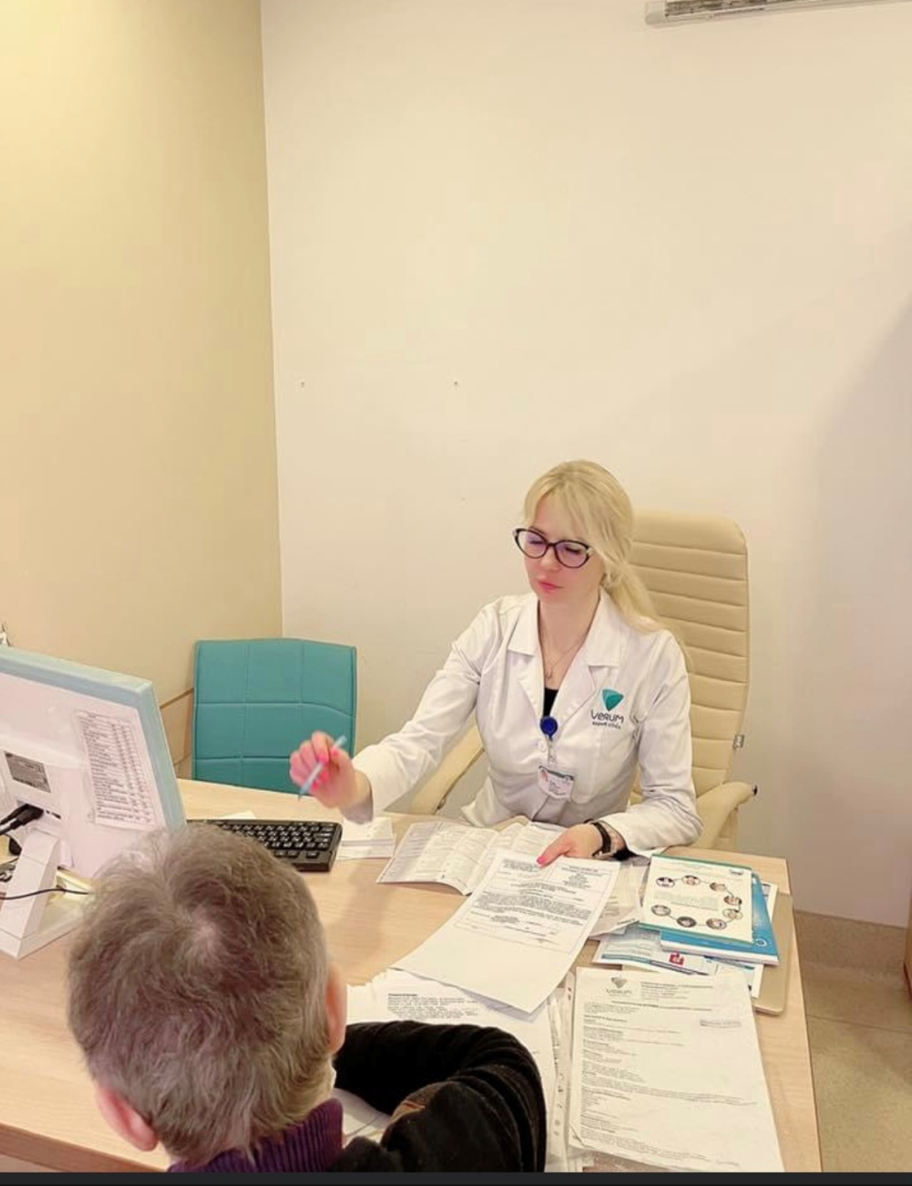
Currently, I take in patients in a special room, that is outfitted as a bomb shelter. During the day, there are several sirens, but the doctors of my clinic may not stop taking in and caring for patients, as we are provided with bomb shelters, generators and a Starlinka.
I use online consultations for the treatment of patients with cirrhosis in the recruited territories and in zones of combat conflicts
I have developed no cost pro-bono programs for such patients and also for the military with viral hepatitis and gastrointestinal diseases
Notes:
General recommendations in wartime
Use online advice of a gastroenterologist and hepatologist
In time to diagnose a stress disorder
Use online help of psychologists and psychiatrists. Use autotraining
Maximum exclude contact with ecotoxins

Slide 20
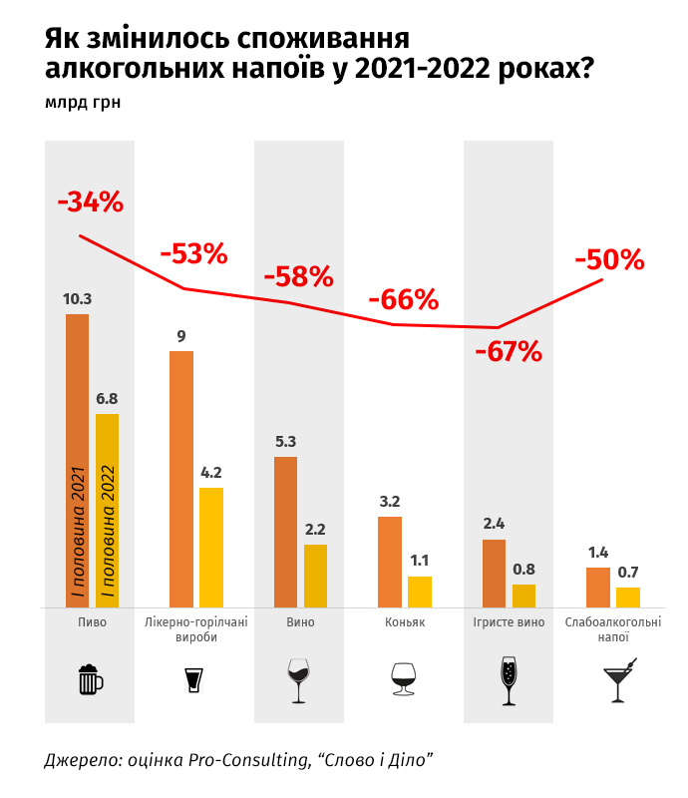
The consumption of alcohol by people is increasing.
Alcohol is a true satellite of wars.
From late February to early April, the sale of alcohol in Ukraine was banned.
The use of alcohol has initially decrease.

Slide 21
EASL is deeply concerned about the situation in Ukraine. EASL have published a joint statement, together with the World Health Organization Regional Office for Europe, and the European Centre for Disease Prevention and Control (ECDC): EASL, WHO, and ECDC Joint statement: Ensuring high-quality viral hepatitis care for refugees from Ukraine.

