Slide 1
Gut microbiota and alcoholic liver disease
Jasmohan S Bajaj, MD
Division of Gastroenterology, Hepatology, and Nutrition,
Virginia Commonwealth University and Central Virginia Veterans Healthcare System, Richmond, Virginia, USA

Slide 2
Outline
Why is the microbiota a target in alcohol-associated hepatitis?
Current therapies for ArLD and potential issues
Specific alterations in gut-liver axis
Focus on brain and liver-related outcomes
Clinical trial experience
Road ahead and reminder that these therapies are part of a multi-disciplinary approach

Slide 3
Gut Microbiota Alterations in ArLD and Substance abuse disorders

Slide 4
Factors that impact Gut Microbiota Composition and Function
Microbiota
structure & function
Antibiotics
Disease stage
Active
Alcohol
Co-morbid
conditions
Medicines
Diet
Organ failures
Host Genetics
Disease etiology
Bacteria
Fungi
Archaea
Protists
Viruses
Bajaj et al
J Hepatol 2020

Slide 5
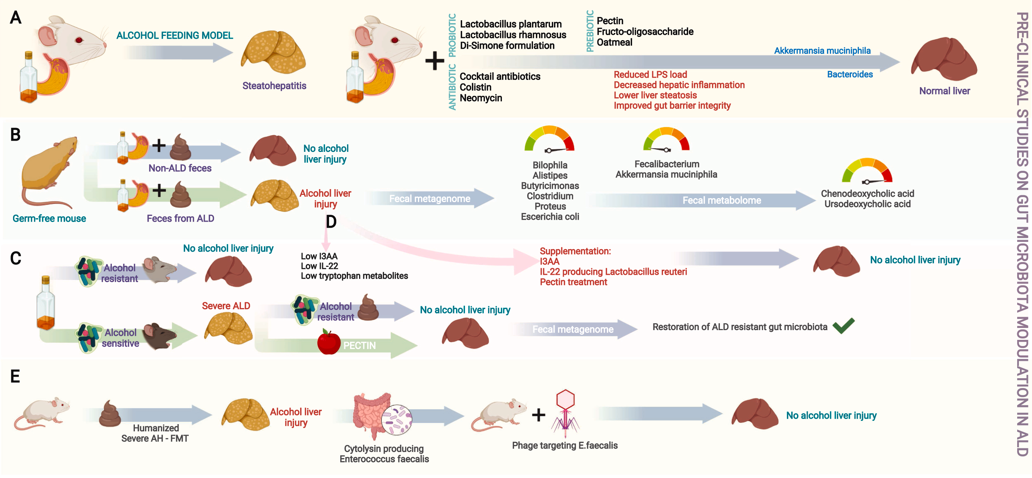
Llopis et al Gut 2016, Ferrere et al J Hepatol 2017, Kang et al Hep Comm 2017, Grander et al Gut 2018, Duan et al Nature
2019, Phillips et al JCEH 2022

Slide 6
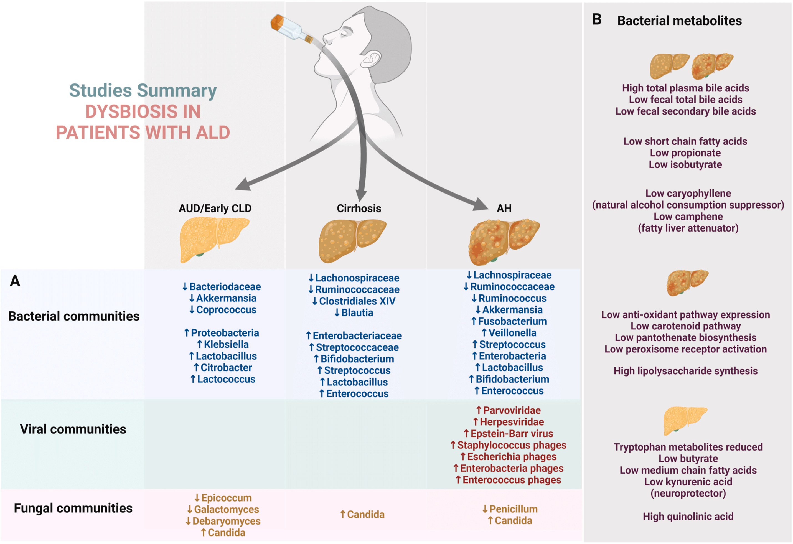
Hsu et al Hep Comm 2022, Jiang et al Hepatol 2020, Lang et al Hepatology 2019, Phillips et al JCEH 2022

Slide 7
Stages of ArLD where Microbiota are important
Brain Dysfunction: depression, anxiety, post-traumatic stress, chronic pain, relapse
Alcohol Misuse
No ALD
Altered circadian rhythm, depression and intestinal permeability
Etiology
Vs Cirrhosis-
related
Alcohol-associated Liver Disease
Steatosis and fibrosis
Compensated Cirrhosis
Decompensated Cirrhosis
Alcohol-associated Hepatitis
Death/Liver transplant
Circadian changes,
intestinal permeability,
Endotoxemia
Endotoxemia, intestinal permeability, fungal dysbiosis, antibiotic and PPI use
Brain Dysfunction: hepatic encephalopathy, nutritional deficiencies, withdrawal
Nutritional changes, endotoxemia
Bajaj JS Nat Rev Gastro Hep 2019

Slide 8
Focus of therapies
1. Improving liver-related outcomes
2. Improving alcohol-related outcomes

Slide 9
Current State of Affairs for AUD and Chronic Liver Disease

Slide 10

Medication | FDA/EMA-approved | APA rec | Use in cirrhosis? | Hepato- toxicity | In Renal failure? | Common adverse effects
Naltrexone | Yes | First line | X Child C | √ | √ | Diarrhoea, nausea, somnolence
Acamprosate | Yes | First line | Allowed | None | ↓ | Diarrhea
Topiramate | No | Second line | Allowed | √ with valproate-based medication | ↓ | Paraesthesia, altered taste, anorexia, difficulty concentrating
Baclofen | No | NA | Allowed | None | ↓ | Fatigue, sleepiness, and dry mouth
Gabapentin | No | Second line | Allowed | √ | ↓ | Fatigue, headache, insomnia
Varenicline | No | NA | Allowed | √ | ↓ | Fatigue, nausea, somnolence
Arab et al Nat Rev Gastro Hep 2021

Slide 11
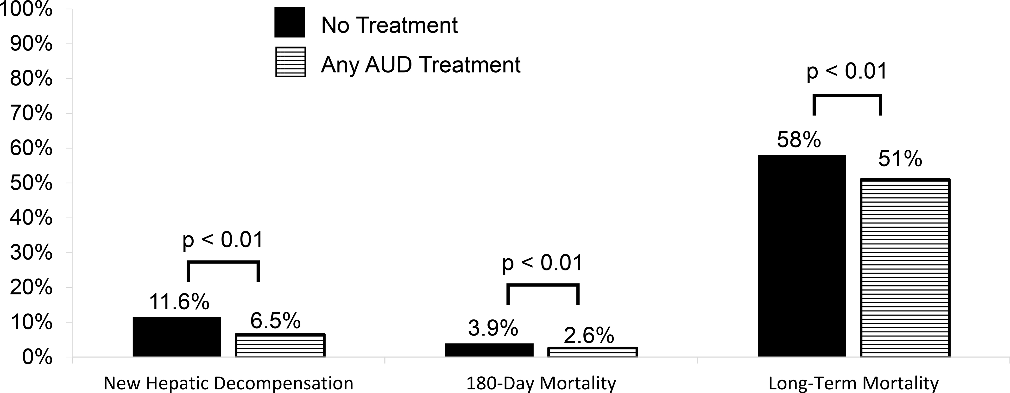
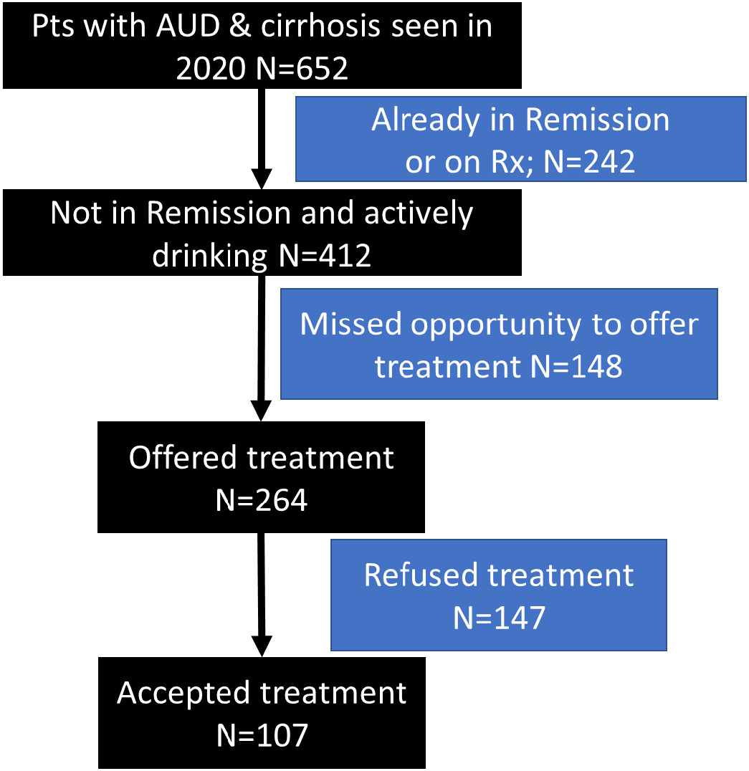
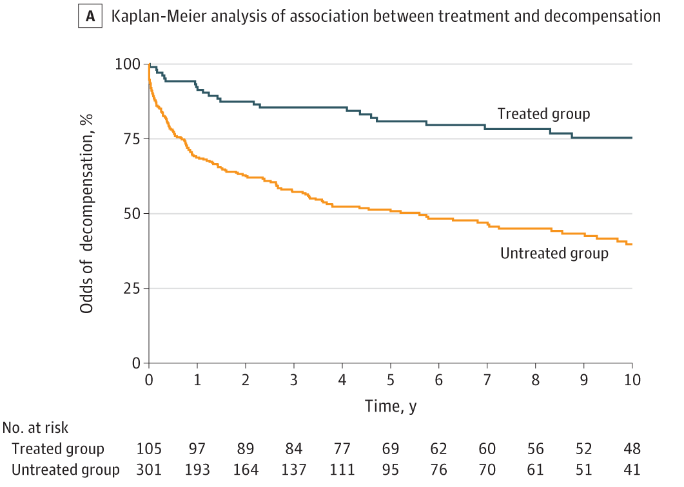
14% started on AUD Rx; 12% behavioral only, 0.4% MAT only and 1% received both Rx.
Rogal et al Hepatology 2020, Vannier et al JAMA Network Open 2022, Chaudhari and Duong et al ACER 2022

Slide 12
Modulating the Gut Microbiome
1. Probiotics
2. Antibiotics
3. FMT
4. Phages
5. Post-biotics
6. Avoiding alcohol

Slide 13
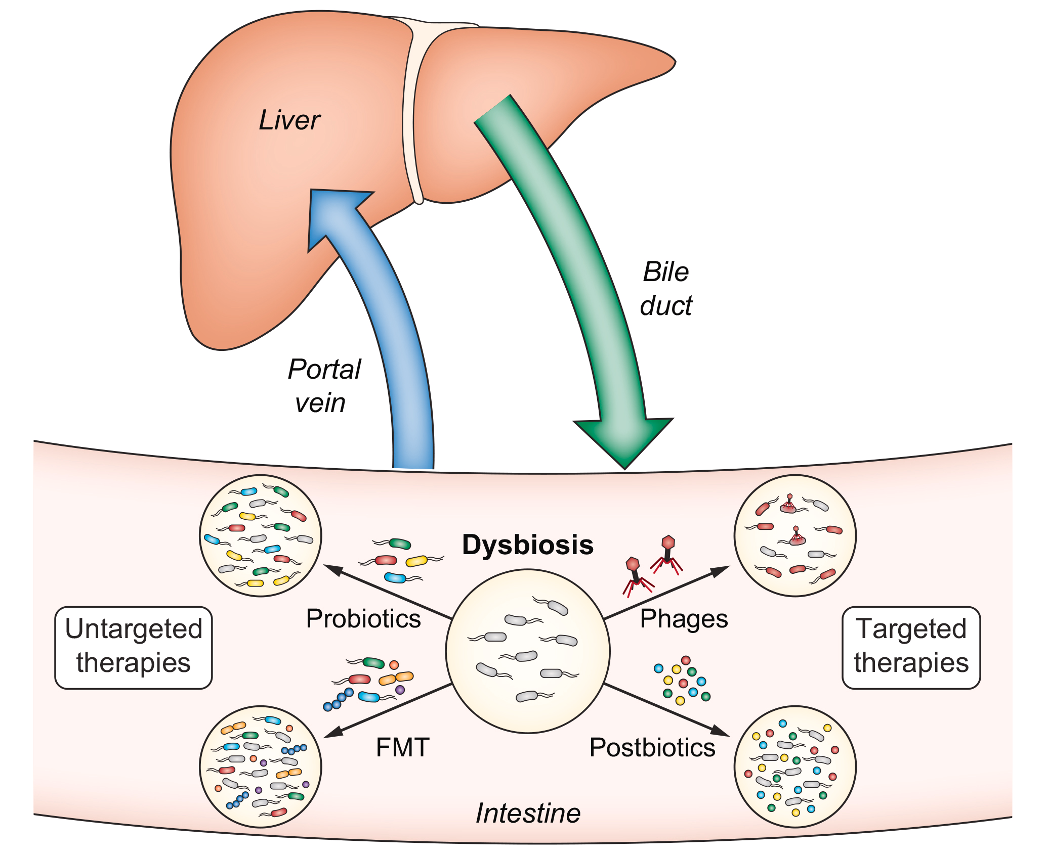
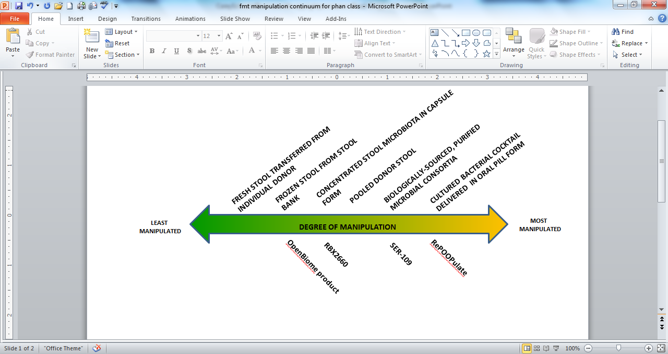
Targeted and Untargeted Microbial Therapies:
Spectrum of New Products
Track 3
Track 2
Track 1
Bajaj, Ng, and Schnabl J Hep 2022, Slide used with permission of Diane Hoffman, JD

Slide 14
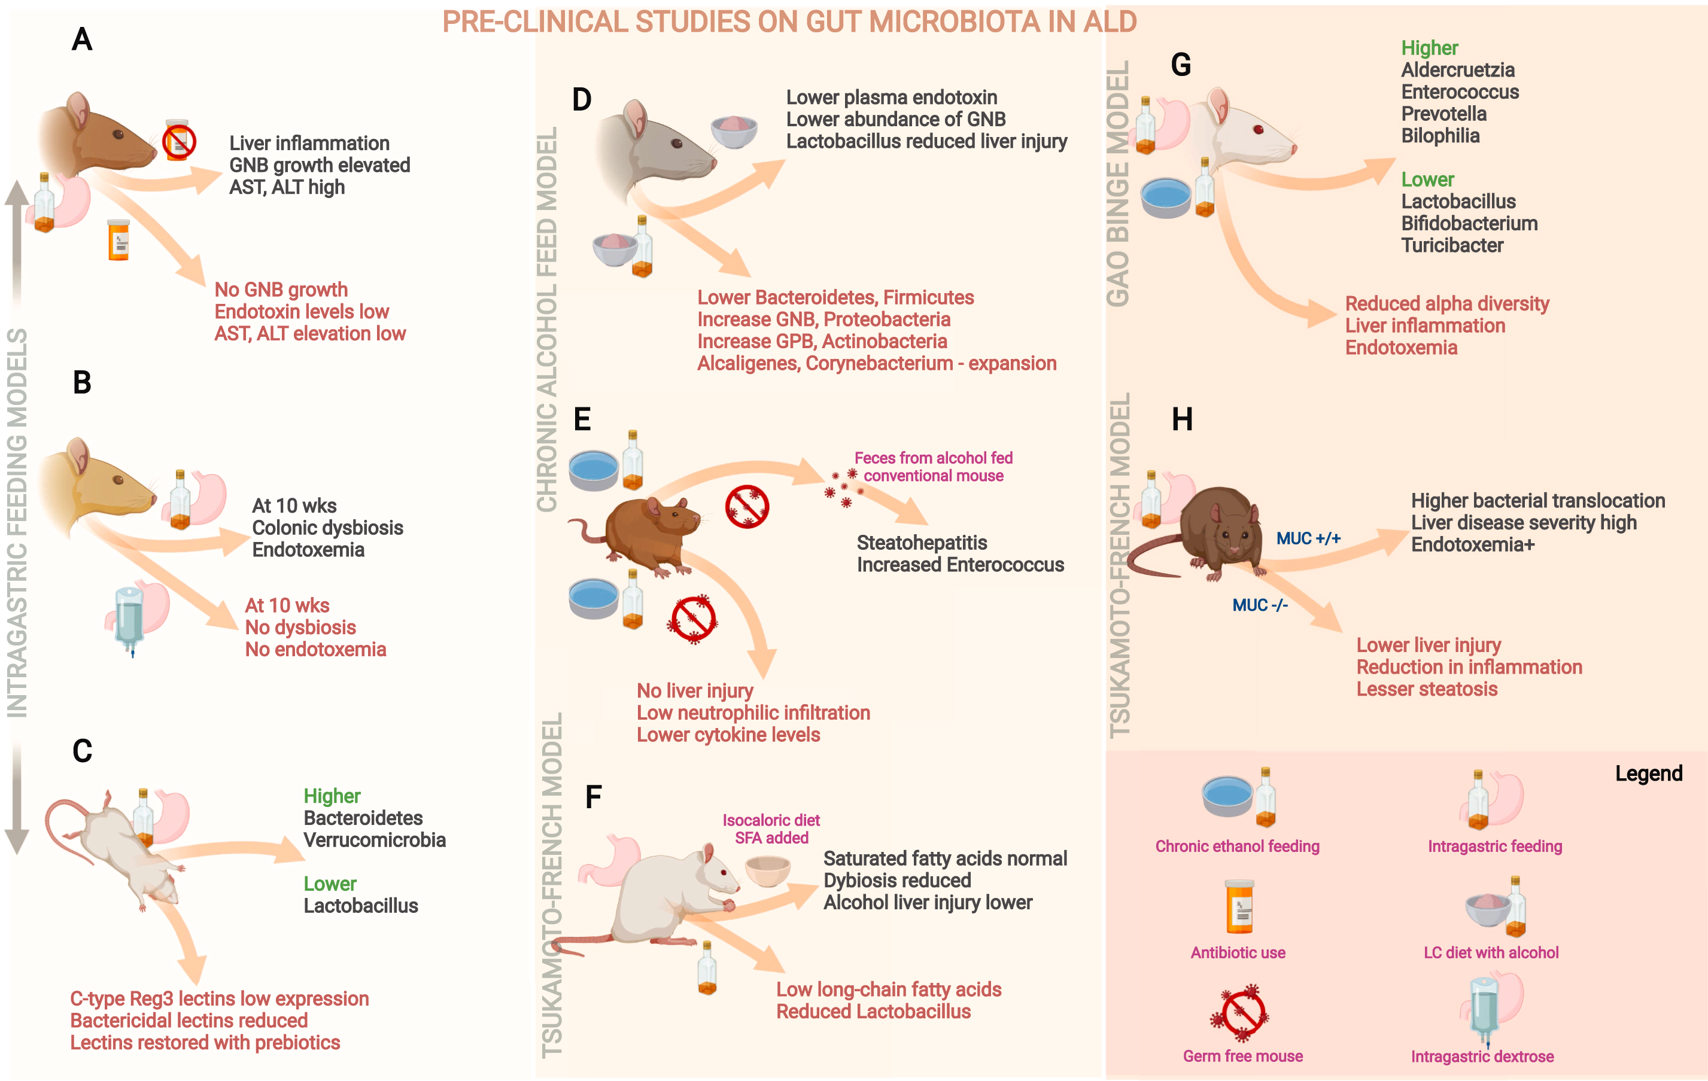
Yan et al Hep 2011, Llopis et al Gut 2016, Peng et al Gastro 2018, Singhal et al Gut Microbes 2021, Phillips et al JCEH 2022

Slide 15
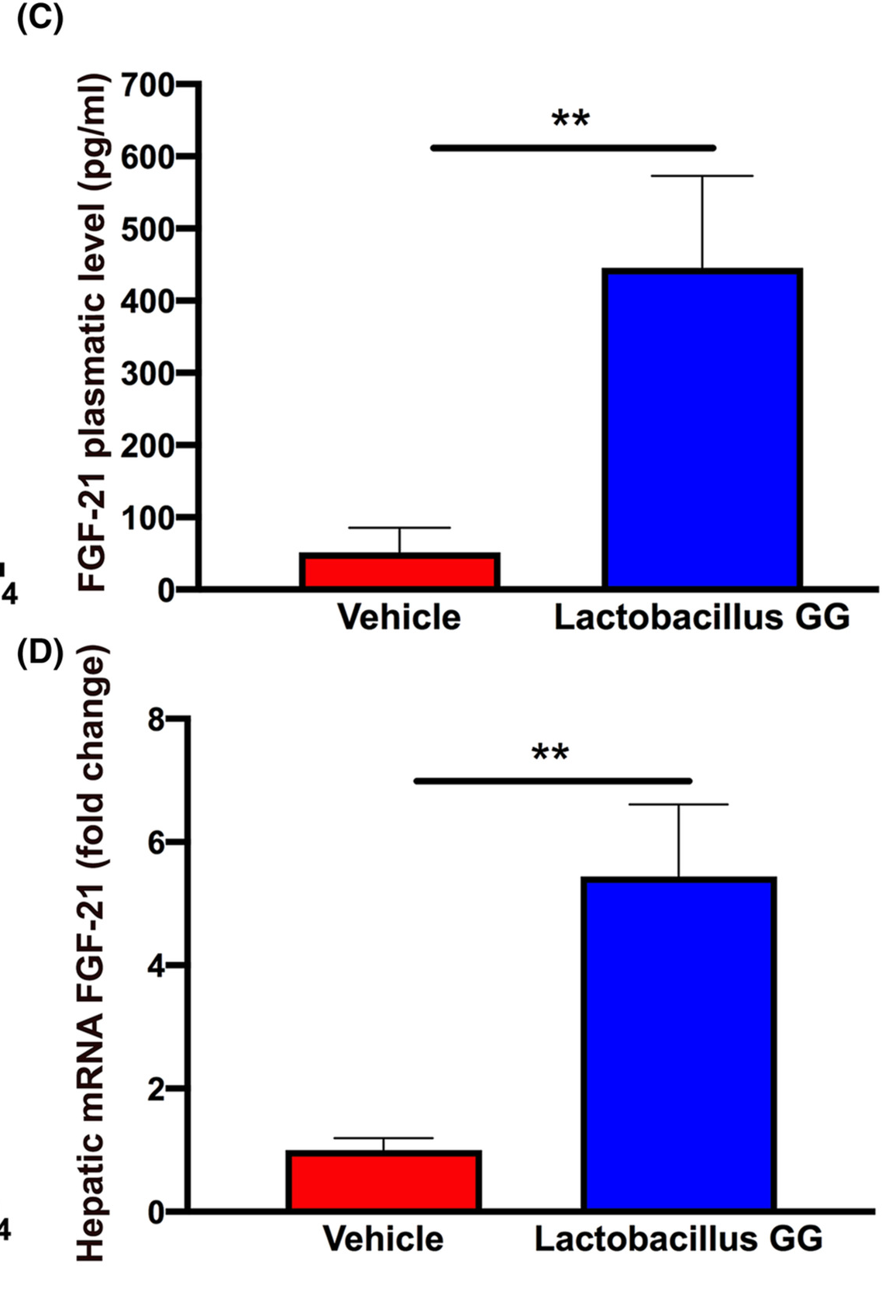
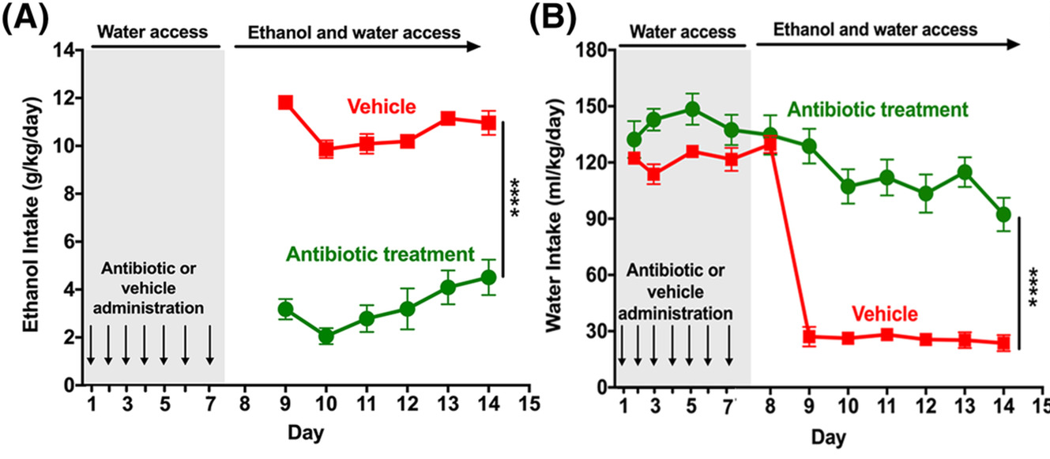
Antibiotics and Probiotics Reduce Alcohol Intake in Animal models
Pre-alcohol antibiotics reduced alcohol intake
LGG increased FGF21 and reduced alcohol intake
This impact was abolished after subdiaphragmatic vagotomy
Also mirrored the impact on sweet substances
Ezquer et al Addiction Biology 2021

Slide 16
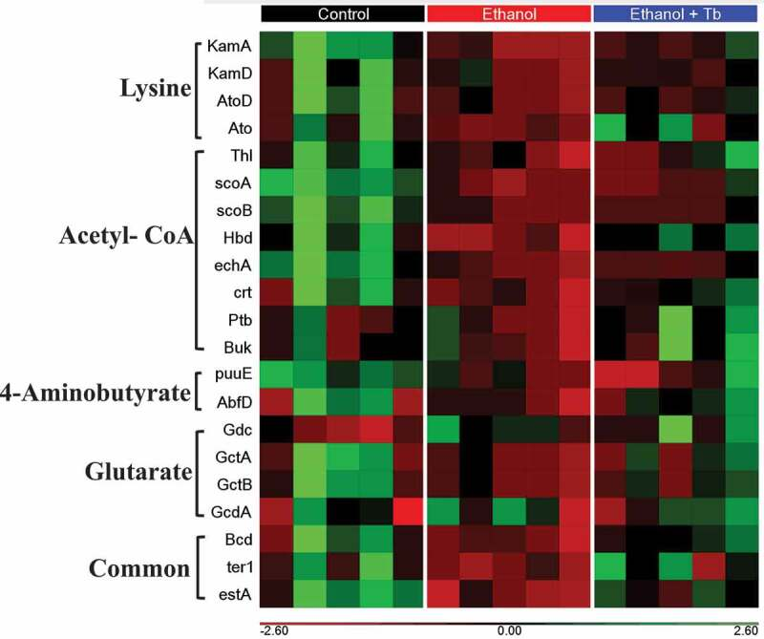
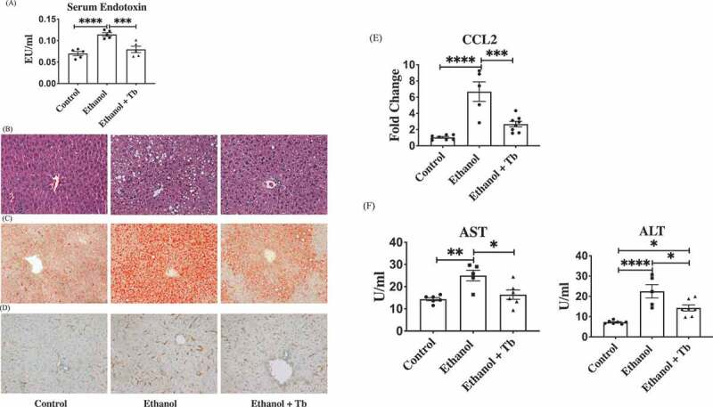
Reduction in ArLD in animal model using butyrate
Singhal et al Gut Microbes 2021

Slide 17
Vatsalya et al Am J Gastro 2023

Slide 18
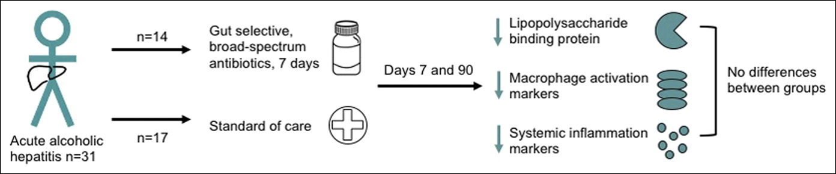
Sidsel et al Clin Transl Gastro 2021

Slide 19
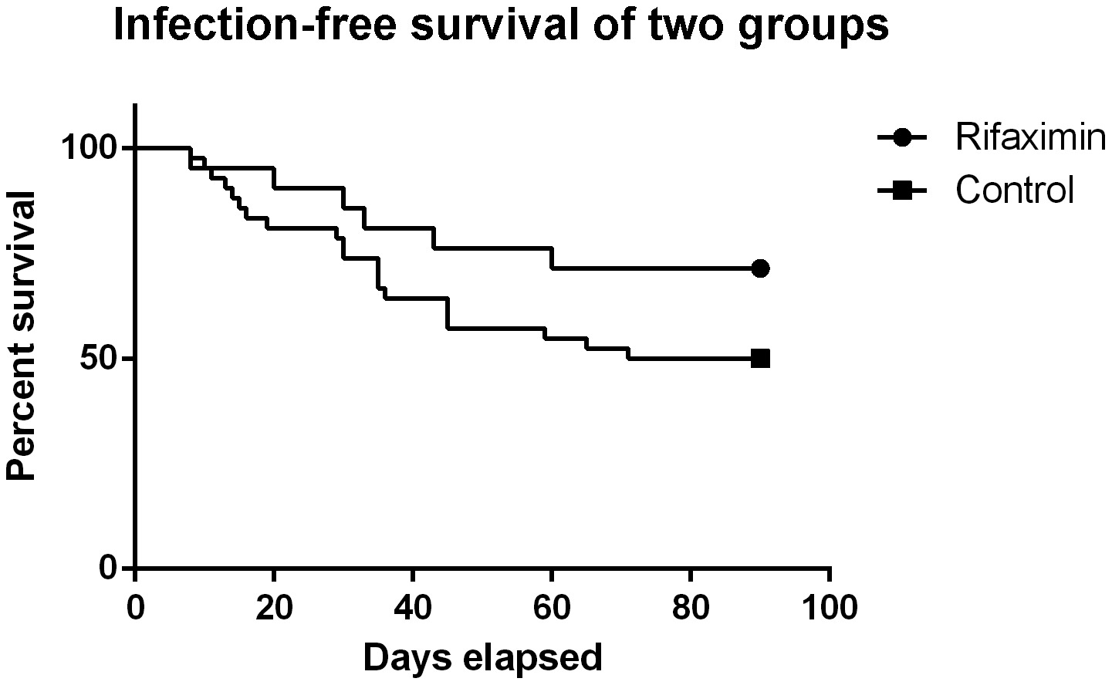
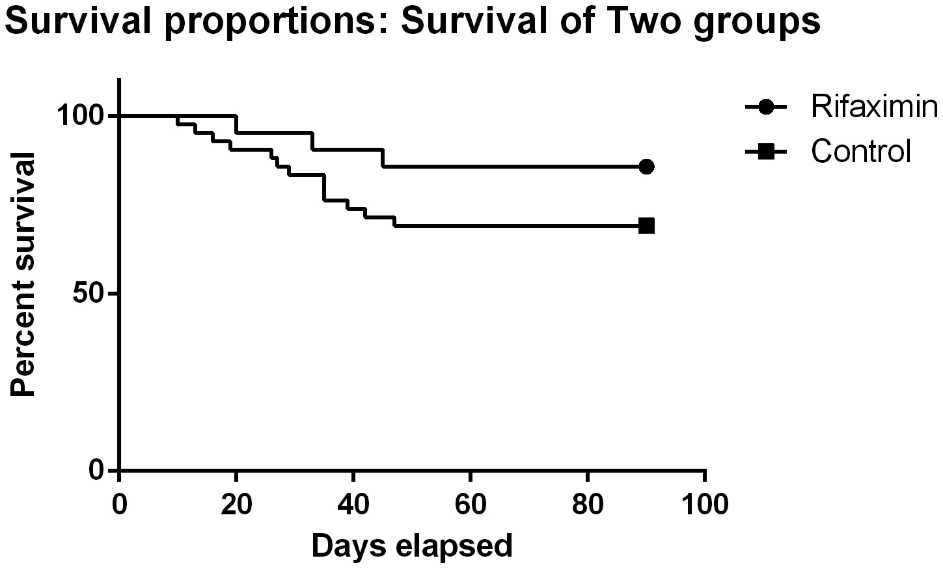
Rifaximin in Alcohol-associated hepatitis
Kimer et al open-label study
  16 rifaximin and 16 standard medical Rx
  550mg three times a day for 4 weeks
  No change in mortality, HE, sepsis, or HRS
  No change in procalcitonin, IL-10, TNF, sCD163 and lipid binding proteins
Jimenez et al open-label study
  21 rifaximin vs 49 historical controls
  1200mg/day for 90 days
  Rifaximin associated with
    Lower Infections (p=0.049)
    Lower liver-related complications (p=0.01)
P=0.12
P=0.15
Jimenez et al Liver Int 2022, Kimer et al PLOS One 2022

Slide 20
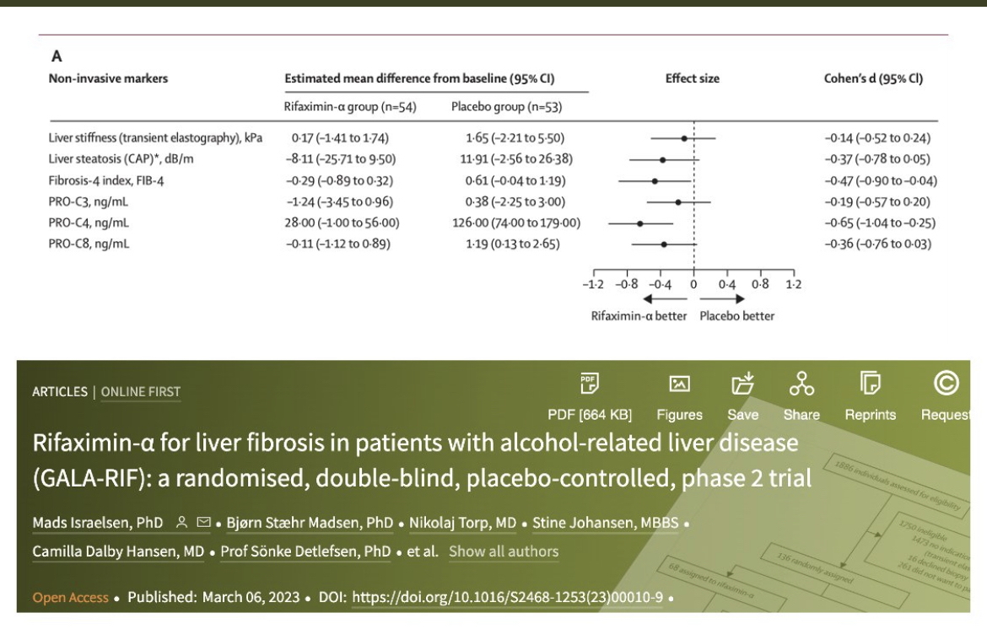
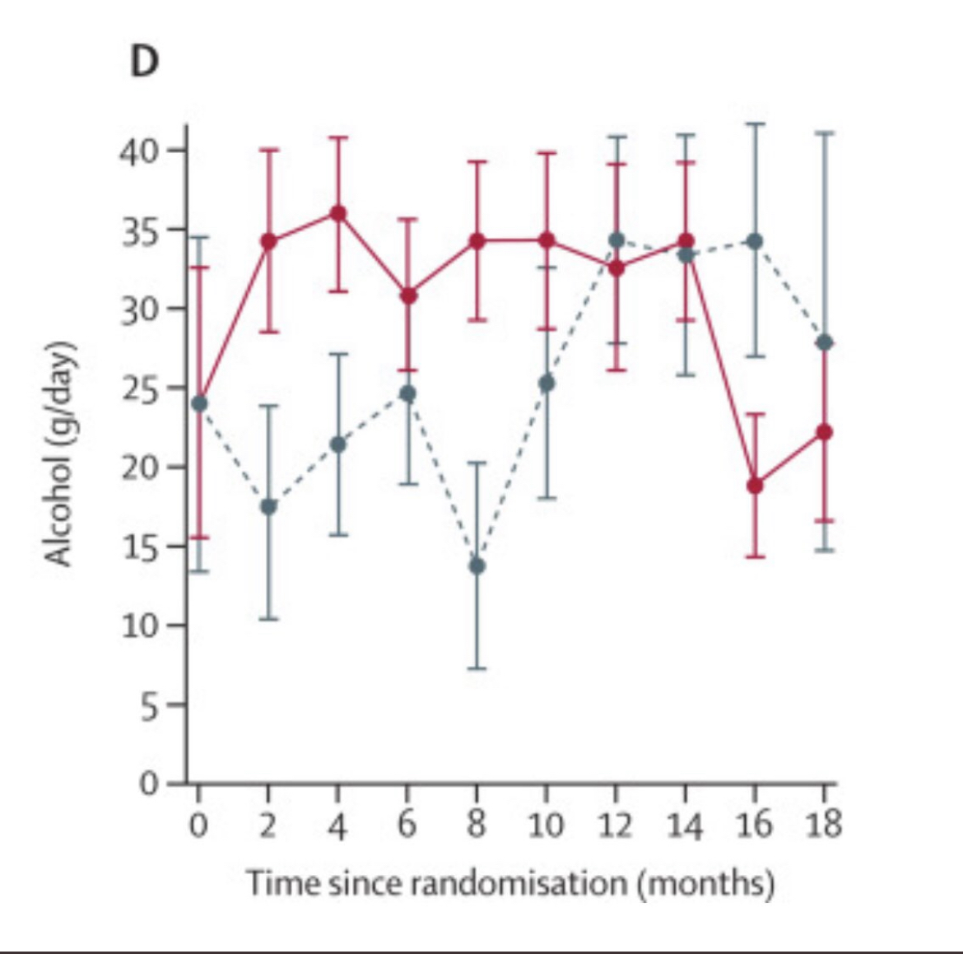
Rifaximin in early ArLD tended to reduce progression but did not affect drinking behavior
Israelsen et al Lancet Gastro Hep 2023

Slide 21
FMT in ArLD and AAH

Slide 22
Case Series of FMT in steroid resistant Alcoholic Hepatitis
Survival Benefit
Microbiota similarity
with donor
Philips et al CGH 2016

Slide 23
Long-term experience in Alcohol-associated hepatology: lower relapse and better outcomes
N=35 FMT
N=26 Standard of care
Not a randomized trial
Alcohol relapse
28.6% FMT
vs
53.8% Standard of care
Philips et al JCEH 2022

Slide 24
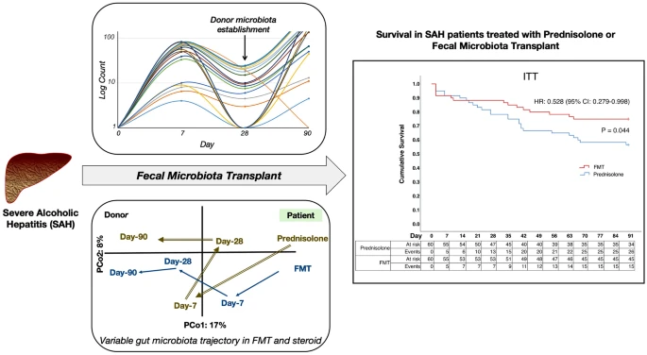
Open-label RCT of FMT (NGT X 7 days)
60 patients per group
Primary outcome: 90-day survival
Prednisolone Survival: 56.6%
FMT Survival: 75%
Higher infections in FMT group
Pande et al Hepatology International 2022

Slide 25
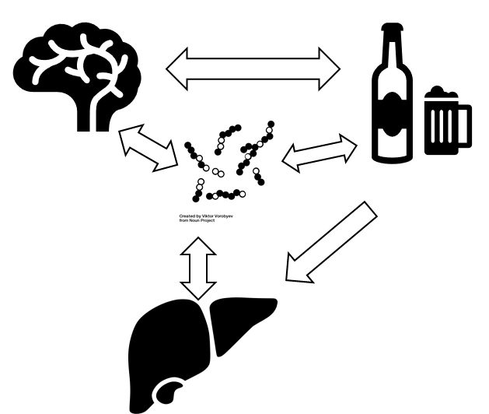


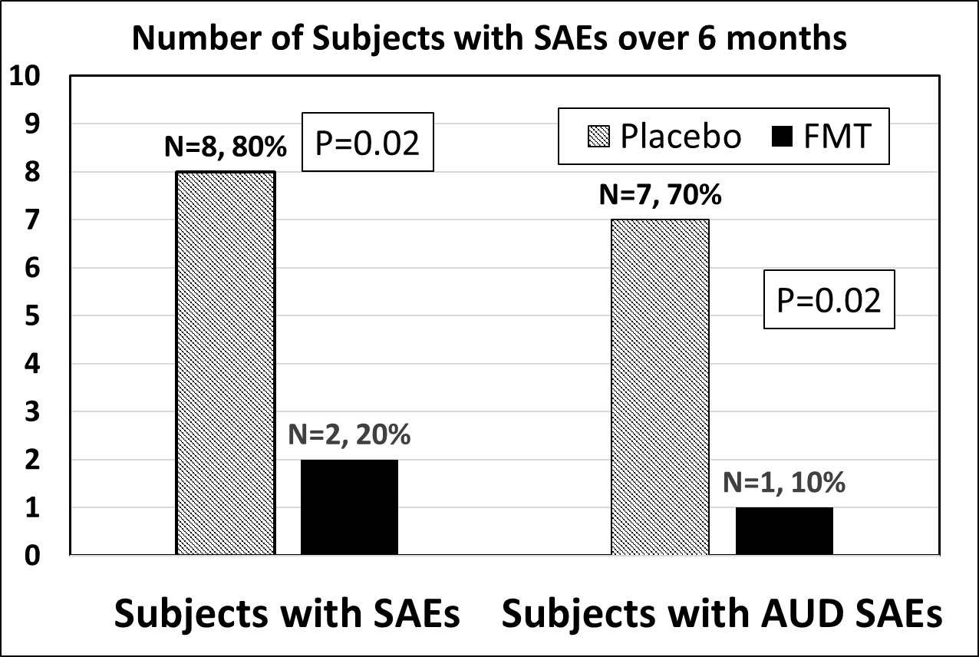

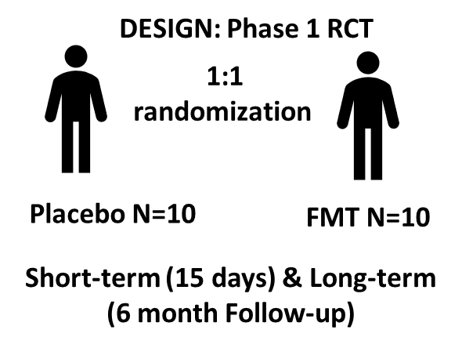
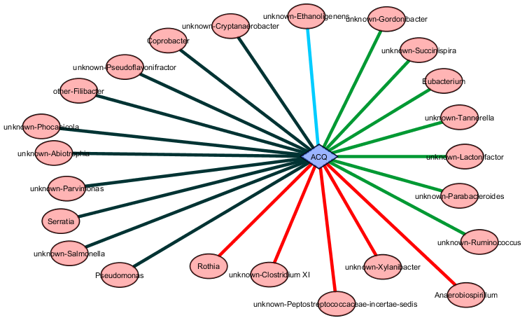
A Randomized Clinical Trial of Fecal Microbiota Transplant for Alcohol Use Disorder
Alcohol Use Disorder (AUD)
Short-term Outcomes in FMT
Long-term Outcomes
Impaired Gut-
Brain Axis
Alcohol use
Cirrhosis
↓ Craving
↓ Alcohol Consumption
↑ AUD-related hospitalizations and Serious adverse events (SAE) in placebo group vs FMT group
↑ Quality of life
↑ Cognition
↓ Systemic inflammation
↓ Intestinal permeability
POPULATION:
Men with AUD and cirrhosis
Unable/unwilling to quit
drinking despite end-organ damage
↑ Microbial Diversity
↑ Short-chain fatty acid (SCFA) producing taxa
↑ plasma and stool SCFAs
↑ linkage of SCFAs with craving and brain function
Trend towards higher long-term abstinence (30% vs 10%) in FMT
FMT was safe and no FMT-related adverse events noted throughout
Bajaj JS et al Hepatology 2020

Slide 26
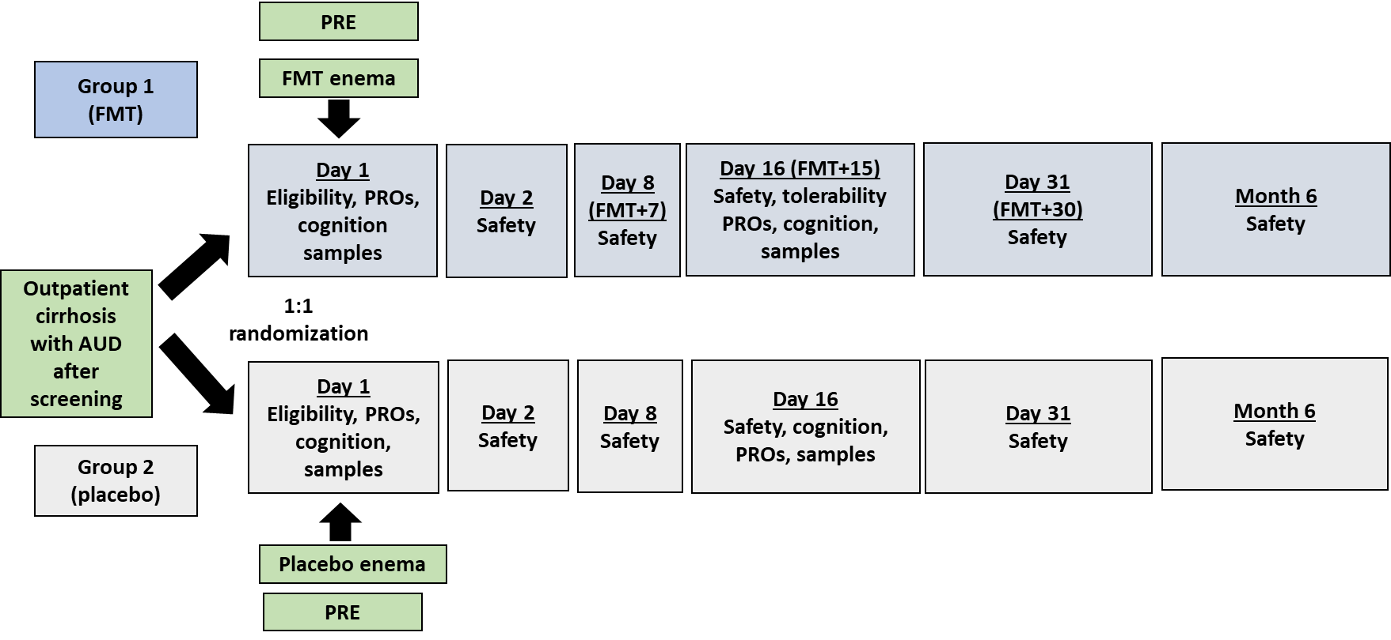
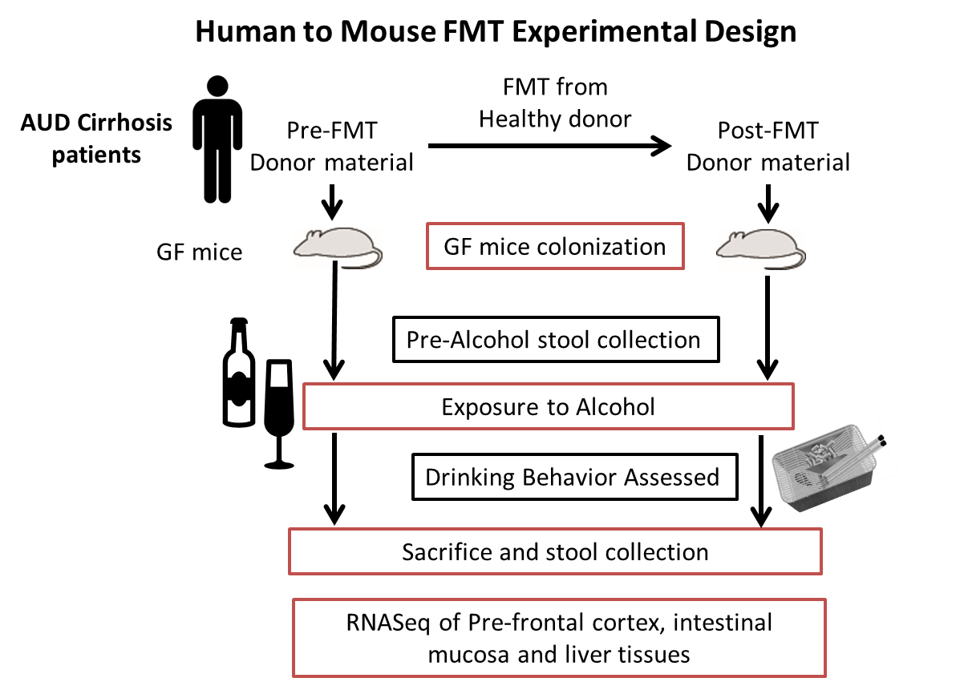
Pre: Pre-FMT, Post: Post-FMT
D1= day 1, D2=Day 2
***p<0.001,*p<0.05 Mann Whitney
14 mice in each group
2A
Ethanol Intake
2A: 24-hour intake
2B: 2-hour initial binge
Alcohol exposure for 2 days
Free of alcohol
for 18 hours
2B
Wolstenholme et al Nature Comms 2022

Slide 27
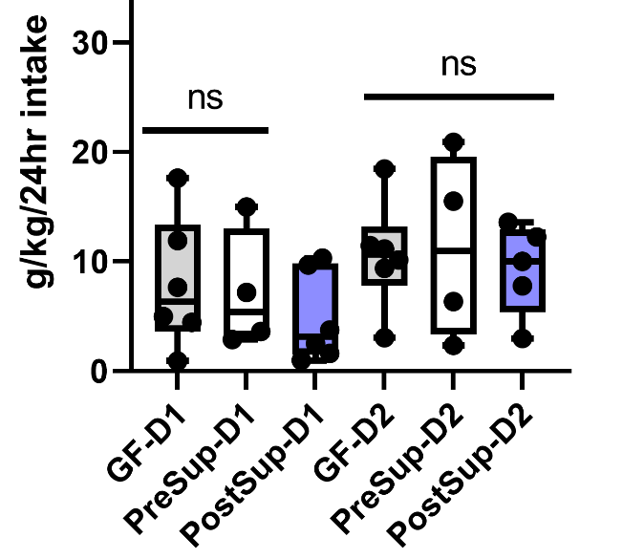
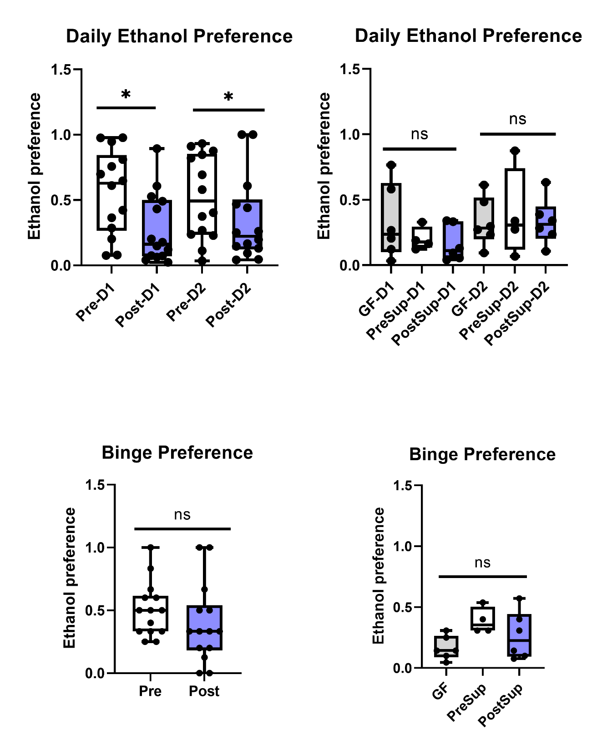
Ethanol intake is decreased in post-FMT stool mice, but not with supernatants
Most DEGs were in the intestine, not the brain or the liver!
Wolstenholme et al Nature Comms 2022

Slide 28
IMPACT: Intestinal Microbiota Transplant in Alcohol-Associated Chronic Liver Disease
Started enrollment
Phase 2 double-blind randomized placebo-controlled study of FMT capsules
Chronic liver disease and cirrhosis who continue to drink despite current and prior therapies
NIAAA-sponsored clinical trial
Is being performed under FDA IND

Slide 29
Future challenges and issues

Slide 30
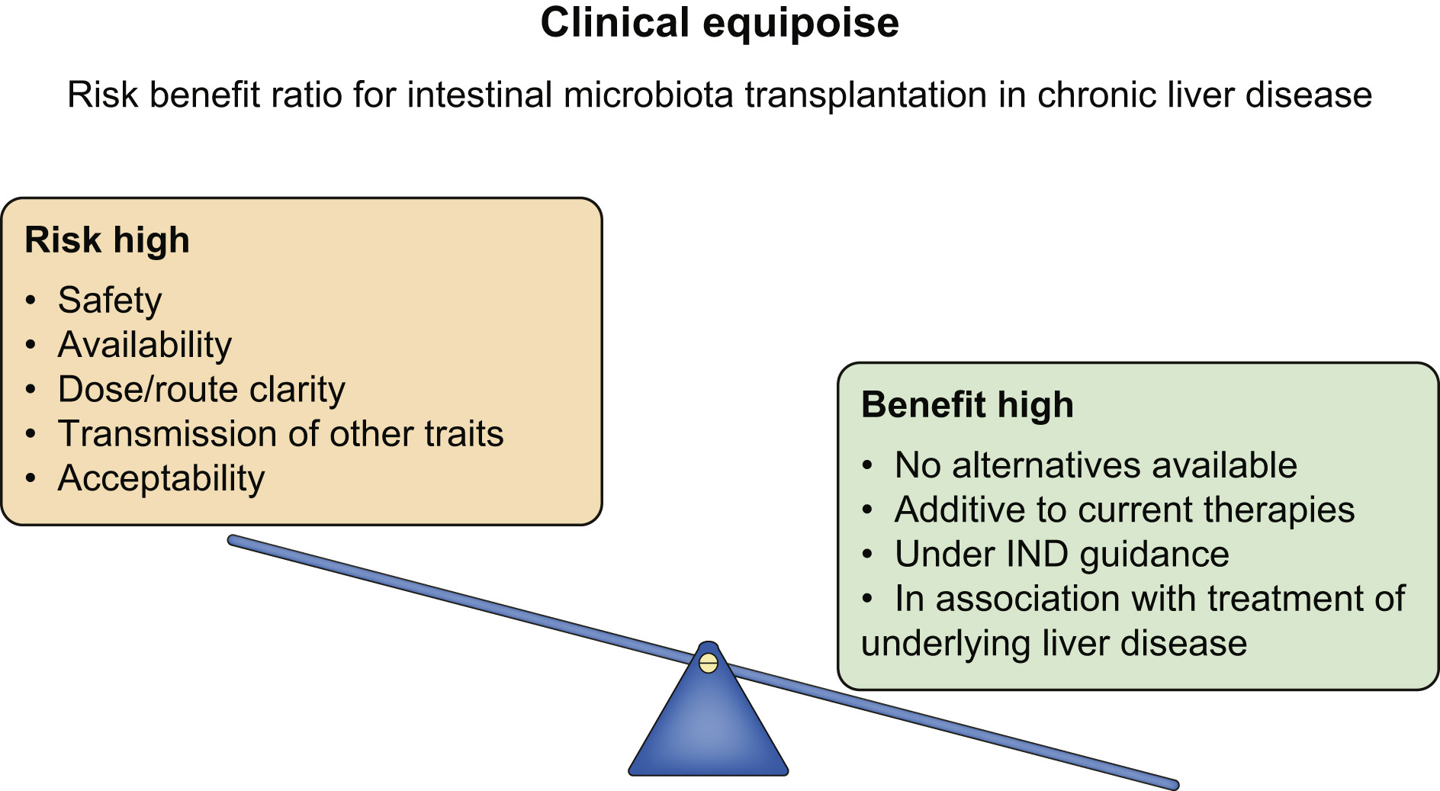
Bajaj, Khoruts J Hepatol 2020

Slide 31
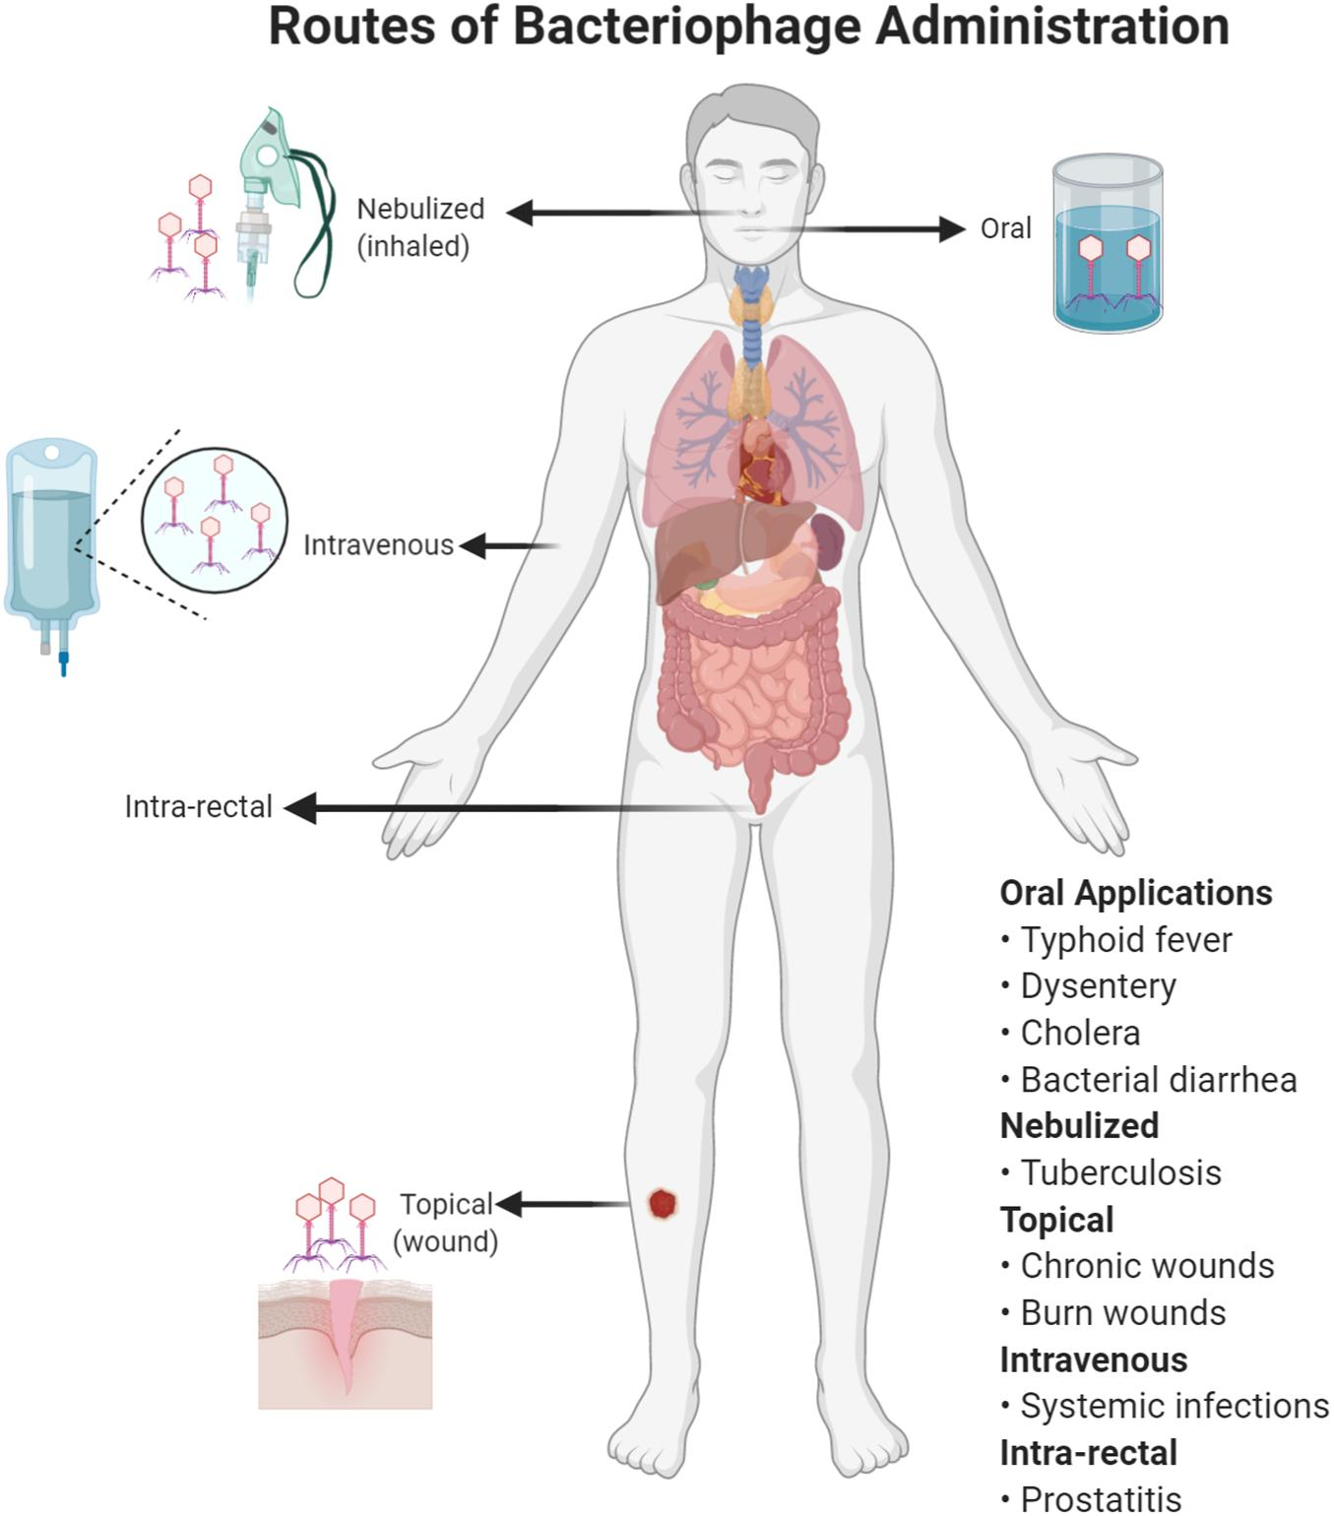
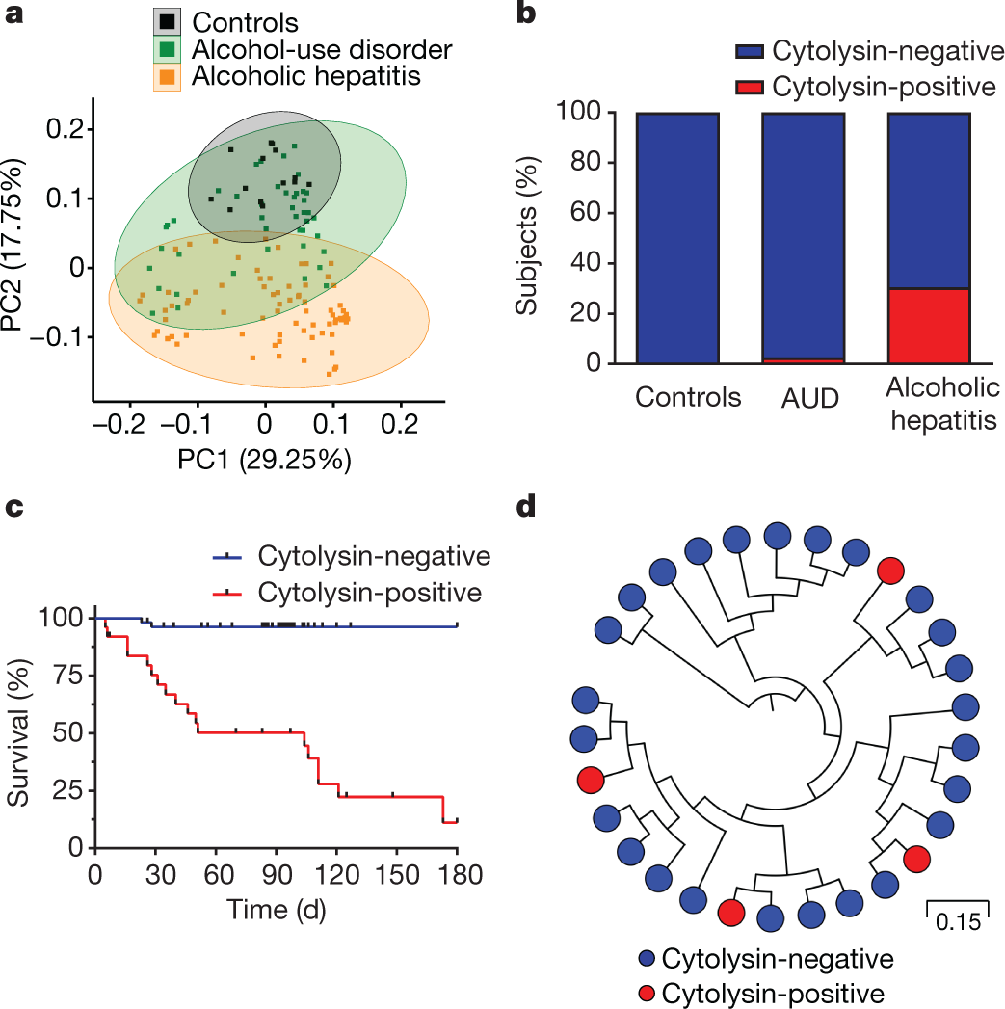
Phage therapy: Potential?
Khalid et al Front Microb 2021, Duan et al Nature 2019

Slide 32
Microbial target remaining questions in AAH
Which patient groups?
What timepoint(s)?
Which route(s)?
What agent(s)
How long for?
Primary outcome: Long-term survival without relapse (need therapies over and above the current Rx and not instead)
Secondary outcomes: everything else!

Slide 33
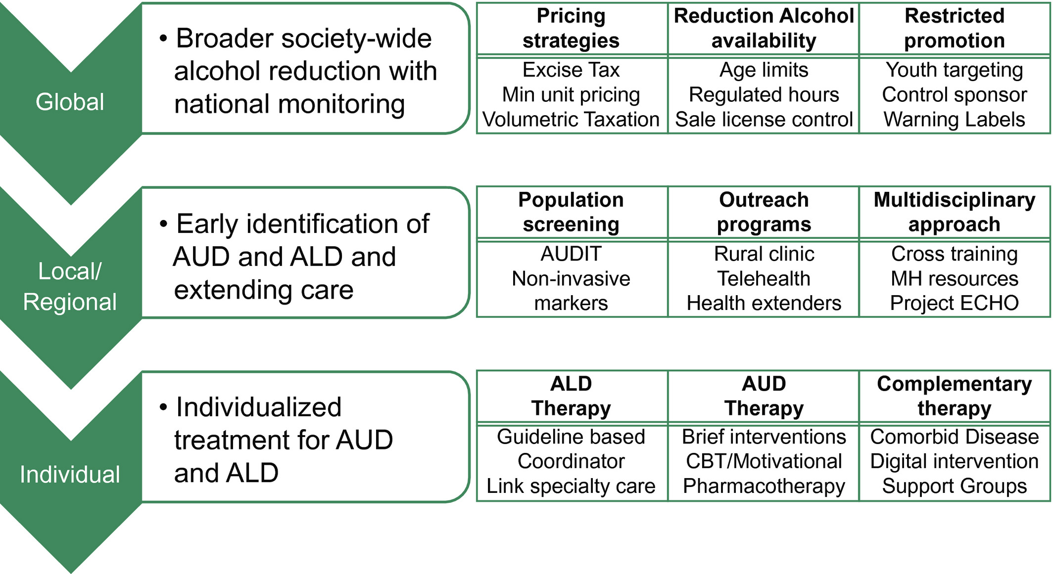
Asrani et al Hepatology 2015

Slide 34
Conclusions
Current therapies for ArLD are not specifically focused on the gut-liver axis and have issues with safety, availability, or real-world effectiveness in advanced patients
Gut liver axis is an attractive target for alcohol-related liver disease
Reduction of alcohol intake and craving has been shown in proof-of-concept FMT and probiotic trials.
For liver-related outcomes, conventional antibiotics have a mixed record
FMT using nasoduodenal route from family member donations have improved outcomes in patients with alcohol-associated hepatitis
Challenges remain in personalizing therapy but promising approaches including phages are being studied
Microbial therapeutics are one part of the multi-disciplinary strategy needed for AUD, AAH, and ArLD

Slide 35
Collaborators and Team Members
VCU/VA Gastroenterology and Hepatology
Arun J Sanyal, MD
Richard K Sterling, MD
Douglas M Heuman, MD
William M Pandak, MD
R Todd Stravitz, MD
Velimir Luketic, MD
Puneet Puri, MD
Michael Fuchs, MD
Mohammad S Siddiqui, MD
Scott C Matherly, MD
HoChong Gilles, NP
Vaishali Patel, MD
Obaidullah Aseem, MD
Amon Asgharpour, MD
Brian C Davis, MD
Hannah Lee, MD
Jennifer Miller, MD
GMU Environmental Sciences
Patrick M Gillevet, PhD
Masoumeh Sikaroodi, PhD
VCU Microbiology/Immunology
Phillip Hylemon, PhD
Huiping Zhou, PhD
DJ Kang, MS
Genta Kakiyama, PhD
Derrick Zhao, BS
Lianyong Su, PhD
University of Minnesota
Alexander Khoruts, MD
VCU/VA coordination current
Edith Gavis, RN
Andrew Fagan, BS
Mary Leslie Gallagher, NP
Diandra Brown, BS
Amy Bartels, RN
Courtney Brown, BS
Travis Mousel, RN
CARI Imaging
F. Gerard Moeller, MD
Joel Steinberg, MD
Robert Cadrain, BS
VCU Biostatistics and DCC
Leroy R Thacker, PhD
Brian Bush
Brian Seigla
VCU/VA coordination past
Melanie B White, RN
Sara McGeorge, BS
Nicole Noble, BS
Ariel Unser, BS
NGRRC University of North Carolina
R Balfour Sartor, MD
Jeremy Herzog, PhD

Slide 36


Slide 37
Microbial target design and challenges in AAH
Mostly hospitalized and have differing dietary habits
Severe alterations in GI, liver, and systemic immune system
Prone to infections
Multiple antibiotics needed
Antifungal therapies needed
Are often on steroid therapy
Pre-hospital diet, alcohol misuse patterns, and medications may be different
Could be complicated by a long tail of post-discharge AUD-related impaired outcomes
There is often a major disconnect between inpatient, and outpatient services including GI/ICU/hepatology and addiction/mental health

Slide 38
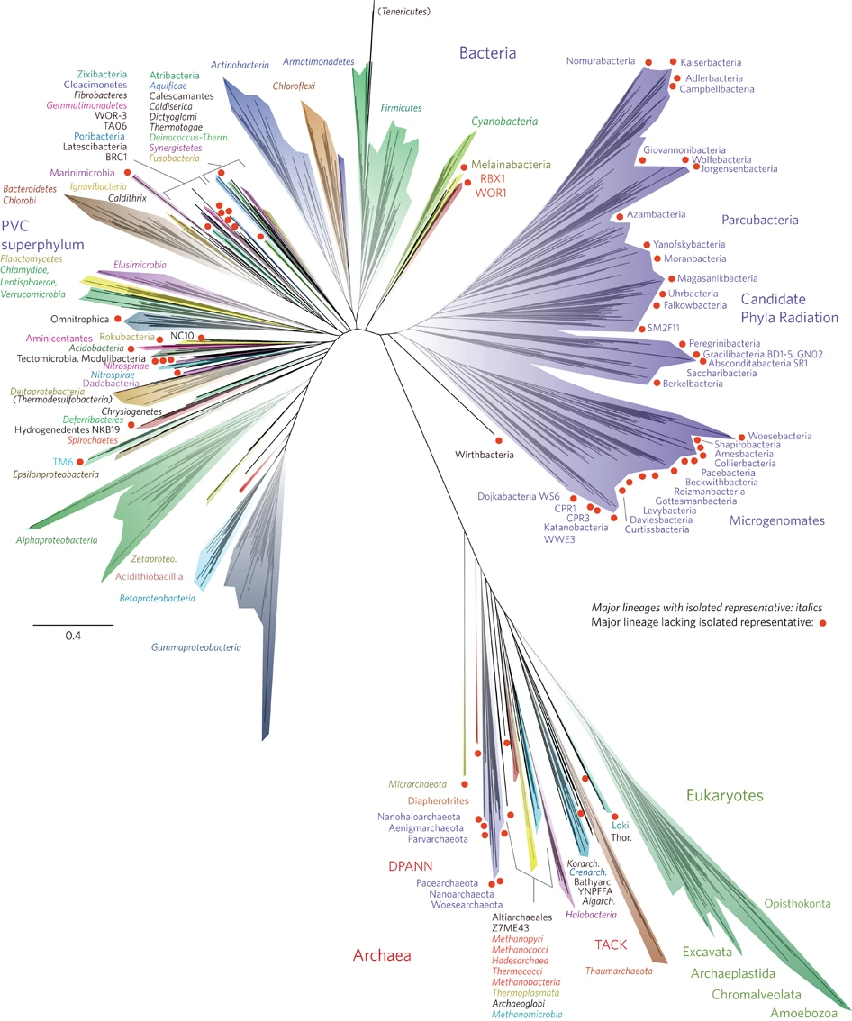
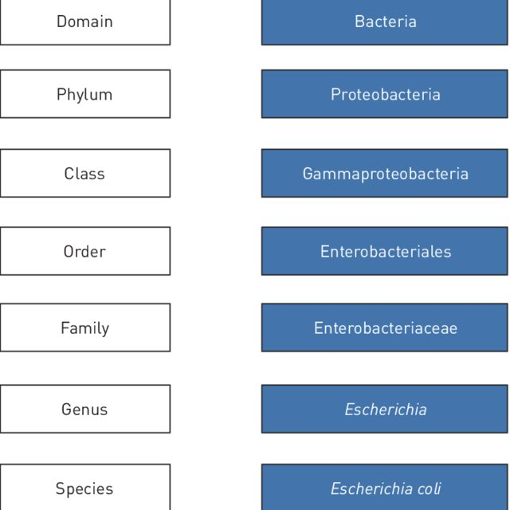
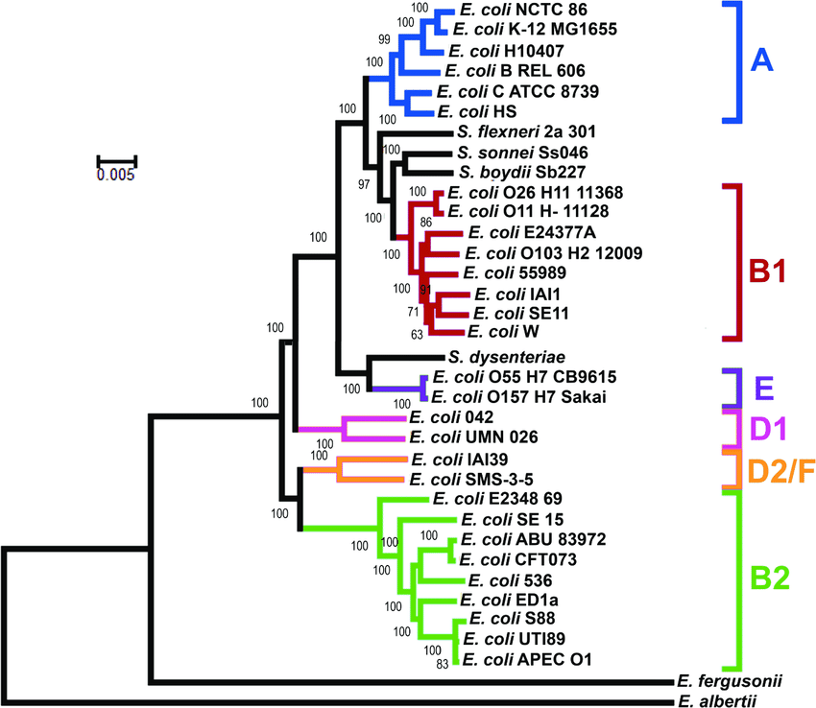
Complexity of the Microbiome
Hug et al Nat Microb 2016

Slide 39
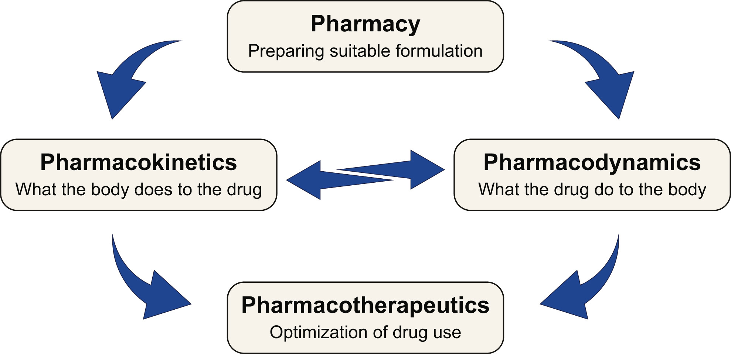
Bajaj, Khoruts J Hepatol 2020

Slide 40
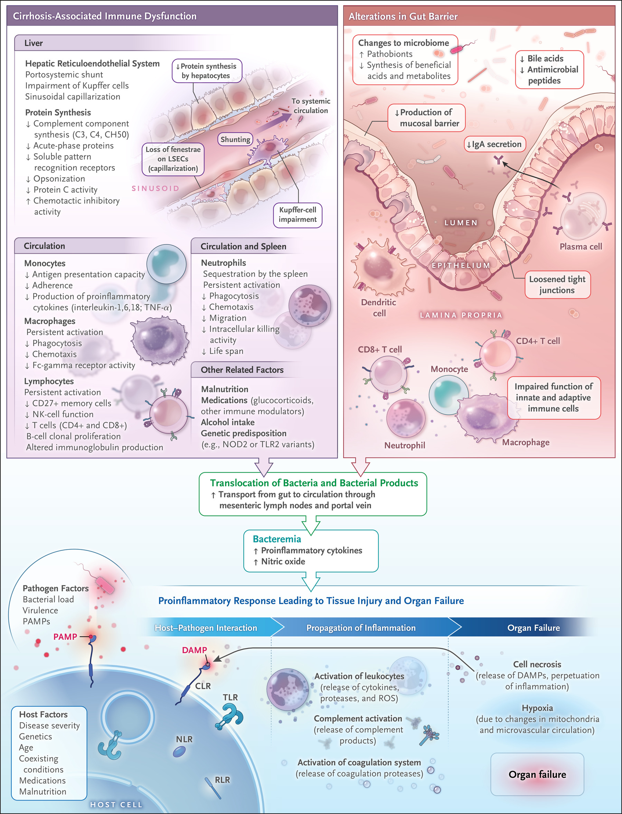
Gut-liver changes and immune dysfunction
Albillos et al J Hep 2020,
Bajaj et al NEJM 2021

Slide 41
Reduction in liver-related outcomes through gut-liver axis change

Slide 42
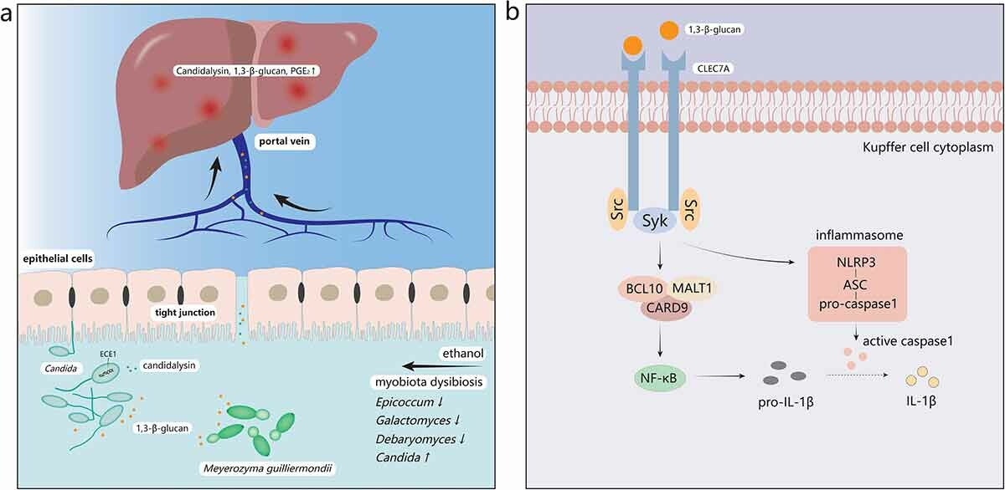

Slide 43
Case Series of FMT in steroid resistant Alcoholic Hepatitis
Survival Benefit
Microbiota similarity
with donor
Philips et al CGH 2016

Slide 44
Specific current means by which we can potentially improve outcomes
  Regular dental cleaning and avoid periodontitis
  Withdraw unnecessary PPI use
  Carefully re-evaluate the need for antibiotics, which could encourage fungal infections
  Emphasis on fermented, probiotic foods
  Ensure that focus on treating liver disease along with microbiota is not lost

Slide 45
Acknowledgements
VCU Microbiology/Immunology
Huiping Zhou, PhD
Phillip Hylemon, PhD
DJ Kang, MS
Genta Kakiyama, PhD
VCU/VA Gastroenterology and Hepatology
Arun J Sanyal, MD
William M Pandak, MD
Richard K Sterling, MD
R Todd Stravitz, MD
Velimir Luketic, MD
Puneet Puri, MD
Michael Fuchs, MD
Mohammad S Siddiqui, MD
Scott C Matherly, MD
Hannah Lee, MD
Douglas M Heuman, MD
Inst for Liver Diseases, London
I Jane Cox
Roger Williams
Shilpa Chokshi
Imperial College, London
Mark McPhail
Simon D Taylor-Robinson
GMU Environmental Sciences
Patrick M Gillevet, PhD
Masoumeh Sikaroodi, PhD
OpenBiome
Zain Kassam
Majdi Osman
Emilee Tu
Audrey Abend
VCU/VA coordination
Melanie White, RN
Edith Gavis, RN
Travis Mousel, RN
Andrew Fagan, BS
Sara McGeorge, BS
University of Minnesota
Alexander Khoruts
University of California,
Davis
Oliver Fiehn
Sili Fan
Funding: VA Merit Review I0CX001076, R21TR0020204, RO1DK089713, RO1AA020203

Slide 46
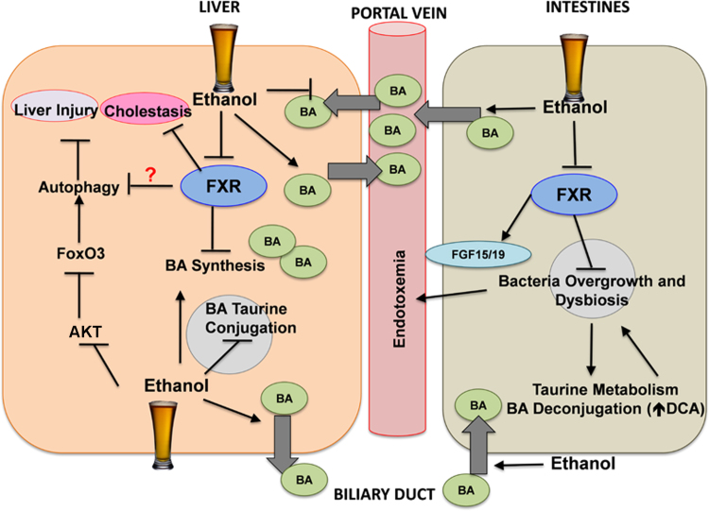

Slide 47
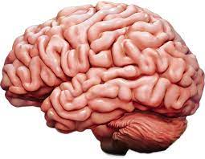
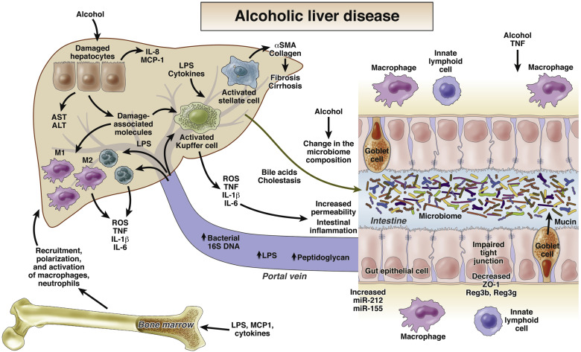
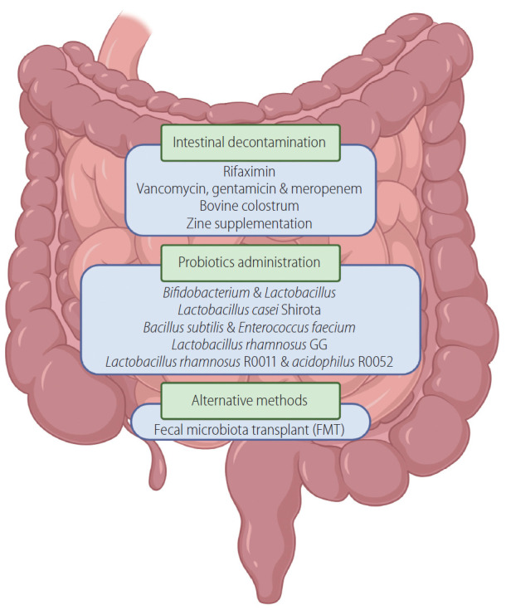
Szabo et al Gastro 2015

Slide 48
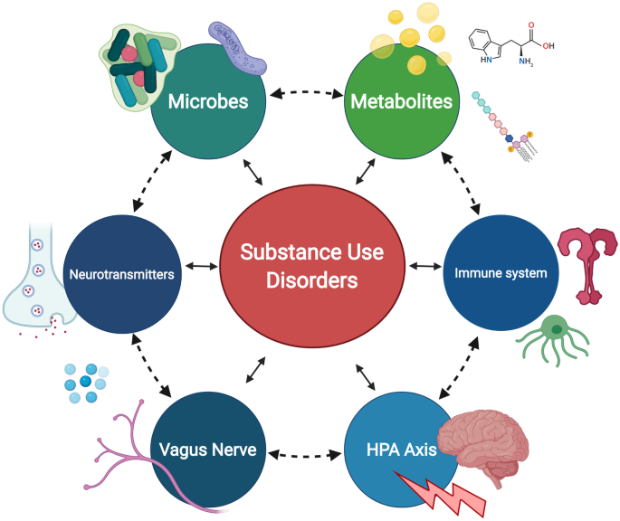
Simpson et al 2022 Journal of Neuroimmune Pharmacology

Slide 49
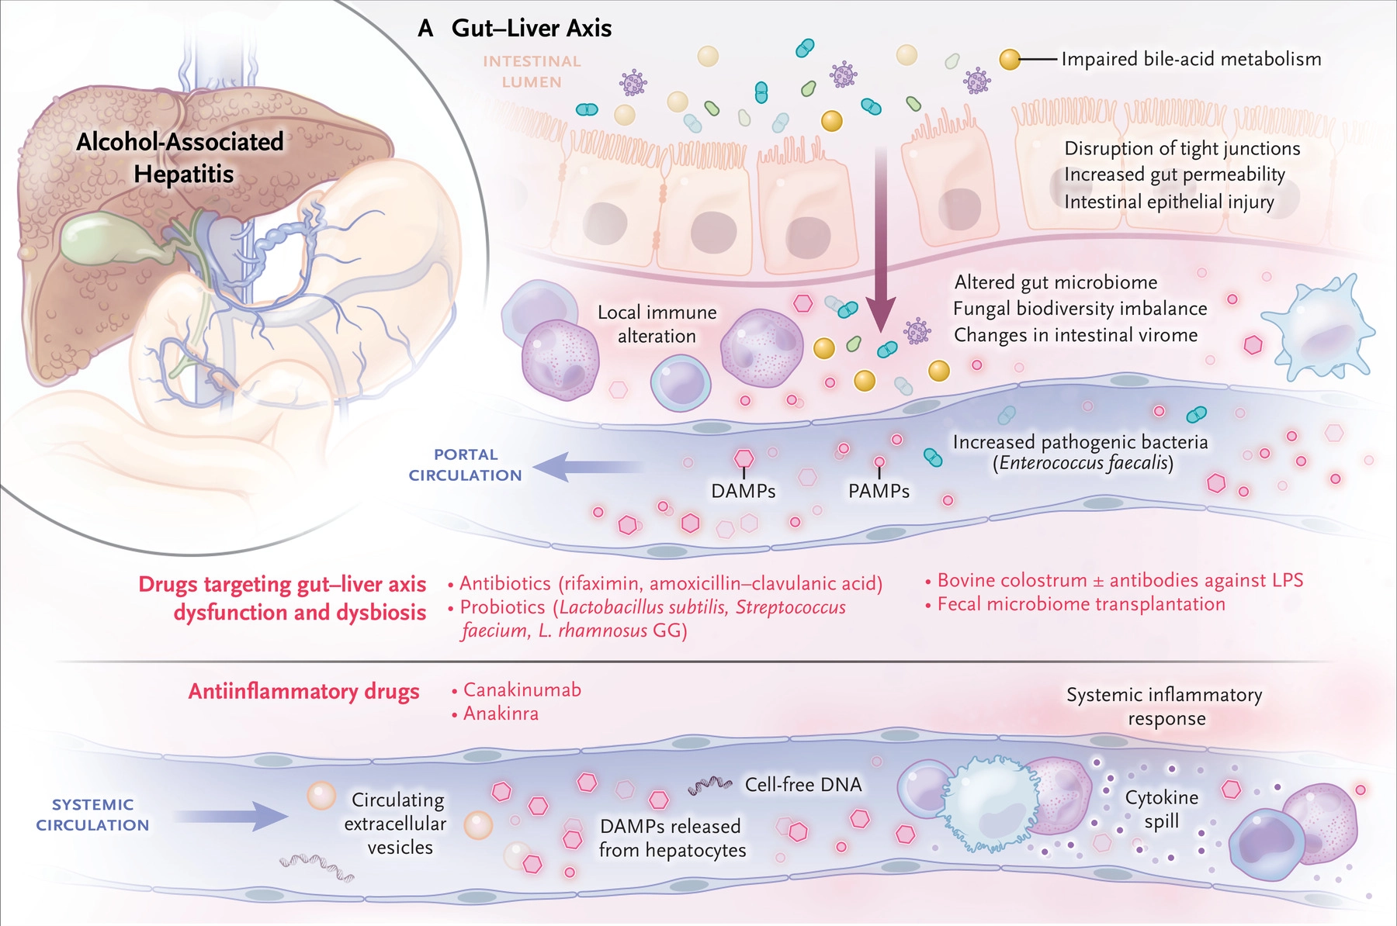
Bataller et al NEJM 2022

Slide 50
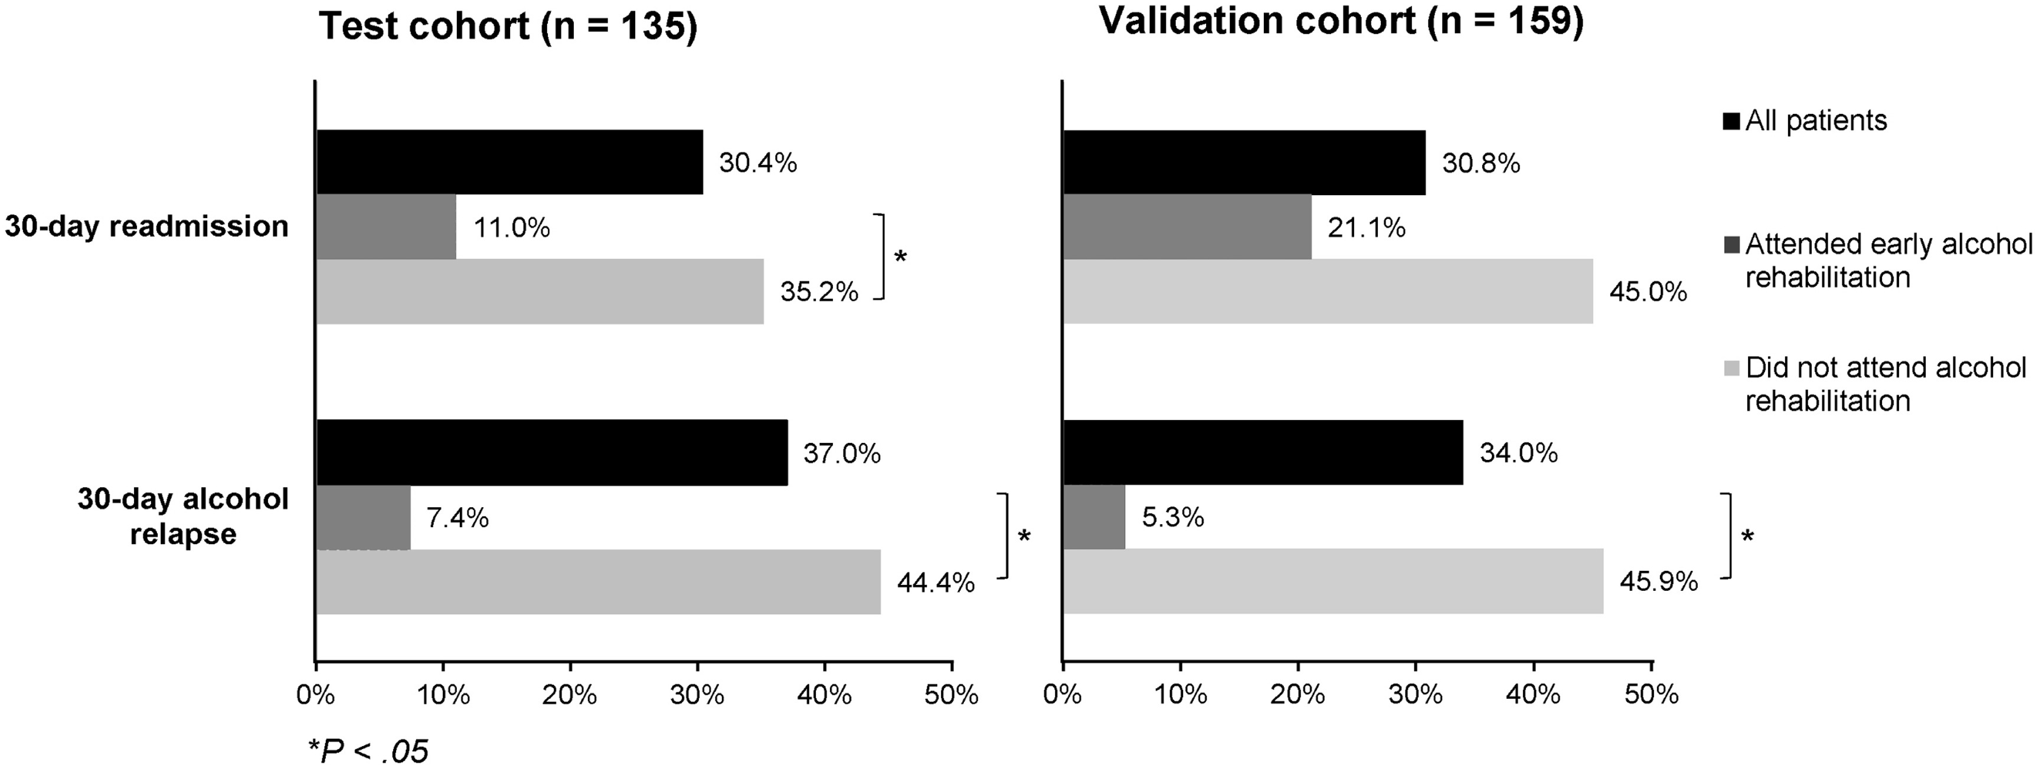
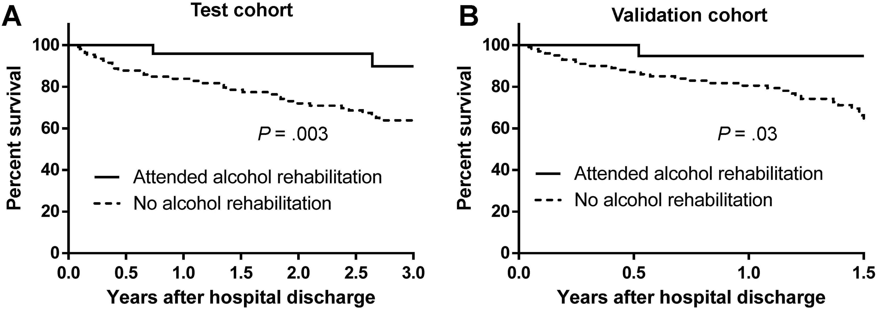
Need to integrate inpatient and outpatient management of AAH
Peeraphatdit et al CGH 2020

Slide 51
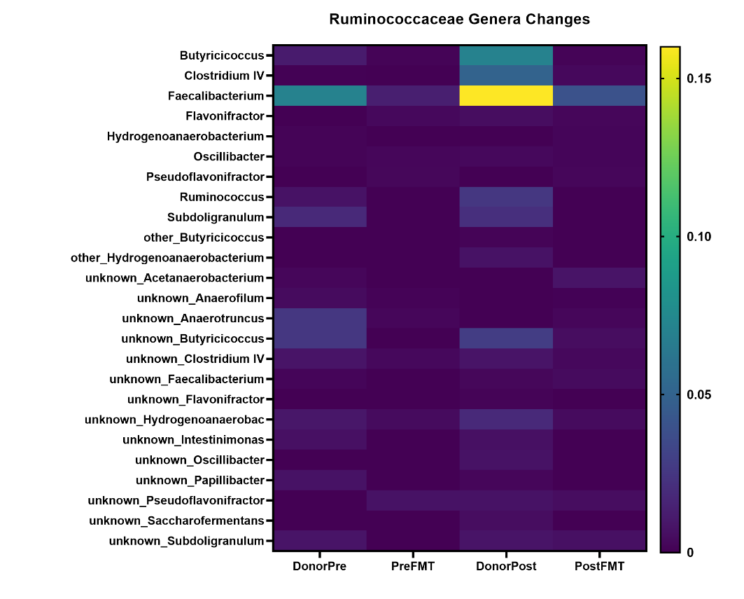
Higher Microbial Engraftment and
most DEGs were in the intestine
Wolstenholme et al Nature Comms 2022
Notes:
A: Pre: Pre-FMT but not exposed to alcohol, Post: Post-FMT but not exposed to alcohol
PreAlc: Pre-FMT after alcohol exposure, PostAlc: Post-FMT after alcohol exposure
**p<0.01, *p<0.05, Mann Whitney for unpaired and Wilcoxon signed rank test for paired
Analyses (before/after alcohol), 14 mice per group. None of the GF mice (controls or with
GF supernatants) had microbiota detected.
B: Ruminococcaceae and C: Lachnospiraceae genera heatmap of average relative abundance from human donors pre and post to GF mice.

