Slide 1

Liver Transplantation
Today & Tomorrow
PHS 2023
Norah Terrault, MD, MPH
Professor of Medicine
Chief, Division of Gastrointestinal and Liver Diseases
University of Southern California
@norahterrault

Slide 2
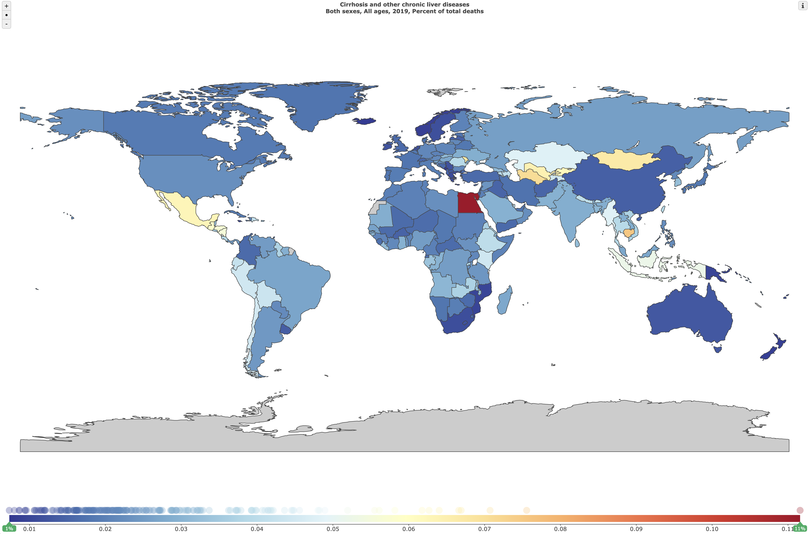
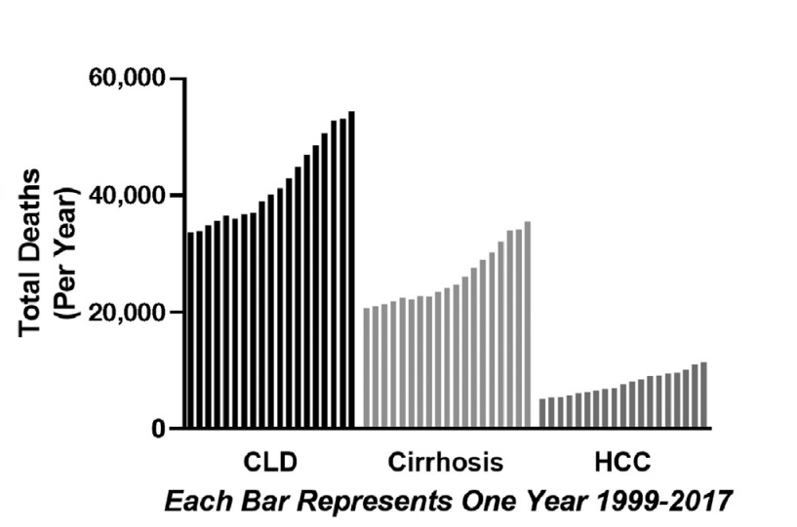
Global Burden of Cirrhosis Mortality
Cirrhosis/CLD ranks 10th globally as cause of death
1.5 million deaths in 2019
US Mortality Increasing
Most rapid rise among young (40 years) and women
% deaths per country for cirrhosis/CLD in 2019
Global Burden of Disease Study. Available from: https://vizhub.healthdata.org/gbd-compare.
Tapper EB, BMJ, 2018;362:k2817

Slide 3
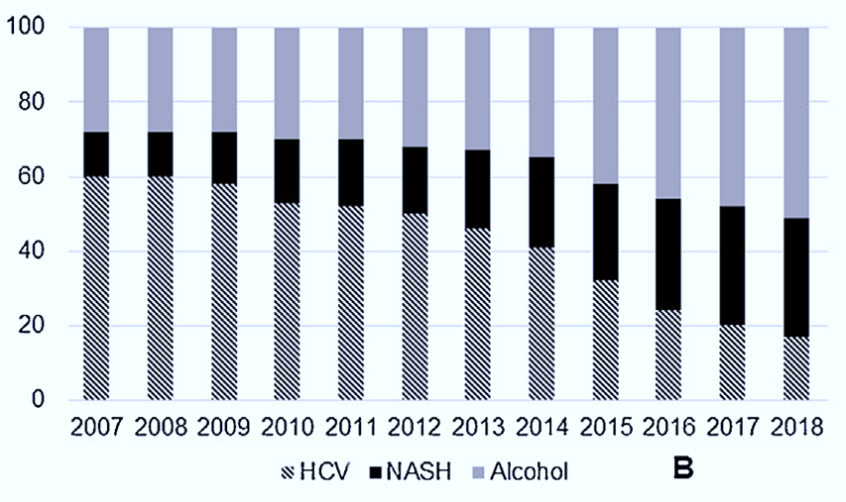
Indications for Liver Transplantation
U.S. (UNOS)
Major shift in past decade
LT listings
Less HCV
More NAFLD
More alcohol, including AAH
HCC still important – rates vary with allocation policies
EUROPE (ELTR)
ALD
HCV
HBV
NASH
Singal A, DDS, 2022;52:98-101
Belli L, J Hepatol. 2018;69:810-817

Slide 4
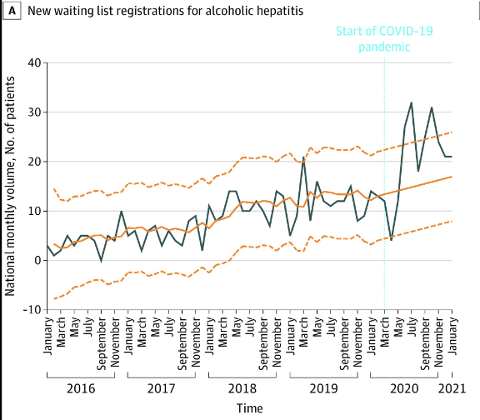
Alcohol-Associated Liver Disease: Recent Trends
Shift away from 6-month sobriety requirement for LT
  Fueled by urgency of considering LT in those with severe AH
Focus on comprehensive psychosocial evaluation → equal or greater importance in predicting relapse
Increased recognition of AUD as chronic disease that requires long-term management
Start of pandemic
Anderson M, JAMA Netw Open, 2021

Slide 5
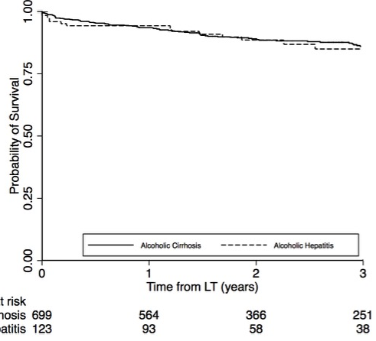
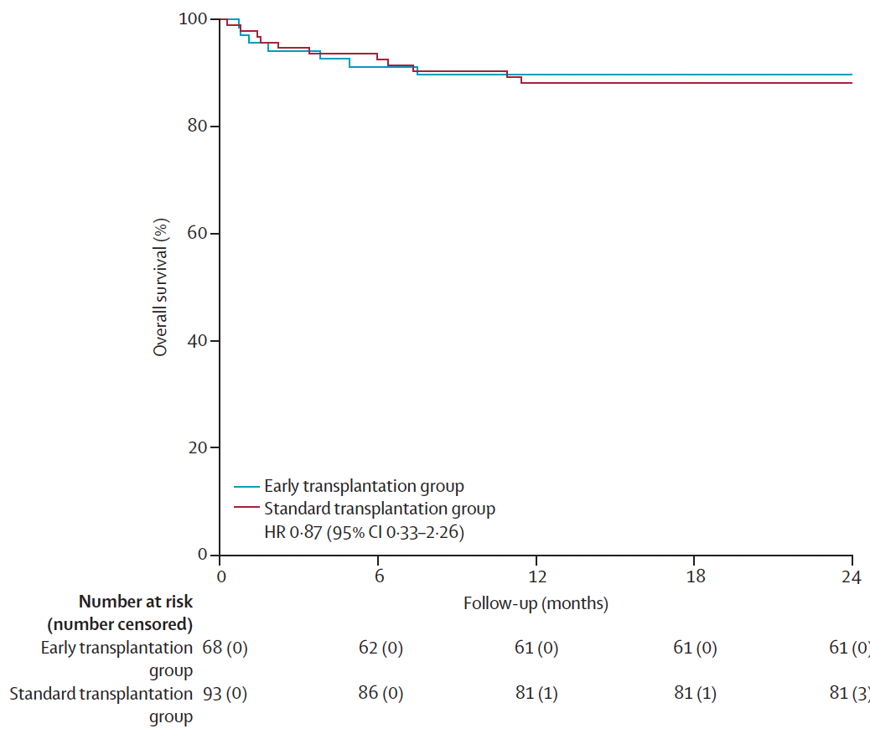
Early LT for AH: Acceptable Outcomes
QuickTrans, 19 French and Belgian hospitals
Early LT for AH unresponsive to steroids
Prospective, non-randomized study
ALD-cirrhosis vs AH
Limited to 12 US sites
N=147 AH
N=699 ALC
89.7%
88·2%
ALC vs. AH
3-yr survival: 85% vs. 83%
p=0.85
HR 0.87 (95% CI 0.33-2.26)
Early LT group
Standard (≥6 months abstinence)
At risk
ALC
AH
Comparable survival to cohorts using a 6-month sobriety requirement
Lee B et al, JAMA Intern Med 2019;179:340-348.
Louvet A, Lancet Gastro Hepatol 2022
Notes:
.

Slide 6
ALD and LT: Need to Improve Outcomes
Patient selection
Reduce selection committee bias
Objective tools to predict high risk for relapse
Managing AUD
Embed AUD treatment in LT care
Establish role of medications, eg. naltrexone
Reducing non-Liver Related Mortality
Surveillance for cancers
Prevention of cardiovascular dz

Slide 7
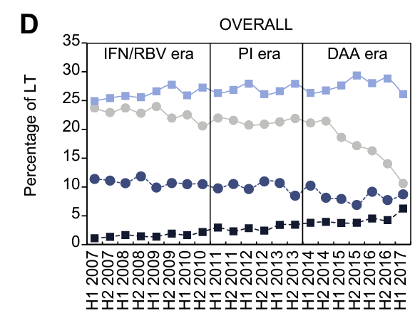
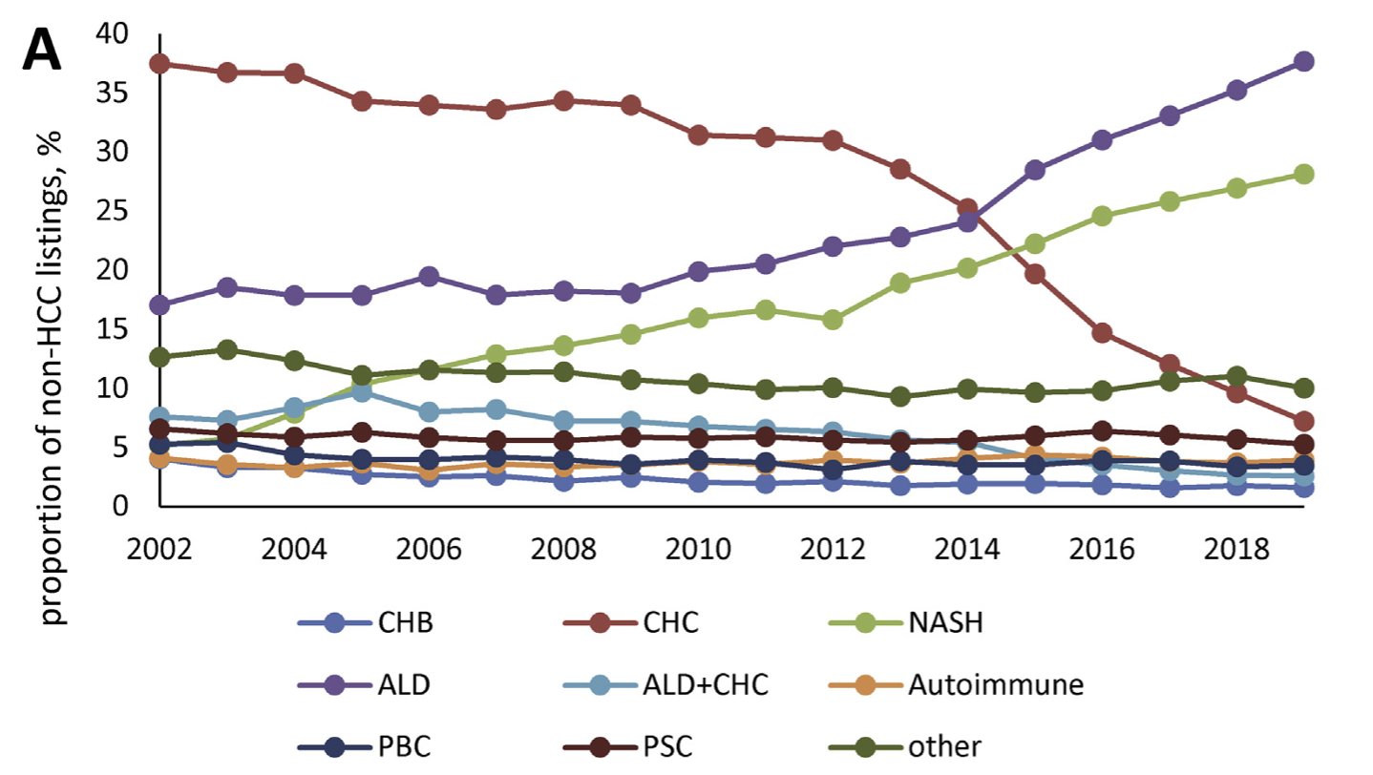
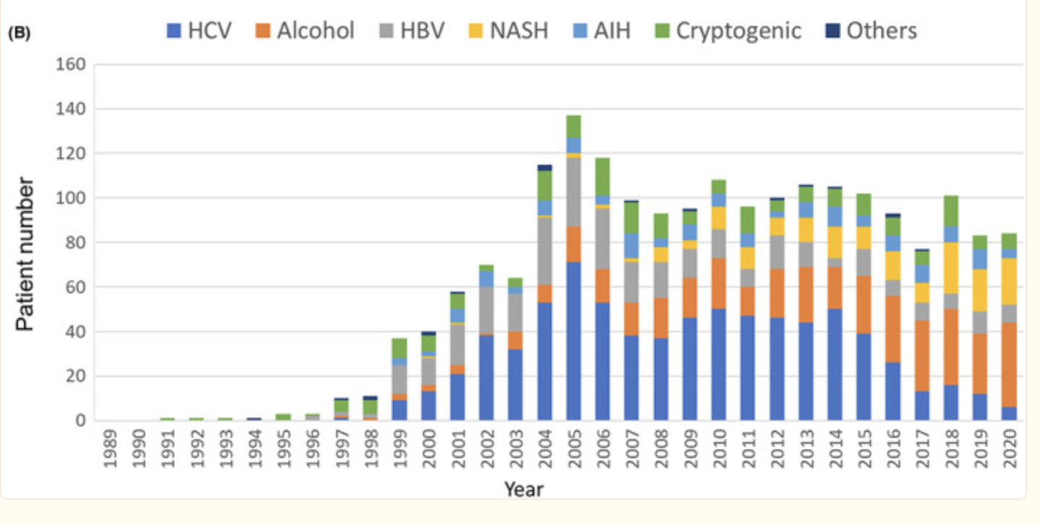
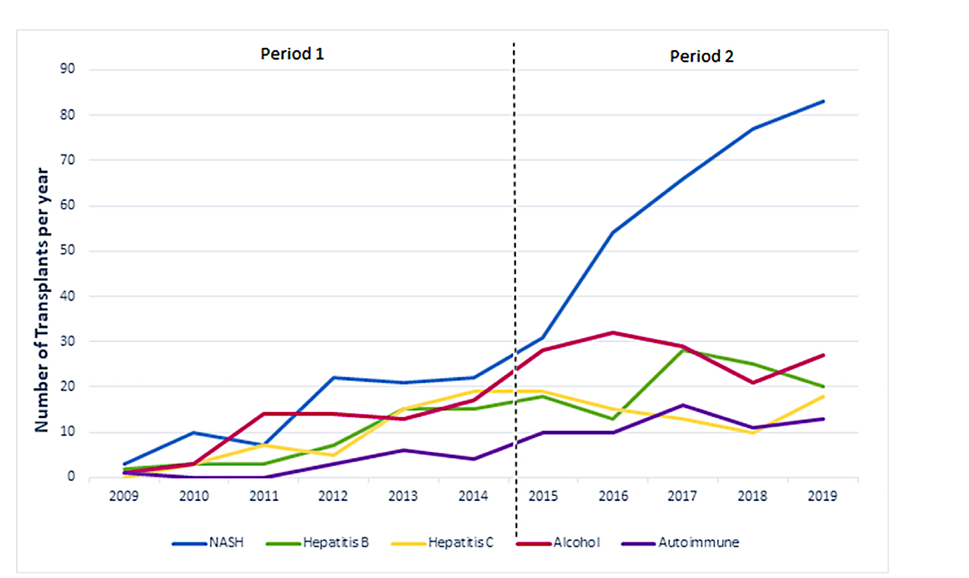
NASH is Rapidly Rising Indication for LT Globally
United States
Europe
Younossi Z, Clin Gastroenterol Hepatol 2021;19:580-589
Japan
India
Belli L, Hepatol 2018;69:810-817
Jothimani M, J Clin Exp Hepatol. 2022;12:908-916
Nishio T, Ann Gastroenterol Surg 2022;7(1):42-52

Slide 8
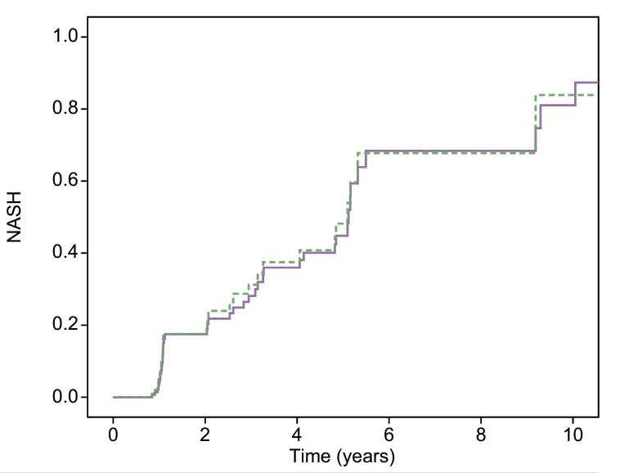
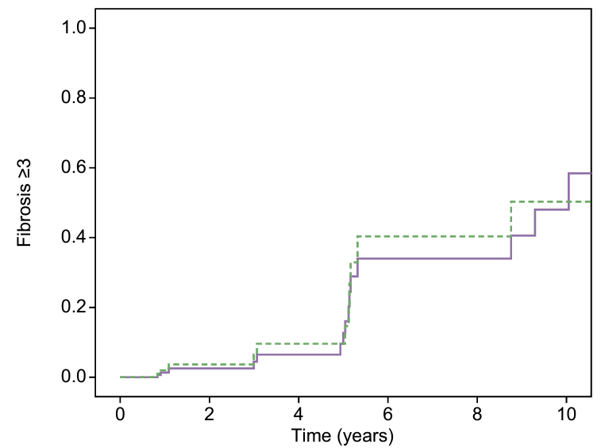
NASH and Risk of Recurrent Disease: Inevitable?
NASH
Advanced fibrosis
19 LT centers in France & Switzerland 2001-2018
150 patients with at least one graft liver biopsy available ≥6 months after LT
Median follow-up after LT was 4.7 (2.8-8.1) years.
86% had metabolic syndrome at 5 years follow-up
60% at 5 years
20% at 5 years
Significant risk factors from advanced fibrosis were
Metabolic syndrome before LT (OR 8.5; p=0.038)
Long-term use of cyclosporine (OR 11.39; p=0.031)
Grade >−2 steatosis at 1 year after LT (OR 10.72; p=0.049)
Villeret F, JHEP Report, 2023

Slide 9
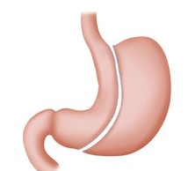
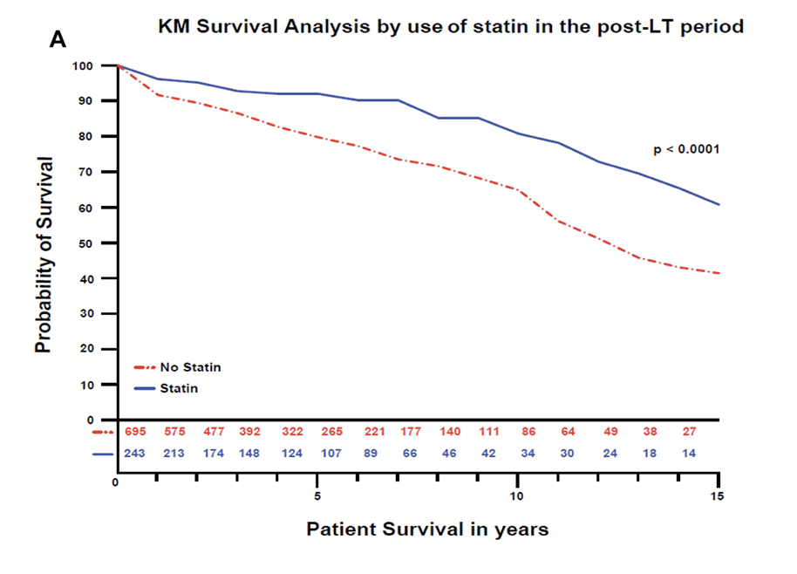

NASH in LT Setting
Prevention and Treatment of Recurrence
Bariatric surgery in LT candidates and recipients
18.8% on waiting list
29.1% at same time as LT
52.1% post-LT
Bariatric Surgery
IMS Modification
Metabolic management
Statins?
GLP-1 agonists?
Future: NASH-specific drugs
Metabolic Comorbidity | CNIs | MMF | mTORi | Steroids
Diabetes | ⬆ | -- | -- | ⬆
Dyslipidemia | ⬆ | <CNI | ⬆ | ⬆
Hypertension | ⬆ | <CNI | ⬆ | ⬆
Renal Injury | ⬆ | < CNI & mTORi | <CNI | --
Weight | ⬆ | <CNI | <CNI | ⬆
deBarros F, Updates in Surgery, 2021
CNI: calcineurin inhibitors
MMF: mycophenolate mofetil
mTORi: mTOR inhibitors
Statin
No Statin
HR 0.38 (0.19-0.75), p=0.005
Rinella M, CGH, 2023

Slide 10
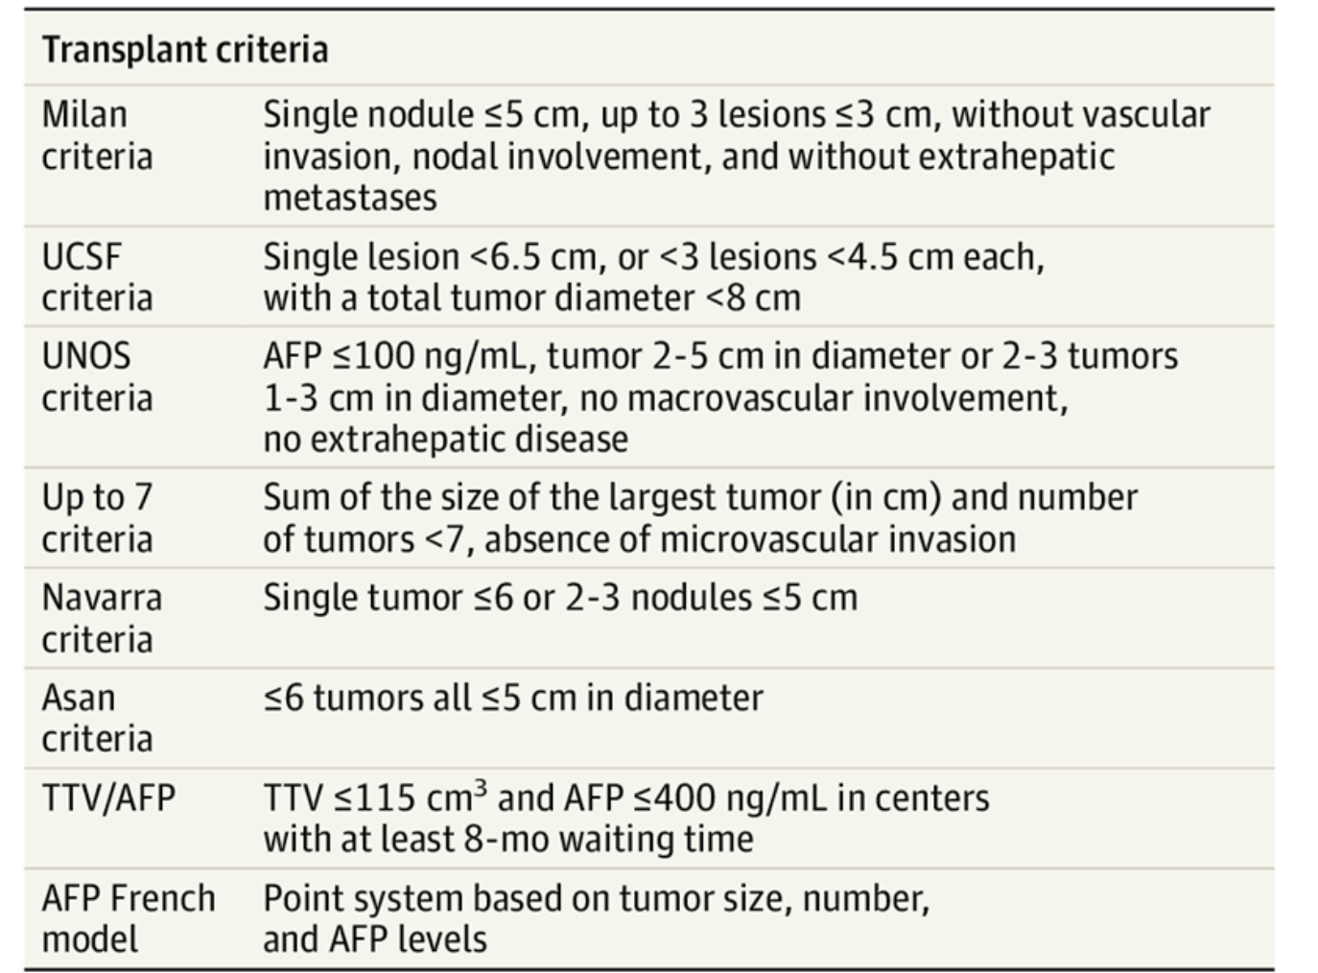
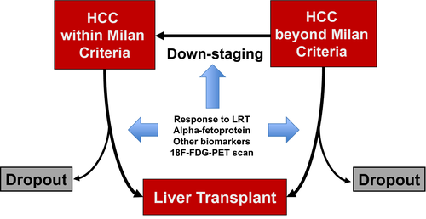
Liver Transplantation for HCC
Beyond Milan Criteria
Down-staged Patients
Tumor Morphology
Size
# Lesions
Biomarkers
AFP
Higher rates of drop-out on the list
Higher rates of recurrence post-LT
5-year patient survival 70-80%
5-year patient survival 50-70%
Toniutto P, J Clin Med 2021
Brown Z, JAMA Surgery 2023
Mehta N, Clin Liver Dis 2021

Slide 11
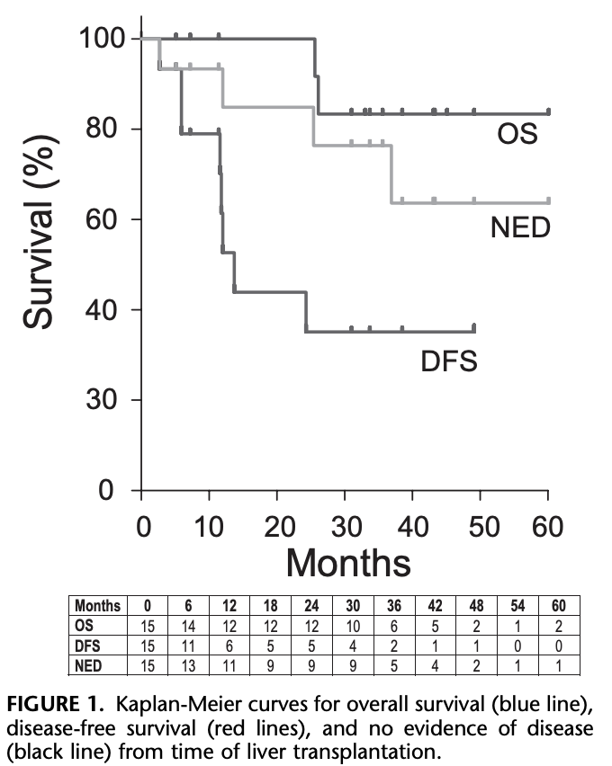
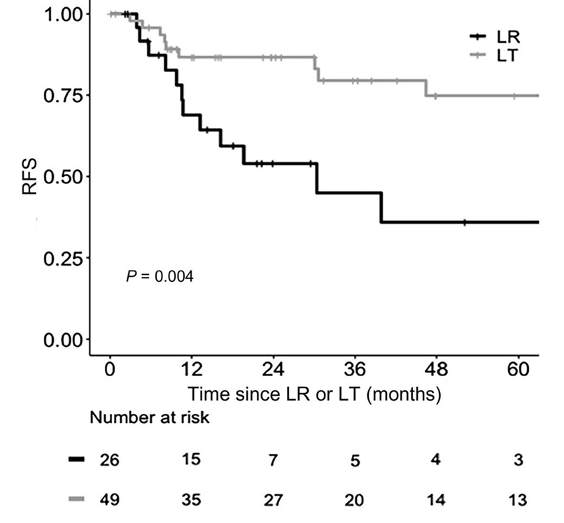
Expanding Transplant Oncology
Small iCCA or mixed HCC/CCA
≤5cm
Liver-limited CRC metastases
83%
Liver transplant offers survival advantage for select patients with liver-limited cancers
75%
35%
36%
Concerns to be addressed:
Worsen donor organ shortage
Survival improved vs. non-LT treatment but lower than non-cancer etiologies
Potential negative influence of IMS on cancer recurrence post-LT
SECA-II
OS: overall survival
NED: No evidence of recurrent disease
DFS: disease free survival
LT= liver transplant
LR= liver resection
Panayotova G, World J Gastrointest Surg 2021; 13: 392-405
De Martin E, Liver Transplant 2020

Slide 12
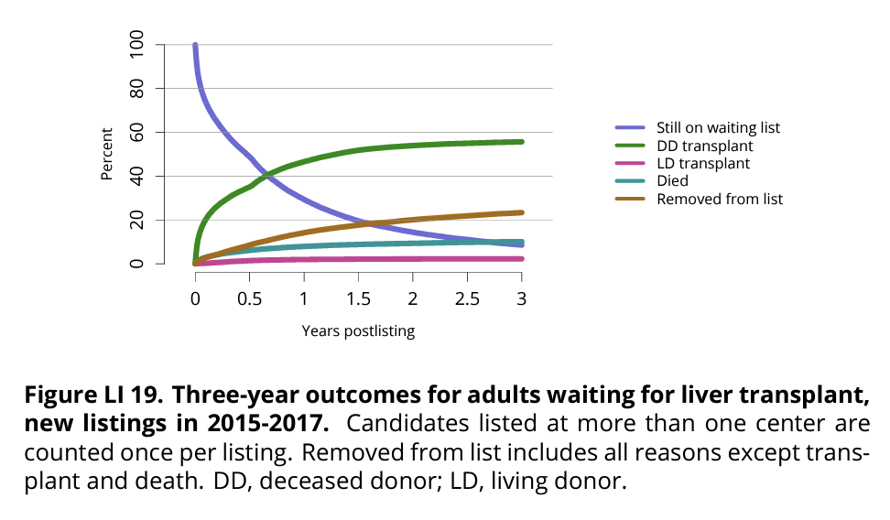
~1 in 5 will die waiting for LT
3-year outcomes after being listed
(2015-2017) in U.S.
In 2020:
63.4% received LT (deceased and living)
18% died or too sick for LT
10.9% removed for other reasons
6.9% condition improved and transplant no longer needed 8.6% still waiting

Slide 13
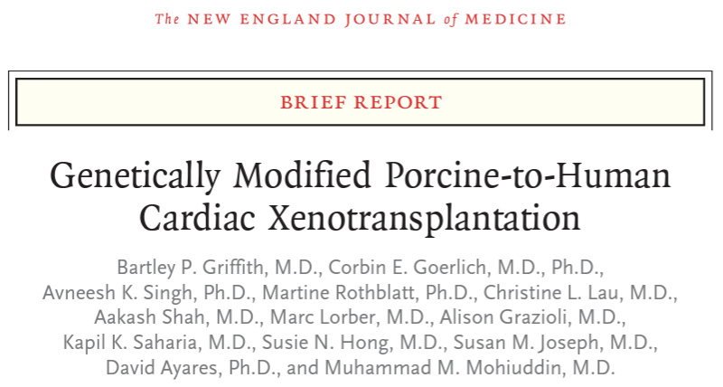
Expanding the Supply of Donors
Current
Decreased donor LT (DDLT)
Emerging
Machine perfusion
Future
Xenotransplantation
Living donor LT (LDLT)
Robotic living donor surgery
Paired liver exchange
HCV viremic donors
Technical innovations
Anti-HBc donors
HBsAg+ donors
N Engl J Med July 7, 2022
Xenoheart supported patient for 7 weeks

Slide 14
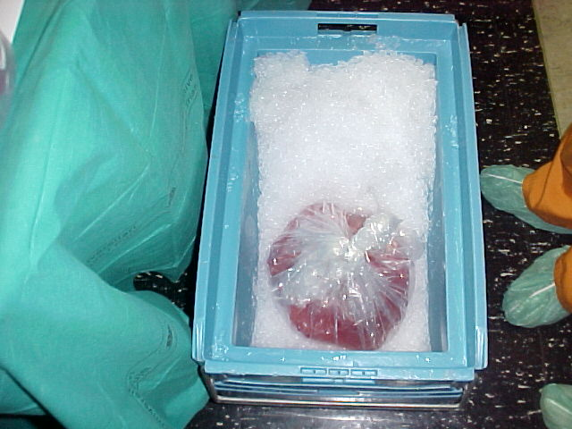
Foster Functional Recovery of Marginal Donor Organs
Standard quality livers
  Donor <65 (70?) years
  No-to-mild steatosis
  CIT <8-10 hours
Hypothermic:
  0-12 ºC
Midthermic:
  13-24 ºC
Subnormothermic:
  25-34 ºC
Normothermic:
  35-38 ºC
Liver graft preconditioning
Graft perfusion
Systems to improve oxygenation
Marginal quality livers

Slide 15
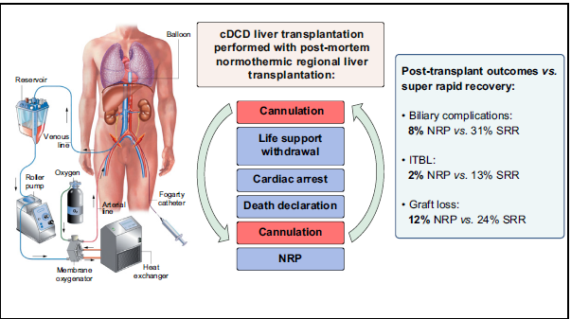
Potentially Achievable Outcomes with Machine Perfusion
Ischemic-type biliary lesions
Hessheimer AJ, J Hepatol 2019;70: 658–665

Slide 16
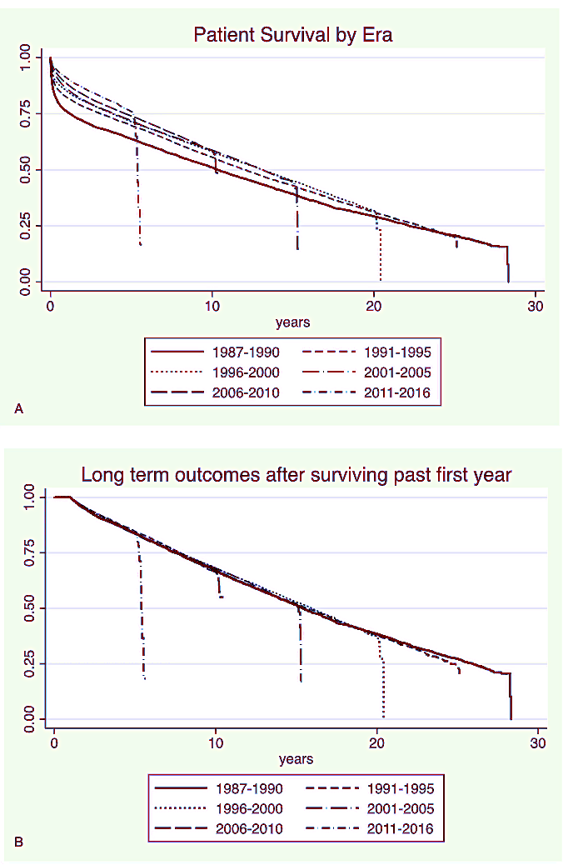
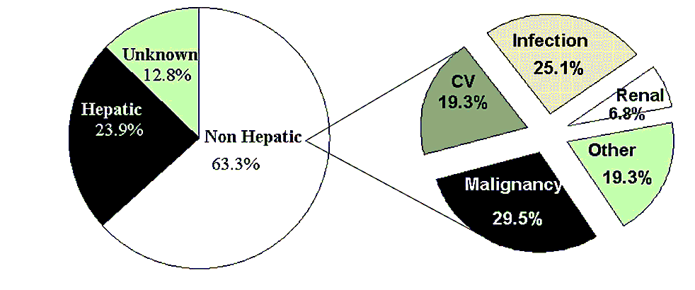
Long-Term Patient and Graft Survival
No improvement in long-term survival over past 2+ decades
Non-hepatic causes of death account for majority – with malignancy, infection and CVD accounting for ~75% of deaths
Rana A, Ann Surg 2019;269:20-27
Watt K, Am J Transplant. 2010 ;10:1420–1427

Slide 17
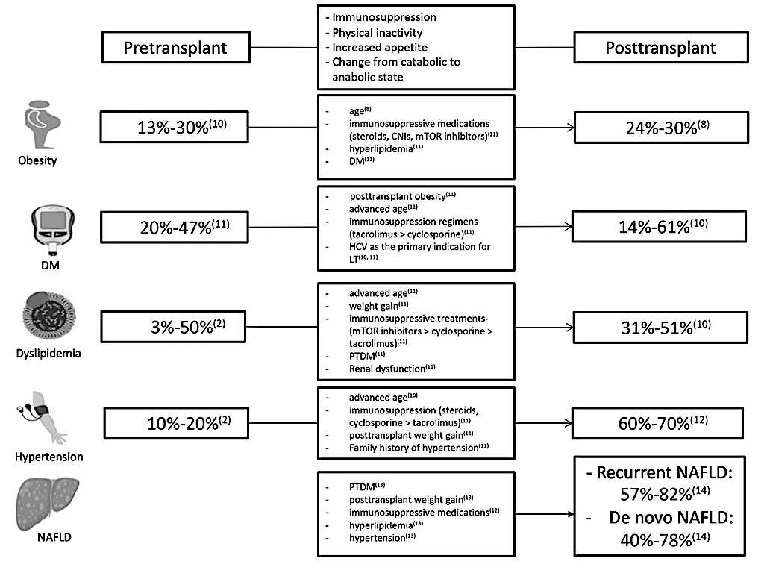
Major Changes in Metabolic Risk Profiles Post-LT
Pretransplant patients are changing – more NASH means older age, more MetS and more renal dysfunction
Azhie A, Liver Transplantation 2021;27:1468‒1478

Slide 18
Prevention and Treatment of Long-Term
IMS Complications
Obesity/ metabolic diseases
Renal Protection
Cardio-vascular prevention
Cancer surveillance
Renal-sparing immunosuppressive regimens
Delayed CNI introduction
mTOR + low dose CNI
GLP-1
Statin
No Statin
HR 0.38 (0.19-0.75), p=0.005
Rinella M, CGH, 2023

Slide 19
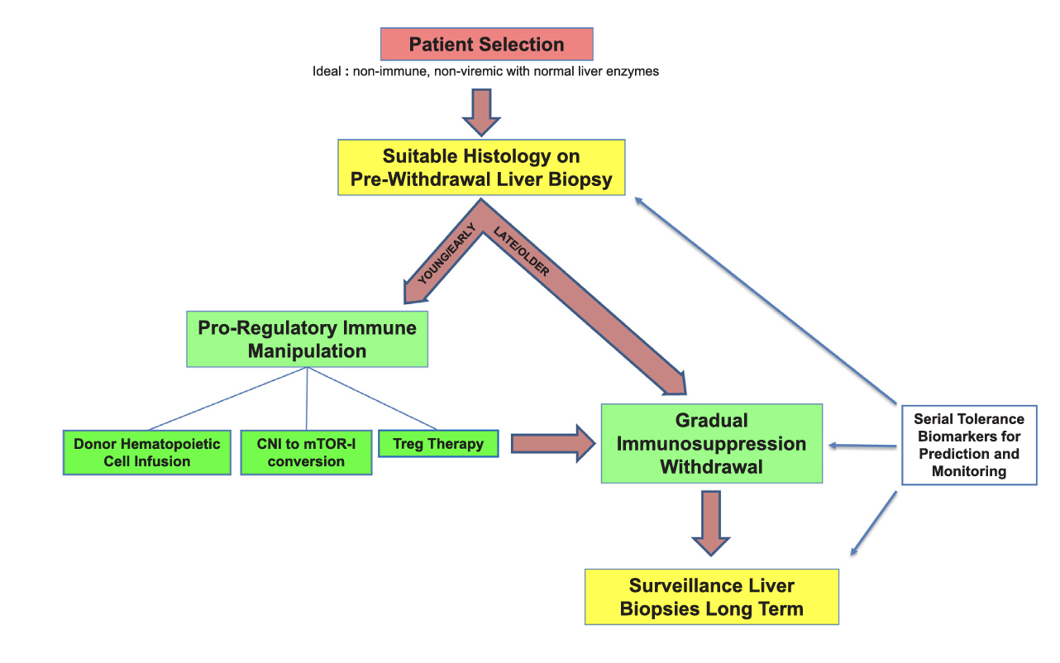
Most Desirable Outcome: IMS Withdrawal
Studies have demonstrated that 20-30% of LT recipients can be weaned off IMS completely = tolerant
Best candidates
>50 years
>3-5 years from LT
Non-autoimmune dz
No recent ACR
Pre-weaning biopsy without histological subclinical acute or chronic rejection or other findings
Future
Future
Levitsky & Feng, Hum Immunol 2018;79:283-28

Slide 20
Summary: Looking to Tomorrow
Transplant Indication
Recipient Phenotype
Donor Options
Post-LT Care
Less HCV
More NAFLD
More alcohol
Non-HCC oncologic indications
Older
Higher frailty status
More obesity
Higher frequency of comorbidities (CVD, CKD)
Improving DDLT quality with machine perfusion
More LDLT, with technical advances and robotic surgery
Liver exchanges
Xenotransplantation
Prevention of metabolic risks and consequences
AUD management
IMS withdrawal and minimization to reduce renal, infectious and cancer risks

Slide 21

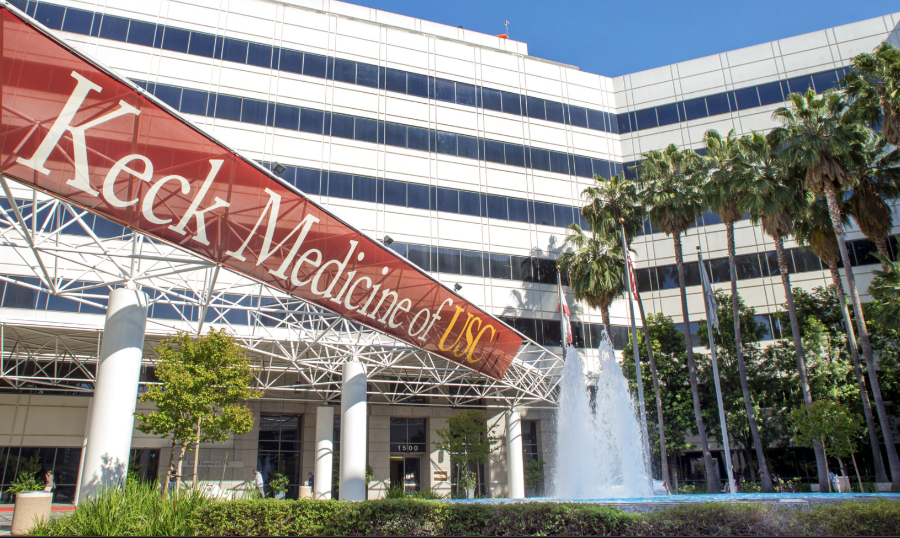

Thank- you!

