Slide 1



Take-home messages from Monday 27th March 2023
Marc Bourliere , MD 15th PHC
Hôpital Saint Joseph Paris (Virtual)
27-29th March 2023

Slide 2

Medical research in France
The new Director of the National Institute for Health and Medical Research (INSERM)

Slide 3



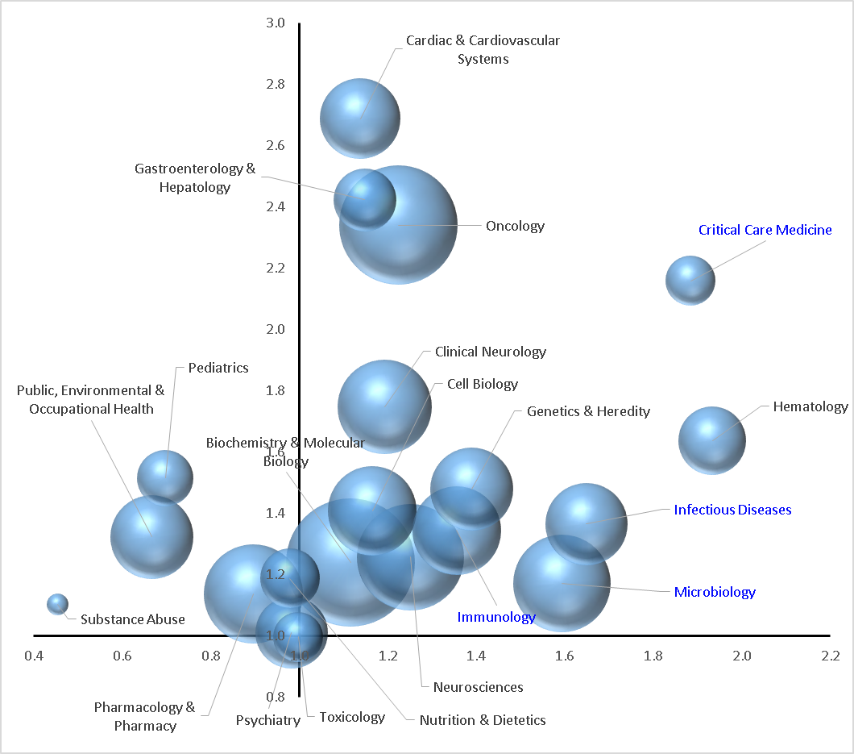


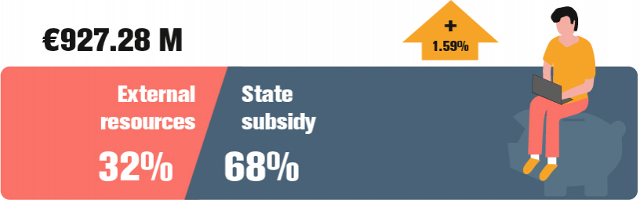
5th world rank in 2001-2003 representing 6.1%
10th world rank in 2019-2021 representing 4.1%
Dramatic increase of China
Strong progression of Australia and Canada
In Europe, strong increase of Italia and Spain
Our Missions for health
      Produce and disseminate knowledge nationally and internationally
      Provide scientific expertise and support for science based policy in health
Impact Normalisé ( < ou > 1)
      Play a major role in the national coordination of health research
INITIATE,
DEVELOP AND COORDINATE BIOMEDICAL RESEARCH OF EXCELLENCE
      Support higher education and research training
      Create value from discoveries and their applications
Research institution and funding agency, covering a continuum from fundamental and clinical research to population health
Spécialisation ( < ou > 1)
Clinical and
preclinical trials
Fundamental
research
Cohorts and
epidemiological
studies
~ 1,16 B€
Expertise
for public health
and research policy
Biomedical
research
infrastructure
Technology
transfer
35 %
65 %

Slide 4
Reinforce Medical Research in France
Roadmap for the future
Strong Reinvestment in Research funding
  Improve salaries of searchers, offer new position for searchers with welcome package
  Increase of funding of laboratories
  Develop new job research ( Biogenetic, Bioinformatic, Artificial intelligence, …)
Attract physicians in research labs
Better local coordination between Universities, Inserm and Hospitals.
Development of National Programs of Research leaded by Inserm
Develop transdiciplinary research
Improve and simplify the organisation of Big data ressources and use
Reinforce the organisation of Biobanks
Improve the organisation and feasibiity of academic clinical trials
Improve translational research and valorisation of research
Improve the access to European funding
Notes:
Pourtant si la visibilité de l’Inserm, de l’Institut Pasteur, du CNRS, voire de l’INRA dans la recherche en santé est très bien établie, celle des EPS est victime de sa dilution en de nombreux établissements indépendants les uns des autres. Mais même les plus gros comme l’AP-HP, les HCL ou l’AP-HM ne sont pas vus comme des établissements de recherche à part entière.
Recherche = mission conférée aux hôpitaux par la Loi
Elargissement, au fil du temps, à l’ensemble des établissements de santé : des CHU, au SPH puis à l’ensemble des établissements de santé
Recherche clinique = recherche appliquée à l’homme, recherche qui concerne les patients, qui vient en complément des recherches fondamentales, développées plus particulièrement par les organismes de recherche (EPST) et les universités.
« Continuum de la recherche fondamentale à la recherche clinique » : des échanges réciproques, permanents → importance de l’environnement scientifique : pas de recherche clinique de haut niveau sans une recherche fondamentale de haut niveau : importance du rôle des CHU
Hôpitaux – CHU → acteurs incontournables de la recherche clinique car ils bénéficient de nombreux atouts : PATIENTS , CLINICIENS – INVESTIGATEURS, ORGANISATION ADAPTEE

Slide 5




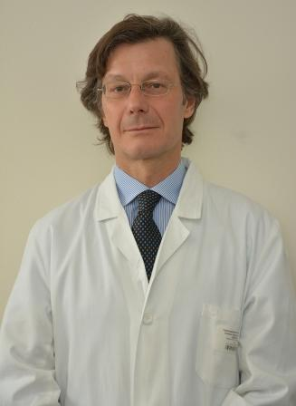


Hepatitis B : Optimal management

Slide 6
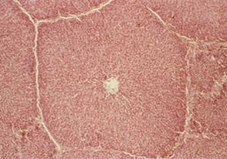
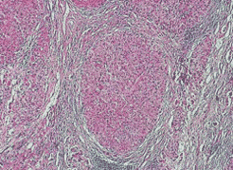
International Treatment Guidelines
The HBV journey
HBV infection = A fibrotic liver disease
normal liver
Cirrhosis
Disease progression predictable by fibrosis measurement over time
F1
F2
F3
Time bar for treatment initiation
Treatment initiation
5 years after start of therapy
Notes:
6

Slide 7
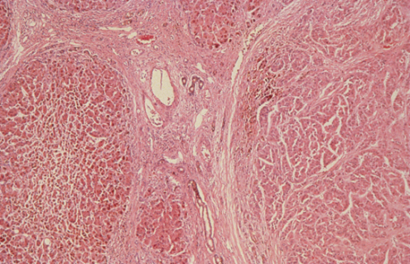
The HBV journey
HBV infection = A chronic liver disease
normal liver
Cirrhosis
Disease progression predictable by fibrosis measurement over time
F1
F2
F3
you cannot turn back the clock
Time bar for treatment initiation
?
?
?
normal liver
HCC
HBV infection = An oncogenic disease
Notes:
7

Slide 8
Summary
The 2016-2018 international HBV guidelines focus mainly on inhibiting fibrosis progression for treatment indications and endpoints
Prevention of HCC development should be given greater focus in guideline updates that require therapeutic approaches other than those established for the prevention of fibrosis progression
Beyond HBsAg loss, other reliable endpoint biomarkers and their appropriate cut-off values should be defined to guide off-treatment management

Slide 9
Long term effects of NUCs
Nucleos(t)ide analogues (NA) are efficacious in suppressing the replicative pathway particularly HBV DNA, but impact on HBV RNA and HBcrAg takes longer to suppress, over many years; its impact on HBsAg secretory pathway is minimal, and seldom lead to HBsAg loss
Nucleos(t)ide analogues (NA) are efficacious in:
  Important clinical endpoints: reducing mortality, reducing HCC and improving liver decompensation in observational studies
  They have proven efficacy in surrogate endpoints: suppressing viral load, improving HBeAg seroconversion and improving abnormal LFTs; also in regression of liver cirrhosis, and reducing markers of fibrosis (FIB-4, transient elastography), reducing viral integration events
Current high genetic barrier NA have very low levels of resistance
The evidence is unclear whether tenofovir is superior to entecavir in preventing HCC, although on a practical basis, this could be a preferred option
Long term safety is well established, with myopathy confined to telbivudine, mild renal and bone wasting to tenofovir, and entecavir reported to have rare cases of lactic acidosis. No major safety issues reported with tenofovir alafenamide to date
The future of NA in the context of therapies of functional cure

Slide 10
Stop NUCs controversy
Pros | Cons
HBsAg loss increase survival | HBV DNA rebound
State of inactive carrier | ALT flares
Long term therapy off in 50% | Hepatic decompensation
Reduced Costs
Careful selection of patients
Active retreatment plan

Slide 11
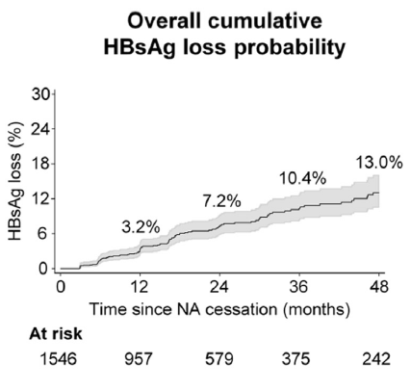
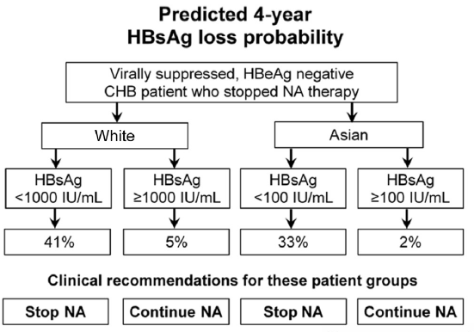
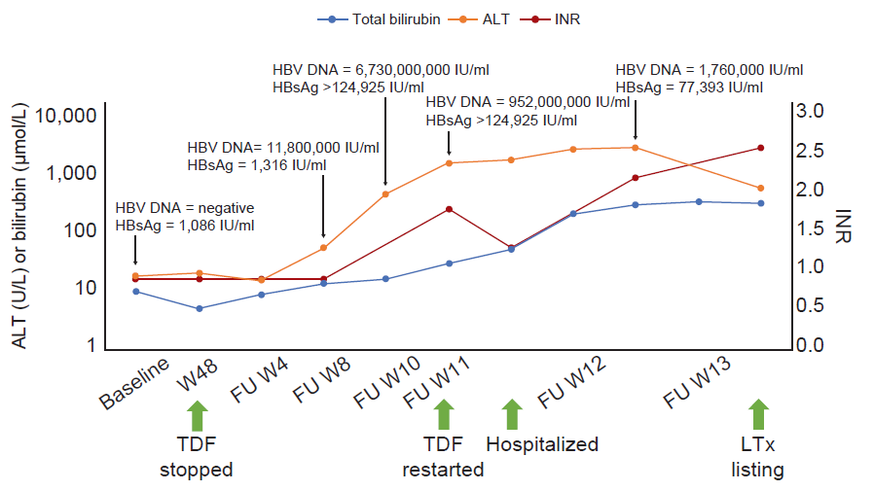
Stop NUCs controversy
Possible in selected patients
HBeAg negative patients without cirrhosis
Low level of HBsAg at the time of stopping NUC
1900
531
60
TDF
TDF
*Caucasian patients=174 (11%)
Hirode G et al, Gastroenterology 2022

Slide 12
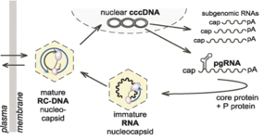
New drugs for HBV cure
Inhibition of viral replication
hNTCP
Entry inhibitors: bulevirtide
HBV polymerase
NUC: ETV, TDF, TAF, novel NUCs and RNAseH inhibitors
Nucleocapsids
CAM: ABI-H0731, JNJ-56136379, RO7049389
IFNs and other antiviral cytokines
Integrated
HBV DNA
subgenomic RNAs
IL12
nuclear cccDNA
pA
IFN-a
pDC
cap
pA
cap
pA
cap
NK
enveloped
RC-DNA virion
pgRNA
NKT
CD8+
T cell
cap
pA
IL1-b
mature
RC-DNA
nucleocapsid
core protein + P protein
KC
T-cell cytokine response
Viral antigen reduction
Transcription
FXR agonist: EYP001
Viral RNAs
siRNA: JNJ-3989 VIR-2218
ASO: GSK3228836
LNA: RO7062931
RNA destabilizers
HBsAg release
NAPs: REP 2139, REP 2165
STOPS
immature RNA
nucleocapsid
IL6
Invigorate immune responses
Innate immunity
TLR7: GS9620, RO6864018, RO7020531, JNJ6479464
TLR8: GS9688
Immune check points
Anti-PD1: nivolumab
Anti-PDL1
PDL1 LNA
Oral PDL1 sm
“exhaustion”
“high antigen load”
PD-1
Stimulate HBV specific B/T cells
Therapeutic Vaccines
GS2829, GS6779
VTP-300
GSK3528869A
CD8+
T cell
B cell
Dysfunctional
T-cell response
Insufficient
B-cell response
Exogenous HBs Mab
VIR-3434

Slide 13
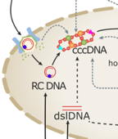

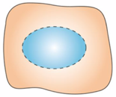
New drugs for HBV cure
New Clinical Trial Design
Combination of direct acting antivirals and immune stimulation
Perspectives: more innovation to come!
SERUM
+1.0
Therapy
Off Therapy
Direct targeting
of cccDNA
Redirect T cells to infected hepatocytes
0.0
Replication inhibition
-1.0
Antigen reduction
Anti-HBsAb
HBV DNA change from baseline
(log ₁₀ c/mL)
De novo
infection
-2.0
Immune response invigoration
Immune stimulation
-3.0
HBV DNA
HBsAg
LIVER
-4.0
Recycling
Time
cccDNA
cccDNA Synthesis
Liver reservoir
cccDNA Loss
CAR-T cells
Festag et al, Mol Ther 2019
Engineered HBV-TCR T cells
Afezi et al, Hepatology 2021
Immune Mobilizing Monoclonal TCRs (Affinity enhanced T cell receptor with an anti-CD3 T cell-activating moiety)
Fergusson et al, Hepatology 2020
Small molecules
Wang et al, J Hepatol 2023
Gene editing: CRISPR/cas9, TALENS, Base Editors
Martinez et al, mBio 2022; Kostyushev et al, Mol Ther Nucleic Acids 2023; Smith et al, Viruses 2021
cccDNA silencing: specific epigenome modifyers ?

Slide 14

Award PHC 2023
Norah Terrault
Liver transplantation today and tomorrow

Slide 15





Hepatitis Delta :
Therapeutic advances

Slide 16
The epidemiology of hepatitis delta revisited !
Global prevalence of HDV is unknown and estimated number of patients varies from hundred of thousands up to tens of millions
  Wide variation of prevalence in different populations and groups (endemic HDV spots and pockets)
  Scarce and low-quality data in many regions
  Absence of universal screening in HBsAg+ population
In many countries HDV-infection vanishes in local population due to total vaccination against HBV for many years, but majority of new cases related to migration from endemic areas.
Structural breaks in incidence of HDV during the last 20 years in different populations may be related to the changes of the major mode of the transmission and migration patterns
HDV-RNA is associated to increased risk of morbidity and mortality in comparison to HDV-RNA-negative patients.
Reflex testing for HDV should be universally accepted, as it dramatically increase the number of HDV cases revealed, and provide us reliable data about the HDV prevalence, but its cost-efficacy in all populations needs to be proved.

Slide 17
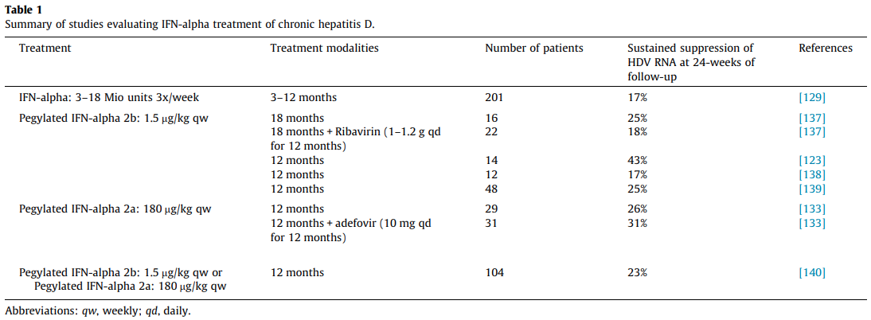
Peg-IFN for HDV
Menta et all, 2019
PegIFNα for at least 48 weeks is the current treatment of choice in HDV-HBV co-infected patients with compensated liver disease (Evidence level I, grade of recommendation 1).
In HDV-HBV co-infected patients with ongoing HBV DNA replication, NA therapy should be considered (Evidence level II-2, grade of recommendation 1).
PegIFNα treatment can be continued until week 48 irrespective of on-treatment response pattern if well tolerated (Evidence level II-2, grade of recommendation 2).

Slide 18
New drugs for HDV
Bulevirtide approved by EMA
- virological and biochemical responses in most patients
- how long to treat? Decompensated cirrhosis?
- Combination with PEG-IFNa?
Additional new treatments in clinical development
Lonafarnib: phase 3 data to be presented in detail
Inferferon lambda: - phase 3 trial is recruiting
Nucleic Acid Polymers: - phase 2 data have been presented, case reports available
siRNAs against HBsAg: - phase 2 studies ongoing
monoclonal antibodies against HBsAg: - phase 2 studies started
Personalized management approach for individual patients with chronic hepatitis D required!

Slide 19
Bulevirtide in real life
Patients included in Per Protocol analysis
Beyond cATU analysis
(n =145)
BLV 2 mg mono
(n = 70)
BLV 2 mg + PEG-IFN
(n = 69)
On treatment Biochemical and combined response
Biochemical response (ALAT < 40 UI)
Combined response (virological + biochemical)
PP
analysis
BLV 2 mg mono
(n = 70)
BLV 2 mg + PEG-IFN
(n = 56)
12 patients that discontinued PEG-IFN
Were excluded from analysis
After 24 months of BLV monotherapy, 68% of patients achieved a virologic response
Patients (%)
After 24 months of mono BLV, 44% of patients had undetectable HDV RNA by local lab cut off
After 24 months of BLV monotherapy, 52% of patients achieved a combined response with minimal difference in response between BLV mono and PEG containing arms
Baseline
w8
w24
w48
w72
Detectable HDV RNA
ALAT < LSN et ARN VHD < 1000 UI/ml
ALAT < LSN et ARN VHD < 0
15 %
-
50 %
7 %
67 %
11 %
75 %
38 %
% Patients
Off Treatment Response*
Anolli M-P. et al , AASLD 2022, Abs. LB 5013 updated
Predictors of response at W24 in multivariate analysis
Variable | OR [IC95%] | P
Interferon between BL and W12 (yes vs no) | 8.40 [3.39 ; 20.79] | p < 0,0001

Slide 20

State of the art lecture
Pr Robert Barouki
Air pollution and the liver including liver cancer

Slide 21
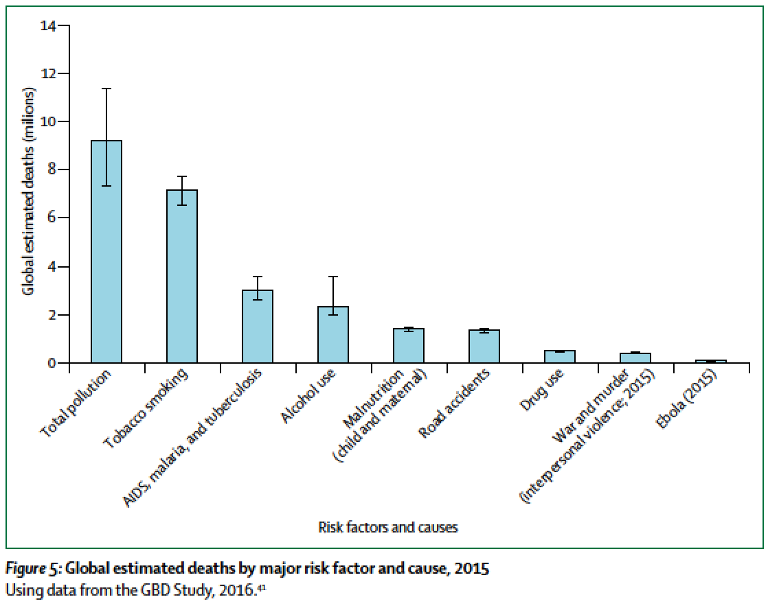
Air pollution and the liver including liver cancer
Strong evidence for the effect of air pollution on liver metabolic diseases:
epidemiologic and experimental evidence
Some evidence for the effect of PM2.5 on liver cancer mortality
Possible effects of PM2.5 on liver cancer (but some contradictory data)
Genotoxic and non genotoxic carcinogens in air pollution components
Evidence for an effect of air pollutant components on metastasis for some cancer locations.
Medical drugs; drugs/narcotics; alcohol
Chemical contaminants: toxins; occupational, some environmental, tobacco smoke
Infectious agents: viruses, parasites, bacteria
Nutritional imbalance
Liver diseases
Expanding the liver exposome
Pollution; particles;
Stressor combination
internal pollutants
Chemical mixtures
Microbiota metabolites
Air pollution is the major contributor to total pollution death toll
7 million deaths per year from air pollution

Slide 22

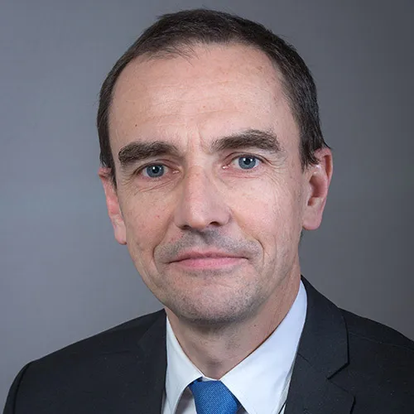





Elimination of HCV : where we are

Slide 23
Impact of COVID on HCV elimination
Percent change (%) in utilization of Direct Acting Antivirals by country and region from
March to August 2020 compared to March to August 2019
The COVID-19 pandemic, especially its first wave, resulted in a drastic reduction in the number of people tested and treated for HCV.
This was primarily the result of limiting access to healthcare and shifting medical staff to fight the pandemic.
Global projections indicate a long-term adverse impact on HCV elimination, but the latest local signals seem more optimistic.
The effect of the pandemic on the elimination of HCV seems to be temporary and the basic problem for the elimination of HCV remains the lack of national screening programs in most countries, including the wealthy ones.

Slide 24
Micro elimination
Microelimination is a good motivator
It is unclear what added value it brings
Sustained testing and treatment remains the only way to eliminate HCV
People with
HCV who
could be engaged
In services
Ex
HCV
Ex
HCV
People who do not want to engage
Ex
HCV
Ex
HCV

Slide 25
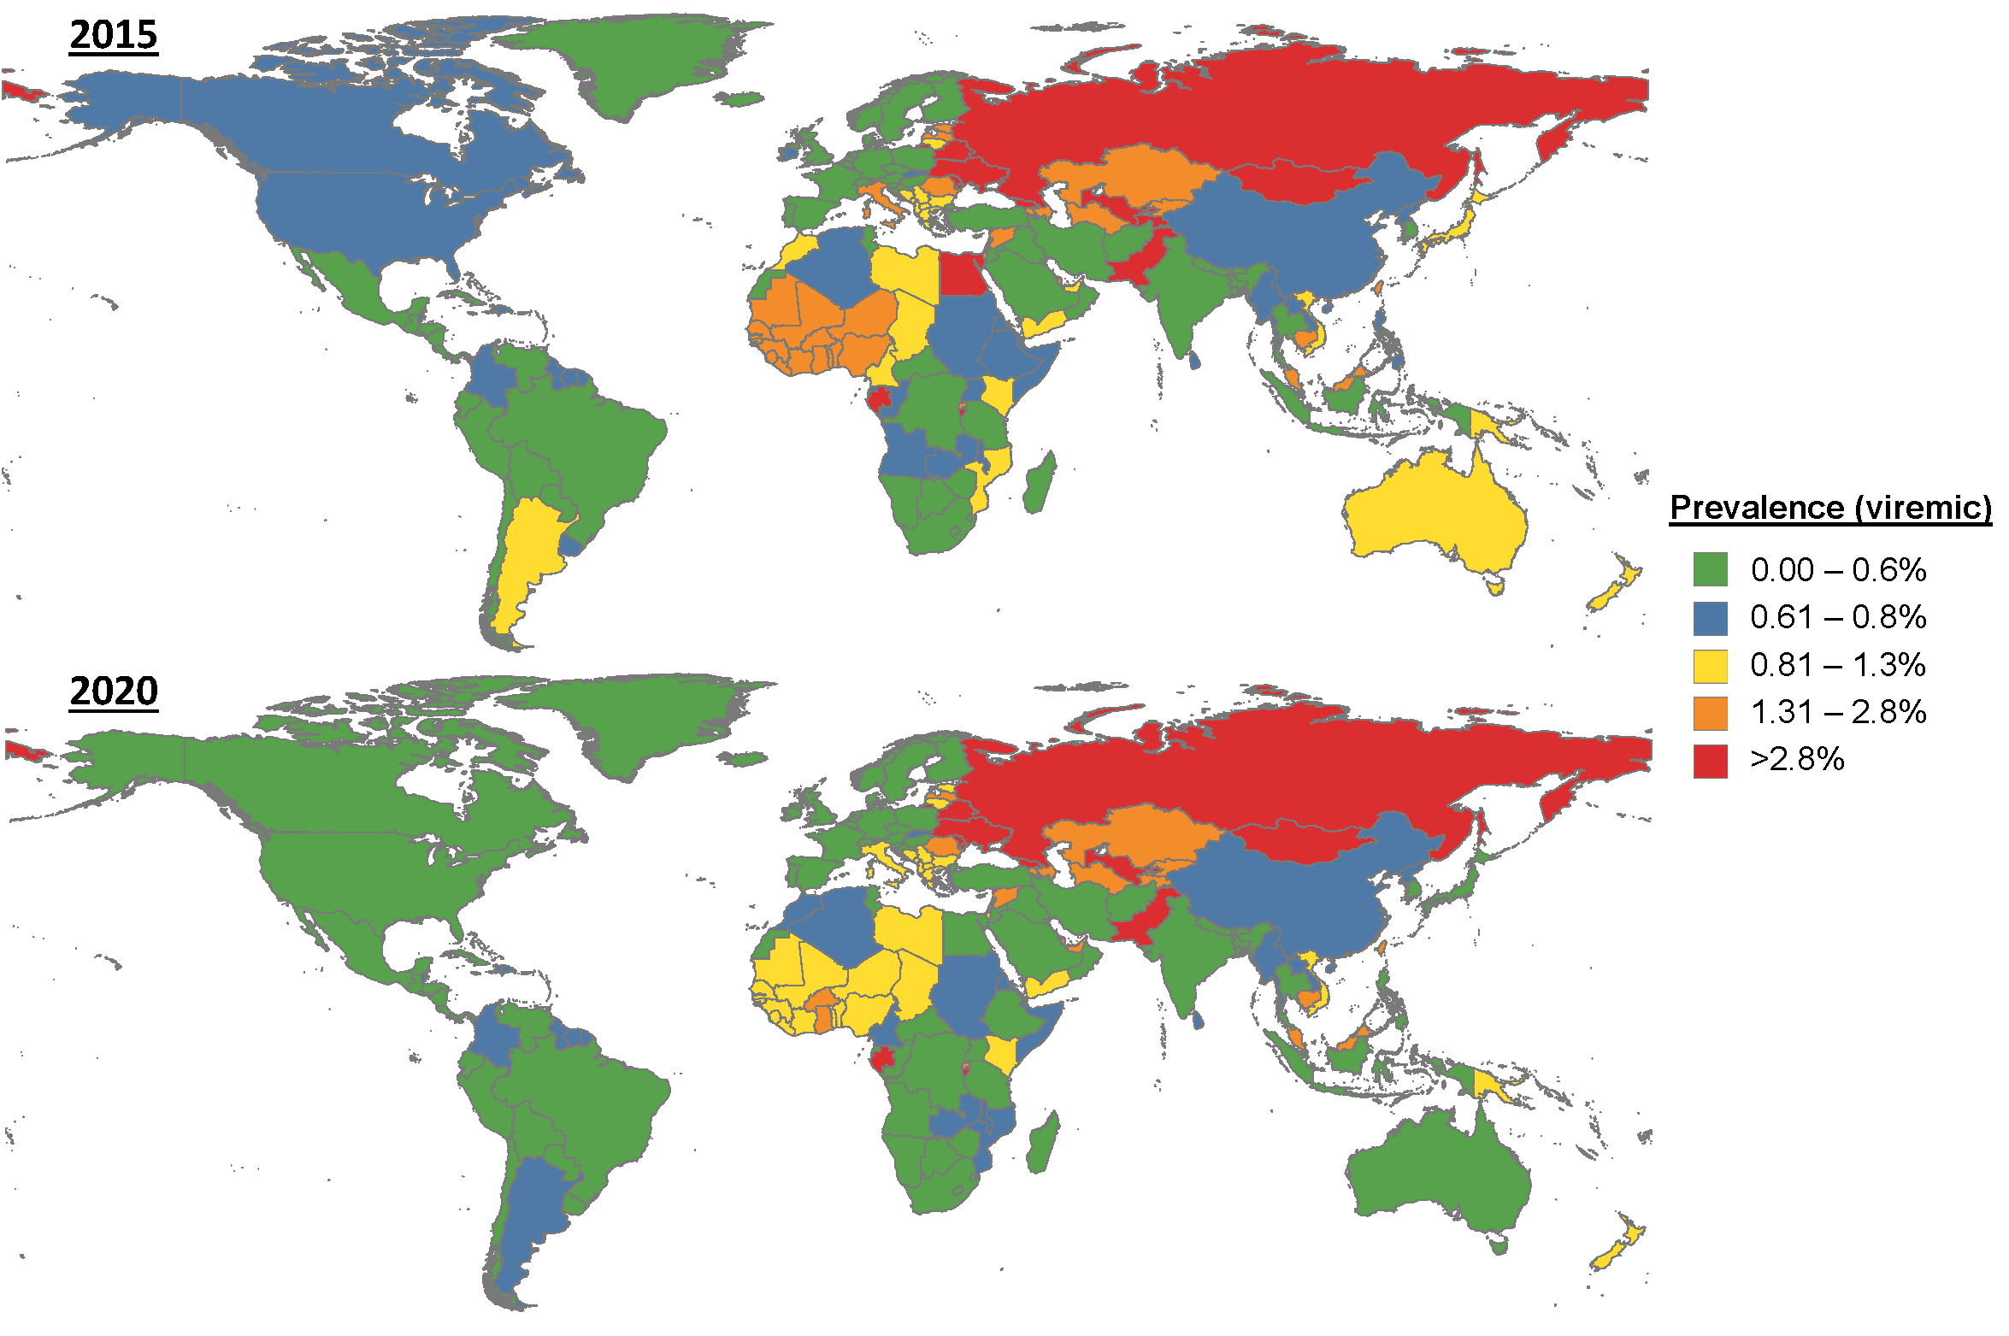

Macroelimination
Egypt succeeded in establishing a useful model of care for HCV management in the country with the highest worldwide disease prevalence.
The sizeable Egyptian program relied on establishing a network of specialized viral hepatitis treatment facilities that provide integrated care for HCV patients.
A sizeable nationwide screening program was conducted in Egypt over six months to screen more than 57 million citizens for HCV serology.
One of the significant challenges facing Egypt after the successful HCV screening and treatment programs is the need to maintain this success by making more efforts towards micro elemination and prevention
.
Lancet Gastroenterol Hepatol. 2022 Feb 15:S2468-1253(21)00472-6.

Slide 26
Worldwide overview
Year 2020: 0,7% (57 million) viraemic, decrease from 2015
Notable global progress towards HCV elimination
Global diagnosis targets not met, 79% HCV infections undiagnosed
Highest HCV prevalence in Eastern Mediterranean region
  Only region that reached 2020 diagnosis/treatment targets
  Achievement WHO elimination targets 2030
    11 countries on track by 2030
    22 countries between 2031 and 2050
Negative effect of COVID-19 pandemic
Several countries with successful elimination plans
Global strategy needed to scale up screening and linkage of care

Slide 27

Thank you for your attention
A great thanks to all speakers who provide me their presentation

