Slide 1
Day 3 Review
Graham R Foster
Prof Hepatology
QMUL

Slide 2
Day 3 review
Disclosures
I have received speaker and consultancy fees from Abbvie, Gilead, MSD, GSK, Biomarin, UniCure, CSI-Behring

Slide 3
The final day – common things are difficult
Most of the patients we see have fatty liver disease or alcohol
So what is new?

Slide 4
NAFLD – NASH - Pinzani
Its complex!
Development of liver disease occurs on a background of environmental and genetic factors
Some of the genetic factors are beginning to be understood

Slide 6
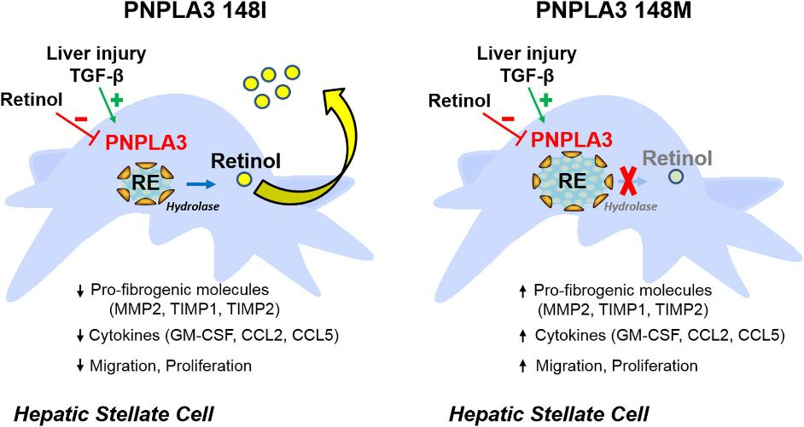
Impact of PNPLA3 Mutation on Hepatic Stellate Cell Biology

Slide 7
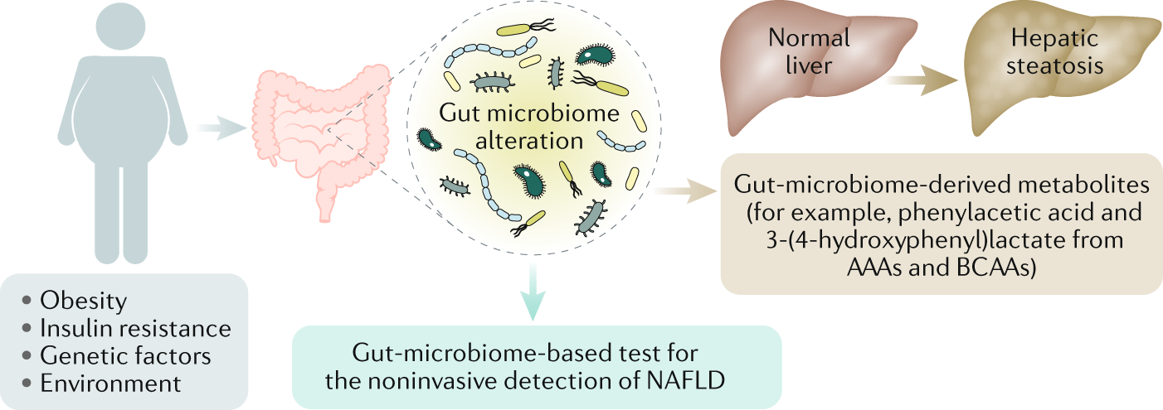
Potential of Gut Microbiome Signatures Derived from Metagenomic
Caussy C and Loomba R.; Nature Rev Gastro Hep 2018

Slide 8
Type 2 diabetes as a risk factor for NAFLD: A call to action
Diabetes and NASH - Cusi
The links between type 2 diabetes (T2D) and NAFLD
    NAFLD occurs in 70%, steatohepatitis in 30-40% and fibrosis (≥F2) in 12-20%
    Closely linked to adipose tissue and hepatic insulin resistance (i.e., liver as the mirror of metabolic health)
2. Whom to screen/risk stratify (FIB-4 +/- elastography +/- ELF)
  3 high risk groups, :
    T2D (highest risk), prediabetes (less than T2D but higher than obesity alone)
    Obesity with cardiometabolic risk factors
    Elevated plasma aminotransferases or incidental steatosis on imaging
3. How to manage main comorbidities (primary care, hepatologists)
  T2D: lifestyle, pioglitazone, GLP-1RA (semaglutide), GLP-1/GIP RA (tirzepatide)
  Obesity: lifestyle, bariatric surgery, GLP-1RA, GLP-1/GIP RA (not approved yet)
  Soon approved NASH drugs in combination with the above
By Kenneth Cusi, MD, FACP (University of Florida)

Slide 9
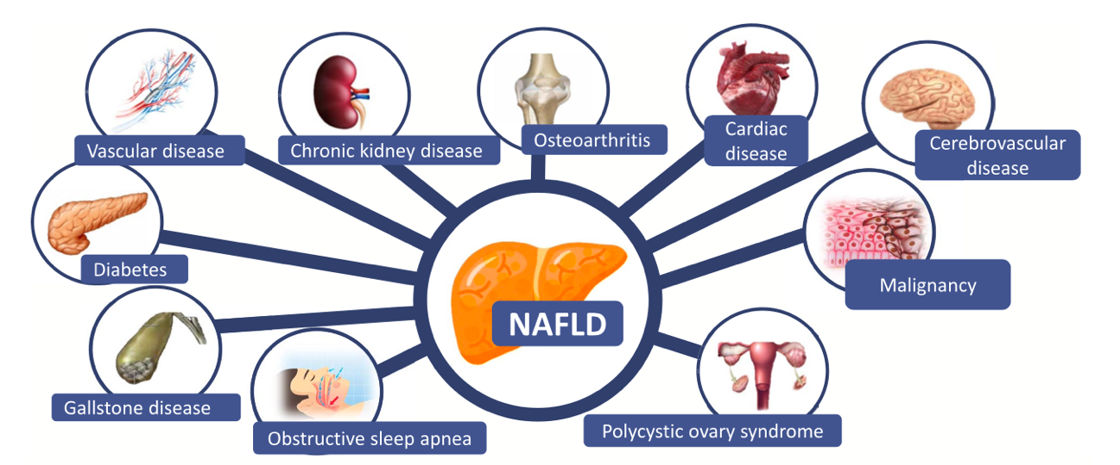
NAFLD and comorbidities: we need a multidisciplinary management - Bugianessi

Slide 10
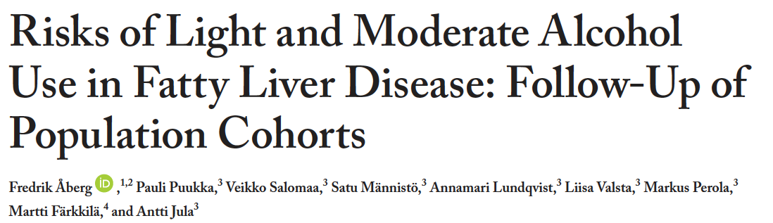
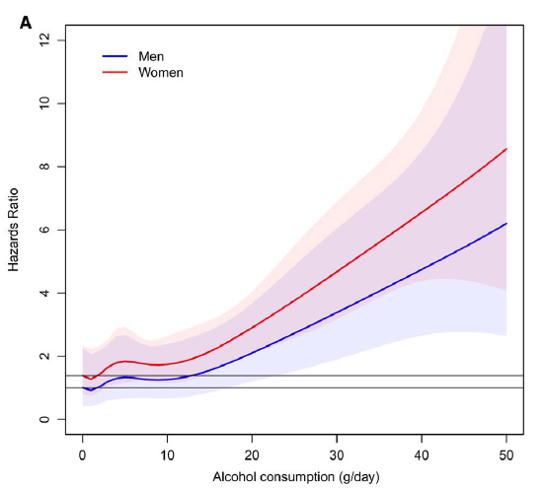
Cortez Pinto
8,345 persons with hepatic steatosis
(fatty liver index >60) who participated in health-examination surveys (FINRISK 1992-2012 or Health 2000
Relationship between average alcohol intake
and risk for advanced liver disease
There was a dose-dependent correlation between the amount of alcohol consumption and the probability of advanced fibrosis
Aberg at al, Hepatology, 2020
Notes:
Another important study coming from Sweden evaluated a group of 8,345 persons with hepatic steatosis
(fatty liver index >60) who participated in health-examination surveys (FINRISK 1992-2012 or Health 2000 and
Found a dose-dependent correlation between the amount of alcohol consumption and the probability
of advanced fibrosis

Slide 11
Caussy cinical case
Management of patients with NAFLD and comorbidities are important
  Consider treatment
  Vitamin E
  Pioglitazone (T2DM)
  GLP-1 agonist (T2DM)
  Screen for HCC
  Liver Transplantation
NASH
Cirrhosis
CV risk
Obesity
  Manage comorbidities
  (hypertension, dyslipidemia, SAOS)
  Weight loss
  Lifestyle
  Obesity treatment
  Bariatric surgery
Caussy C. Current Hepatology Reports 2019;18: 433-443.

Slide 12



In clinical trials, semaglutide treatment was shown to improve NASH resolution but not liver fibrosis when assessed by histology in patients with NASH
SemaNASH is an investigational medicinal product. Semaglutide is not approved for treatment of NASH
Michelle Long
Long - Overview of Treatment efficacy in the semaNASH clinical development programme
NASH resolution
Improvement in fibrosis
and no worsening of NASH
59%
34.0%
43%
10.6%
17%
20.8%
33%
29.2%
patients with
F2‒F3 (trial 4296)*¹
patients with
F4c (trial 4492)²
patients with
F2‒F3 (trial 4296)¹
patients with
F4c (trial 4492)²
Sema 0.4 mg OD
n=82
72 weeks
Sema 2.4 mg OW
n=47
48 weeks
Corresponding placebo
n=80 (4296)
n=24 (4492)
Data based on in-trial period. Two-sided p-values from a Cochran-Mantel-Haenszel test. Subjects with missing data handled as non-responders.
*p≤0.0001.
F, fibrosis stage; NASH, non-alcoholic steatohepatitis; OD, once-daily; OW, once-weekly; sema, semaglutide.
1. Newsome PN et al. N Engl J Med. 2021;384:1113–24; 2. Loomba R et al. Presented at the International Liver Congress (European Association for the Study of the Liver), 22–26 June 2022, London, UK.
Notes:
Narration
The efficacy of semaglutide monotherapy on histological endpoints of NASH resolution and fibrosis improvement have been explored in the phase 2 trials 4296 and 4492 in patients with NASH F2-F3 and NASH F4c, respectively.
NASH resolution
4296: In patients with NASH F2-F3 (trial 4296), 58.9% of patients with NASH F2-F3 treated with semaglutide 0.4 mg OD achieved primary endpoint of NASH resolution with no worsening of liver fibrosis (n=33/56 patients in this trial arm) compared to 17.2% of patients treated with placebo (n=10/58 in the placebo arm). This difference was statistically significant (p<0.0001).
4492: In patients with NASH F4c (trial 4492), treatment with semaglutide 2.4 mg OW resulted in higher proportions of patients with NASH resolution (34.0%, 5 of 47 patients) compared to 32.8% of those in the placebo group (7 of 24 patients) (p=0.2859). This trial was not powered for NASH resolution.
Improvement in fibrosis
4296: In patients with NASH F2-F3, improvement in liver fibrosis and no worsening in steatohepatitis was observed in 42.9% of patients in the semaglutide 0.4 mg group (n=24/56 patients), versus 32.2% in the placebo group (n=19/58) (p=0.4814).
4492: In patients with NASH F4c, improvement in fibrosis without worsening of NASH was numerically higher in the placebo group (29.2%) compared to patients treated with semaglutide 2.4 mg OW (10.6%; p=0.0867)
‘i’ Additional information
*p≤0.0001
p-values are two-sided and taken from a Cochran-Mantel-Haenszel test. Subjects with missing outcomes were imputed as non-responders.
Abbreviations
C, cirrhosis; F, fibrosis stage; NASH, non-alcoholic steatohepatitis; OD, once-daily; OW, once-weekly; sema, semaglutide.
References
1. Newsome PN et al. N Engl J Med. 2021;384:1113-24; 2. Novo Nordisk. Data on file.

Slide 13
In clinical trials, semaglutide treatment was shown to halt progression of fibrosis in patients with NASH
SemaNASH is an investigational medicinal product. Semaglutide is not approved for treatment of NASH
Overview of Treatment efficacy in the semaNASH clinical development programme
Only 5% of patients with F1‒F3 (trial 4296)¹ treated with semaglutide had worsening of fibrosis stage
5%
19%
Sema 0.4 mg OD
n=82
72 weeks
Placebo
n=80
Data based on in-trial period.
C, cirrhosis; F, fibrosis stage; NASH, non-alcoholic steatohepatitis; OD, once-daily; sema, semaglutide.
1. Newsome PN et al. N Engl J Med. 2021;384:1113–24.
Notes:
Narration
Across all patients with NASH, a lower proportion of patients treated with semaglutide had worsening of fibrosis stage over the course of these trials.
In trial 4296, 4.9% of patients with NASH F1-F3 treated with semaglutide 0.4 mg OD had worsening of fibrosis stage (n=4/82 patients), compared to 18.8% of patients receiving placebo (n=15/80 patients).
‘i’ Additional information
Data based on in-trial period.
Abbreviations
C, cirrhosis; F, fibrosis stage; NASH, non-alcoholic steatohepatitis; OD, once-daily; OW, once-weekly; sema, semaglutide.
References
1. Newsome PN et al. N Engl J Med. 2021;384:1113–1124.

Slide 14
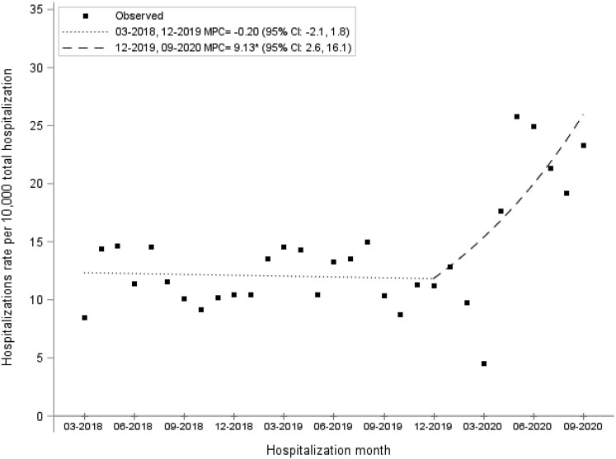
Impact of the COVID-19 Pandemic on Hospitalizations for Alcoholic Hepatitis or Cirrhosis in Alberta, Canada
Pageaux – Alcoholic hepatitis
Shaheen AA, Clin Gastroenterol Hepatol 2022
Notes:
More and more patients are being hospitalized for complications related to alcohol-related liver disease. The Covid-19 pandemic has amplified this, as this study by our Canadian colleagues demonstrates. The rate of hospitalizations for AAH doubled between September 2019 and September 2020

Slide 15
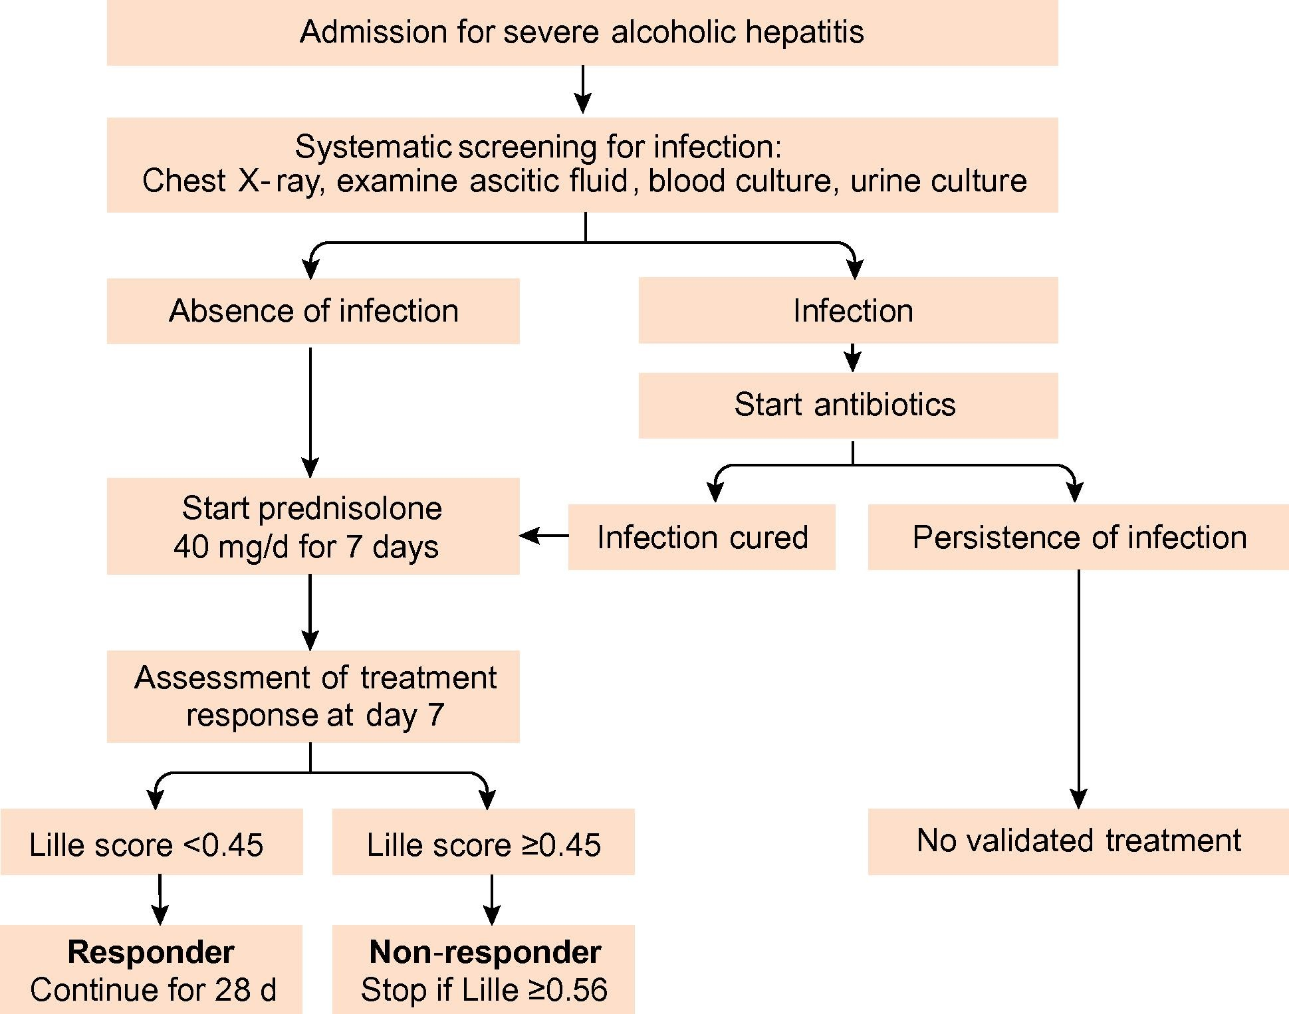
Pageaux – Alcoholic hepatitis
Corticosteroids An algorithm

Slide 16
retrospective
159
Liver Transplantation relapse
Post-transplantation survival
1,00 -
100
  Profile 1 : abstinent
  Profile 2 : late/mild
95
0,75 -
62
  Profile 3 : early/mild
  Profile 4 : early/heavy
Survival (%)
53
0,50 -
0,25 -
Profile 1
Profile 2
Profile 3
Profile 4
0,00 -
9/17 death were
alcohol-related
No. at risk
Profile 1
Profile 2
Profile 3
Profile 4
0
1
2
3
4
5
103
9
22
12
98
9
22
12
84
9
15
7
51
9
12
3
36
8
8
2
18
4
2
2
Lee BP and Im GY, Clin Gastroenterol Hepatol 2022
Notes:
Early relapse, whether mild or severe, had the greatest impact on 5-year post-transplant survival and was associated with primarily alcohol-related mortality (9/17 deaths).

Slide 17
prospective
Liver Transplantation relapse
1,0
2-year cumulative incidence of first alcohol relapse
1,00
Early LT
89,7 %
0,8
0,75
Standard LT
88,1 %
Survival
0,50
0,6
0,25
Cumulative incidence
0,0
0,4
Early LT for AAH (Group A)
33,8 %
0
5
10
15
20
25
p = 0,19
Time after LT (months)
0,2
24,7 %
Standard LT for cirrhosis (Group B)
0,0
0
5
10
15
20
25
Time after LT (months)
Time spent drinking
Heavy drinking
Time spent heavy drinking
p = 0,16
p = 0,001
p = NA
22,1 %
18,1 %
11,5 %
10 %
5,4 %
5,9 %
Groupe A
Groupe B
Louvet A, Lancet Gastroenterol Hepatol 2022
Notes:
The same results were found in a French multicenter prospective study, comparing 3 groups of patients: LT for AAH , LT for alcohol associated cirrhosis without AAH, no LT for AAH. When comparing AAH and cirrhosis patients, no difference was observed in terms of survival. On the other hand, there were significantly more heavy drinking patients in the group AAH compared with the group cirrhosis. It has been shown that a post-transplant excessive alcohol consumption has an impact on survival, especially beyond 5 years. There is a need of addiction specialists within the transplant team

Slide 18
Autoimmune liver disease

Slide 19
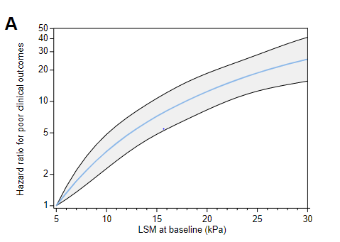
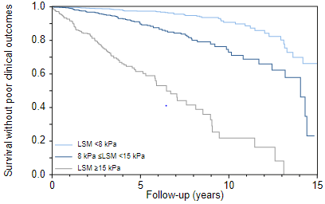

Long-term survival of PBC patients with UDCA: predictors of outcome
NEVENS
Liver stiffness by Fibroscan predicts outcome
Corpechot C, et al. J Hepatol 2022

Slide 20
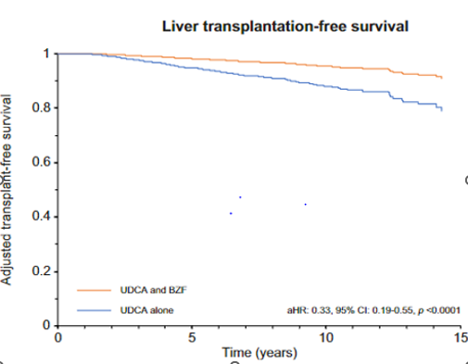
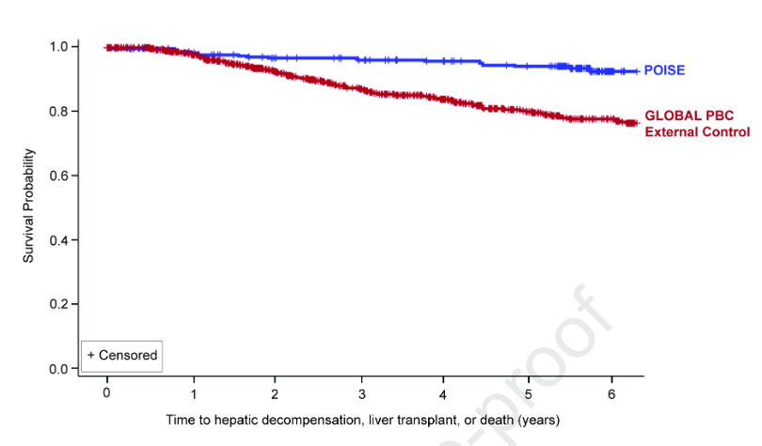
Long-term outcome of second line therapy
Obetichol acid ( FXR agonist)
Bezafibrate ( PPAR agonist)
Murillo Perez CF, et al. Gastroenterology 2022
Tanaka A, et al. J Hepatol 2021

Slide 21
PHC – another fine year
Thank you to the organisers
See you next time!

