Slide 1

Summary of PHC Day 2
Michael W. Fried, M.D., FAASLD
Professor of Medicine
Division of GI and Hepatology
University of North Carolina at Chapel Hill
PHC 2023

Slide 2
Disclosures
Michael W. Fried, M.D.
Grants/Research Support (Paid to Institution)
  University of Florida, NIH
Consultant:
  Roche
  Stock/Shareholder/Employee:
    Target RWE
Speakers Bureau: None
Other Financial Support: None
Thanks to all authors who shared slides for this summary

Slide 3
HCC Diagnosis, Staging and Prognosis

Slide 4
New Tools for HCC Screening
Prof. A. Singal
HCC surveillance improves survival in patients with cirrhosis
Liver ultrasound + AFP currently best population-based strategy
Novel technologies being evaluated: Goal to improve early detection/patient acceptance/cost effectiveness
  GALAD: Combines several serum biomarkers, age, sex
  Liquid biopsy
  Methylated DNA panels
  Abbreviated MRI

Slide 5
HCC Stratification After HCV SVR
Prof. R. D’Ambrosio
Life-long HCC surveillance is mandatory in SVR patients with pre-DAA cirrhosis
In Europe, CPGs definitively endorse HCC surveillance in F3 and compensated advanced liver disease (cACLD) patients with an SVR, independently of other clinical features
Several factors may influence the residual risk of HCC in SVR patients
  Older age, males, diabetes, liver stiffness, others
  Portal hypertension
Personalized surveillance strategies based on HCC risk stratification are warranted in order to optimize patients’ management and to reduce costs

Slide 6
HCC Risk Stratification in NUC Suppressed HBV: Prof. G. Papatheodoridis
HCC risk stratification should be based on HCC risk scores
PAGE-B score (age, sex, platelets) simple and well-validated
HCC risk continues even after HBsAg clearance and ongoing HCC surveillance recommended
  HCC incidence post-treatment HBsAg loss: 1.86%
  HCC incidence spontaneous HBsAg loss: 3.23%
Machine learning models may further refine risk scores

Slide 7
HCC Risk in HBV Inactive Carriers: YES
Prof. J. Jia
The ‘Inactive carrier’ is a historical term for those with low HBV DNA, normal ALT and no or minimal fibrosis
However, there remains a small but persistent risk for cirrhosis and HCC, due to HBV DNA integration
The concept of “inactive carriage’ leads to a false sense of security
HBeAg-negative chronic HBV infection is a better term for our understanding of HBV disease phases and in preparation for novel HBV therapies

Slide 8
HCC Risk in HBV Inactive Carriers:No
Prof. A. Lok
Are HBV inactive carriers at risk of HCC?
  Yes, but risk is very low (<1% after >10 year follow-u) if truly in inactive carrier phase at presentation.
  Risk is lower in those with qHBsAg <1000 IU/mL.
  Risk likely even lower in those who remain in inactive carrier phase during long-term follow-up.
  Risk of true inactive carriers too low to justify HCC surveillance unless presence of cirrhosis or family history of HCC or other risk factors.
Can HCC risk be mitigated by antiviral therapy?
  Data comparing HCC risk in treated and untreated inactive carriers are lacking.
  Data comparing untreated inactive carriers and patients with HBeAg-negative chronic hepatitis receiving antiviral therapy showed lower risk in untreated inactive carriers.

Slide 9
Special Lecture: Caring for Patients in
War-Torn Ukraine

Slide 10
Caring for Patients During War in Ukraine
Prof. E. Manzahalii
Routine medical care severely disrupted
  Healthcare facilities/Pharmacies damaged or destroyed
Care for patients with chronic liver diseases is especially challenging
Cancers are likely undiagnosed due to other more pressing immediate needs
Despite this, ~400 kidney/liver/heart transplants were performed in 2022 during the war
Aid and support for Ukrainian medical personnel remains of critical importance

Slide 11
HCC: Evolving Concepts in Therapy

Slide 12
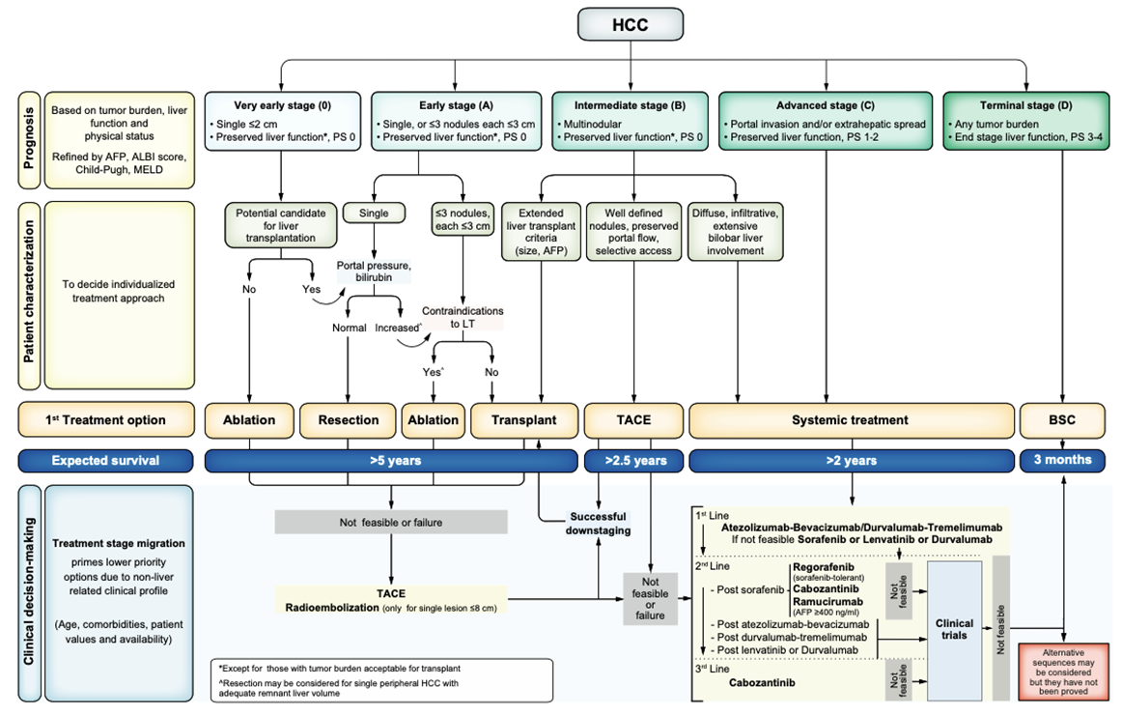
HCC Stage Migration and Untreatable Progression: Prof. M Reig
BCLC Staging 2022

Slide 13
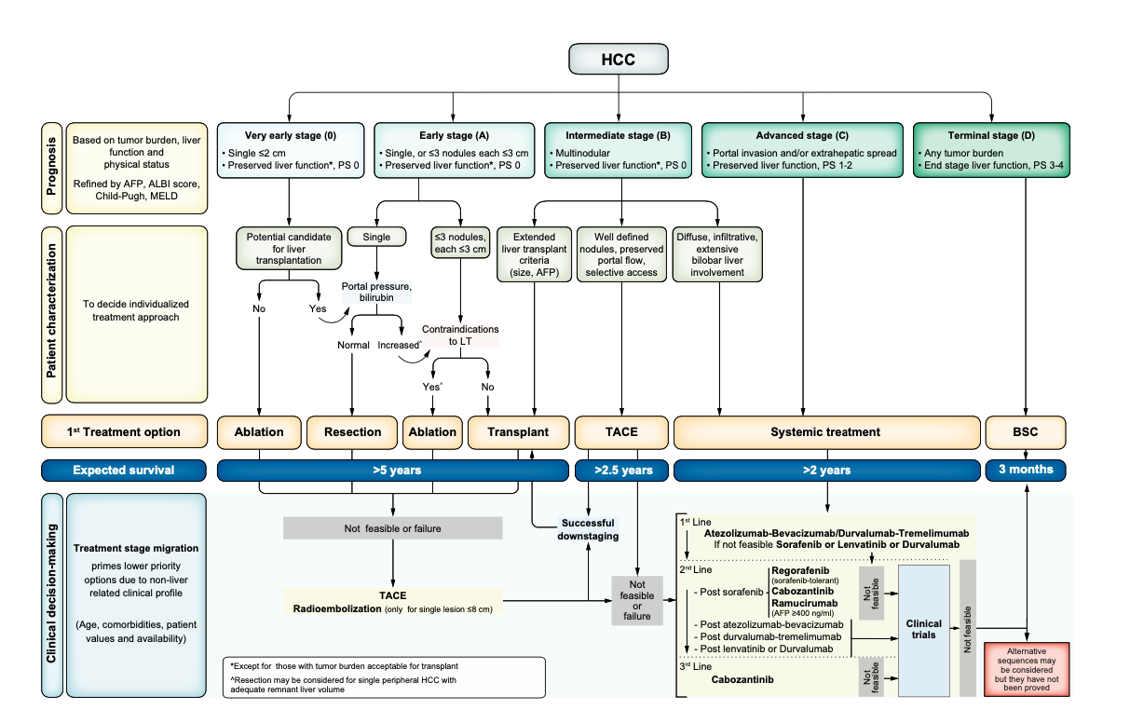
HCC Stage Migration and Untreatable Progression: Prof. M Reig
Optimal treatment for advanced HCC (and those with Treatment Stage Migration after initial therapy) requires a multidisciplinary team and commitment to shared decision-making
Physician – Multidisciplinary Team --> RESPONSIBILITY
‘Shared-Decision Making’ and ‘Value-Based Healthcare’
Age
Comorbidities
Patient values
Treatment availability
HCC location
Techniques (type of ablation, surgery or
material for loco-regional treatments)
Type of systemic treatments
Etc.

Slide 14
Systemic Therapies for HCC
Prof. J. Edeline
Current standard of care: Atezolizumab-bevacizumab
Improved OS: 19.2 vs 13.4 months
Improved PFS: 6.9 vs 4.3
Improved ORR: 30% vs 11%
Improved tolerability
Improved quality of life
=> Real revolution
Finn, NEJM 2020 and Cheng, J Hep 2022

Slide 15
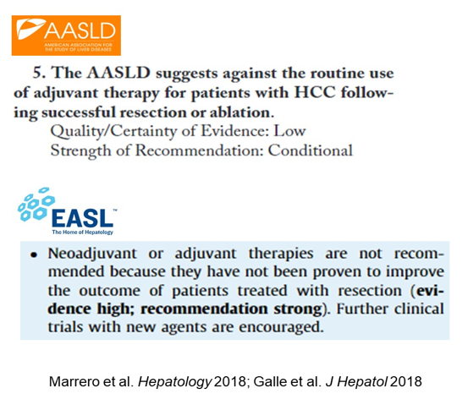
Towards Adjuvant Therapies in HCC
Prof. P. Nahon
~70% risk of recurrence in early-stage treated HCC
But with the right agents can it:
  Decrease local recurrence (synergy with procedure)?
  Treat micro-metastases?

Slide 16
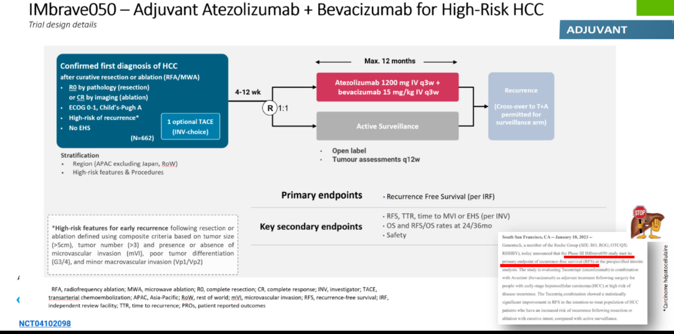
Towards Adjuvant Therapies in HCC
Prof. P. Nahon
Recurrence Free Survival improved in high-risk patients after ablation or resection

Slide 17
End-Stage Liver Disease and Transplantation

Slide 18
COVID-19 and ESLD
Prof. D. Samuel and I. Kounis
COVID – 19 is related to increased mortality and morbidity in patients with end stage liver disease
ACLF is the main driver of mortality in cirrhotic patients infected by SARS COV 2
Vaccination in end stage cirrhotic patients is recommended to prevent severe disease
  Reduces hospitalization and deaths
Clinical trials should be performed to test efficacy and tolerance of COVID treatments for patients with advanced liver disease

Slide 19
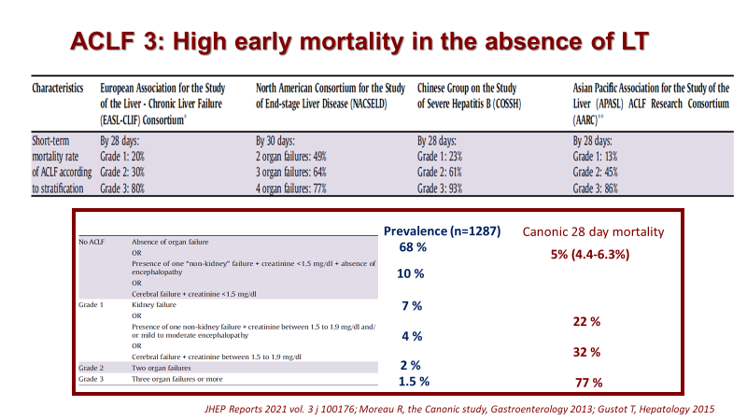
Liver Transplantation for ACLF
Prof. M. Berenguer

Slide 20
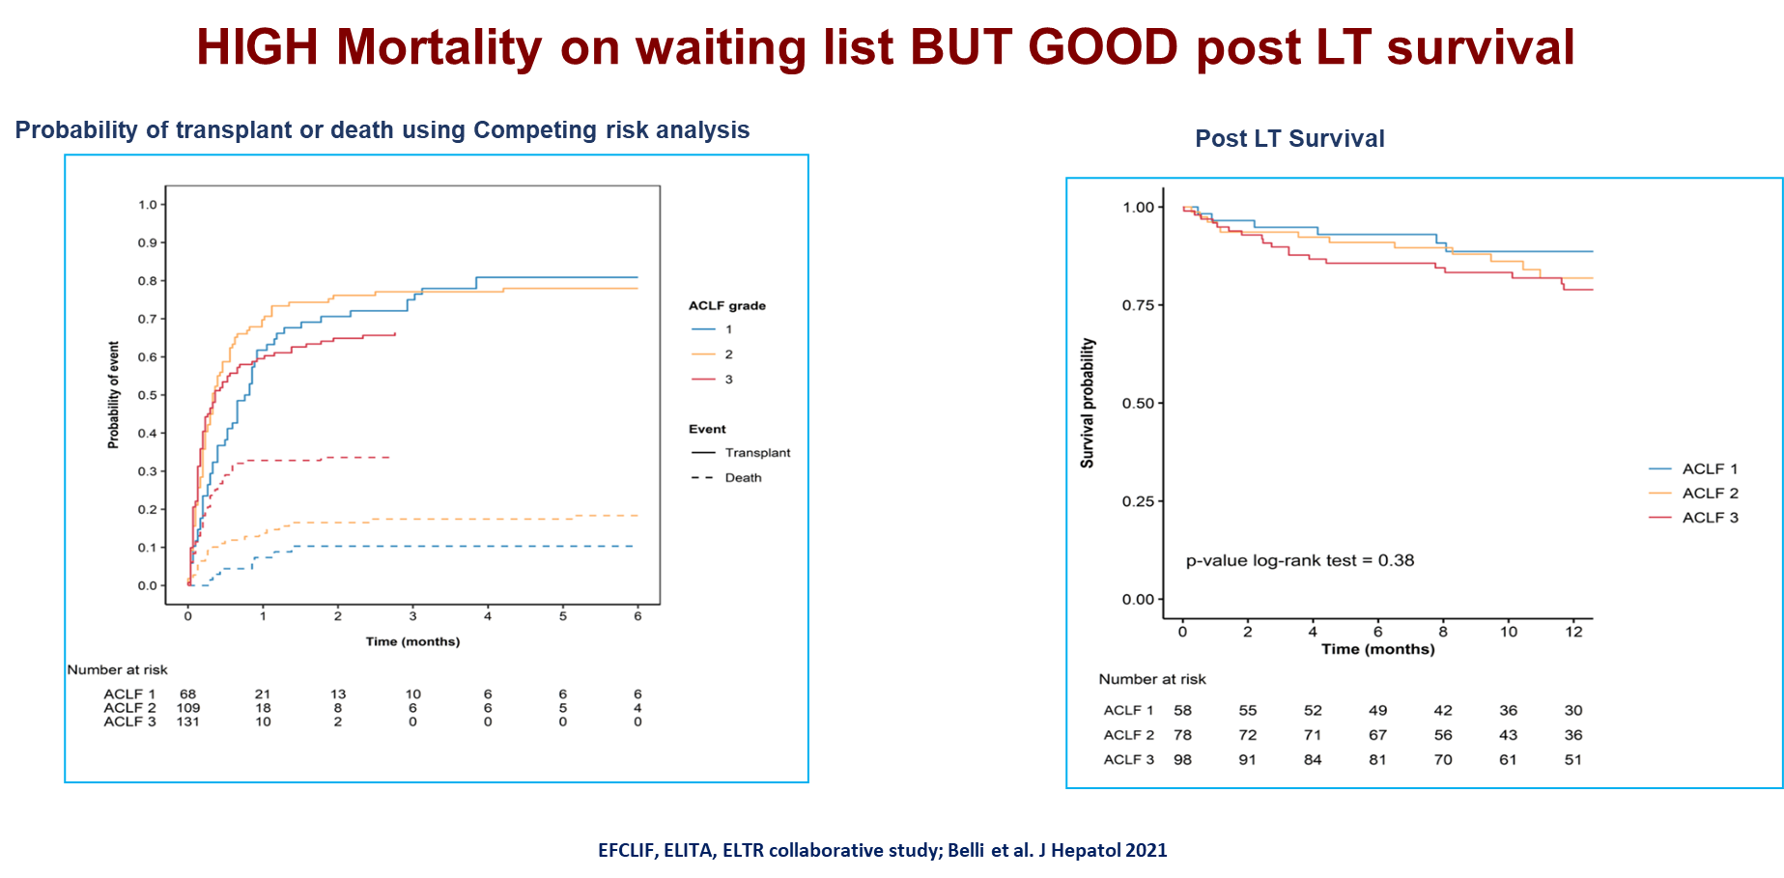
Liver Transplantation for ACLF
Prof. M. Berenguer

Slide 21
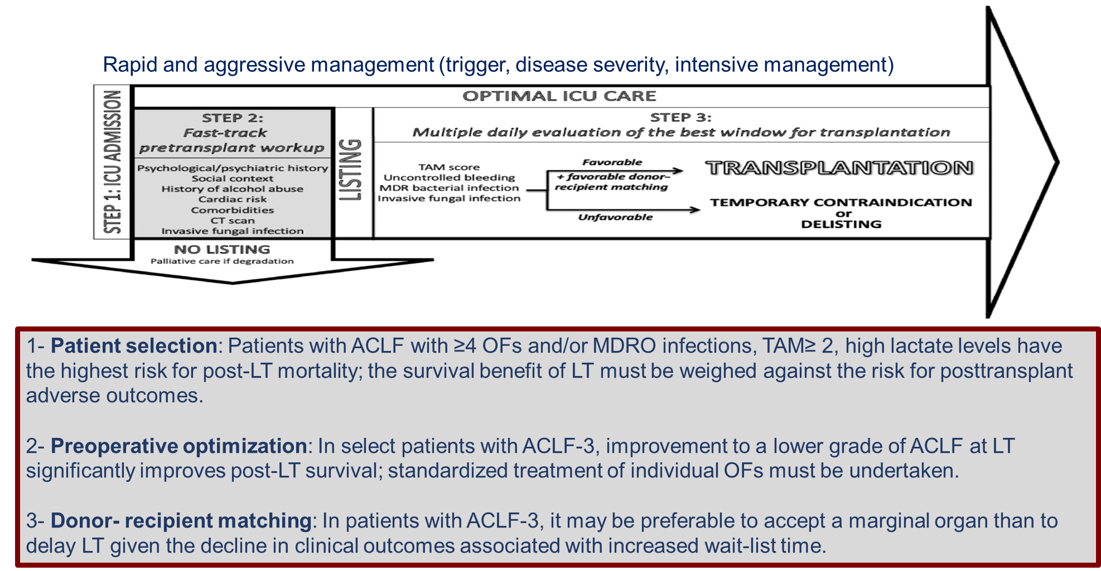
Liver Transplantation for ACLF
Prof. M. Berenguer

Slide 22
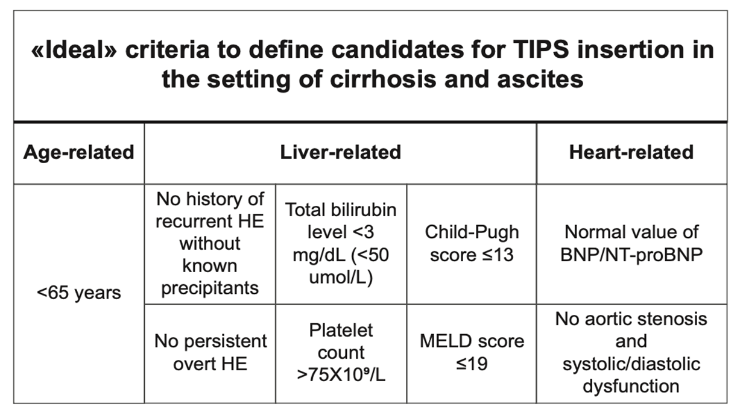
TIPS in Decompensated Cirrhosis
Prof. C. Moreno
TIPS has demonstrated benefit in controlling complications of portal HTN (Ascites, Variceal hemorrhage) but it is not without complications
Careful selection of candidates for TIPS can optimize its utilization:

Slide 23
Acutely Decompensated Cirrhosis
Prof. A. Gadano
Decompensated cirrhosis covers a heterogeneous universe of patients with different underlying pathophysiological basis and outcomes.
Important to distinguish acute decompensation (HE, Ascites, GI bleeding) from ACLF
ACLF is an established phenotype of acutely decompensated cirrhosis associated with systemic inflammation, multiorgan injury and increased short-term mortality.
1-year Mortality varies:
  Stable decompensated cirrhosis: ~10%
  Unstable decompensated cirrhosis: ~36%
  Pre-ACLF (Developed ACLF within 3 months of index admission): 67%
Better predictive tools and treatments needed for these patients

Slide 24
State of the Art Lecture:
Gut Microbiota and Alcoholic Liver Disease

Slide 25
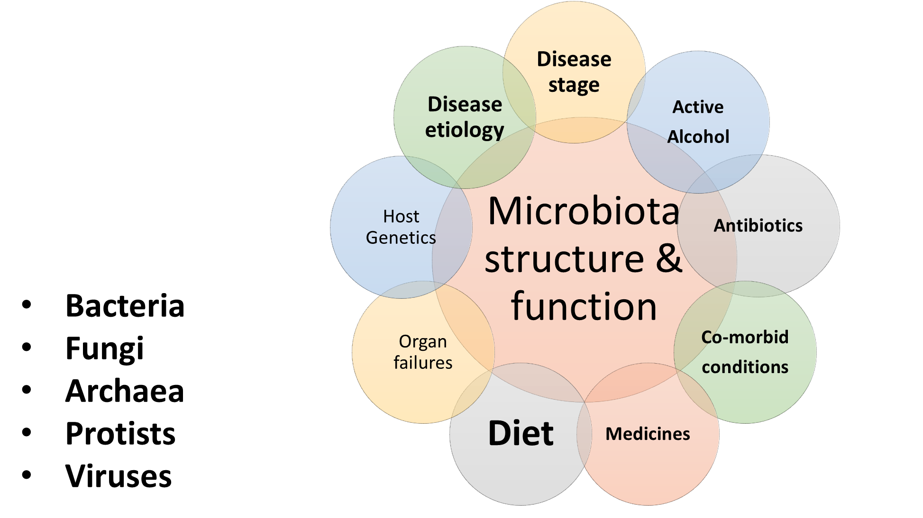
Gut Microbiota and Alcoholic Liver Disease: Prof. J. Bajaj
Numerous factors that affect Gut Microbiota

Slide 26
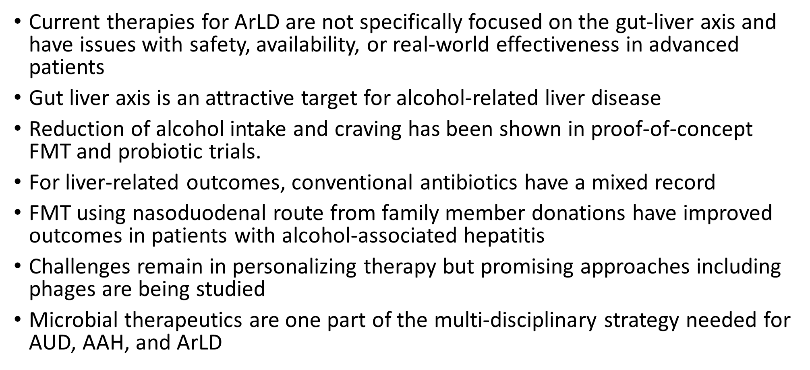
Gut Microbiota and Alcoholic Liver Disease: Prof. J. Bajaj

Slide 27
Until Next Year!
Jusqu'à l'année prochaine!

